Slide 1
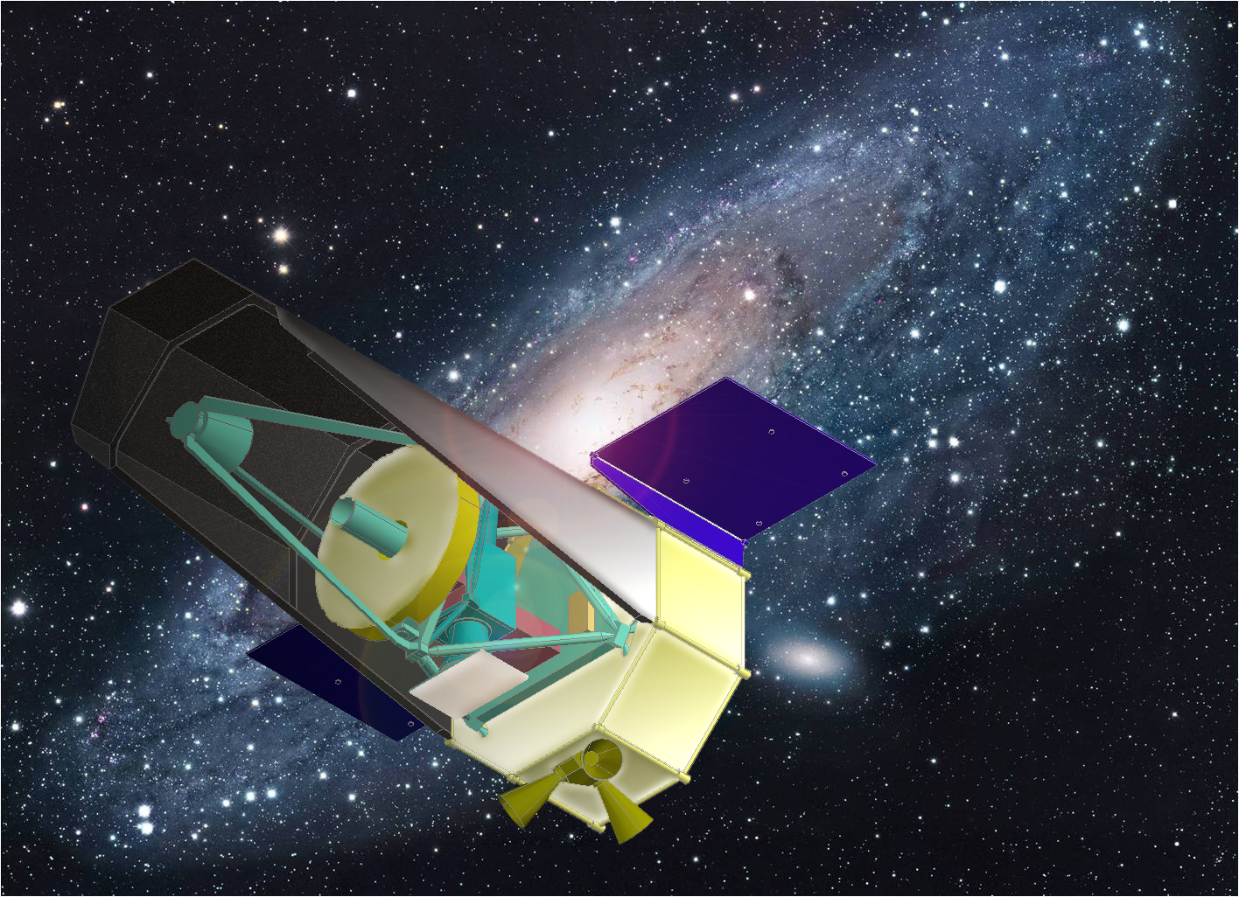
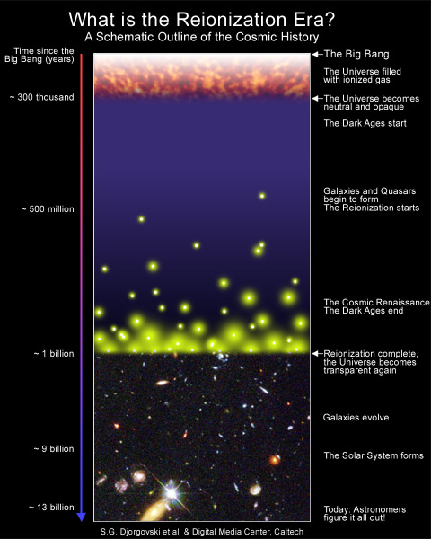
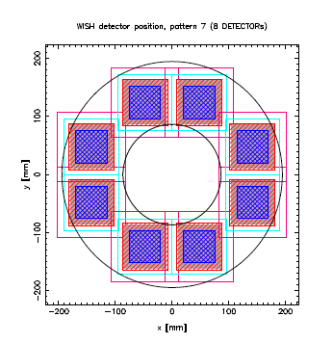
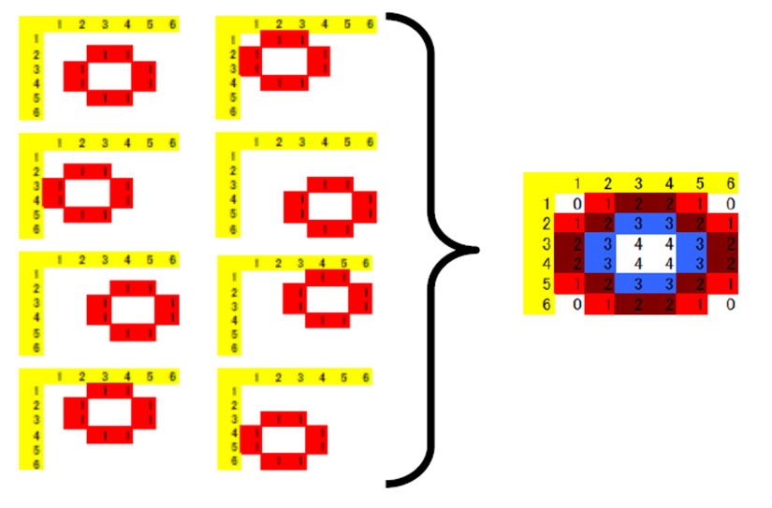
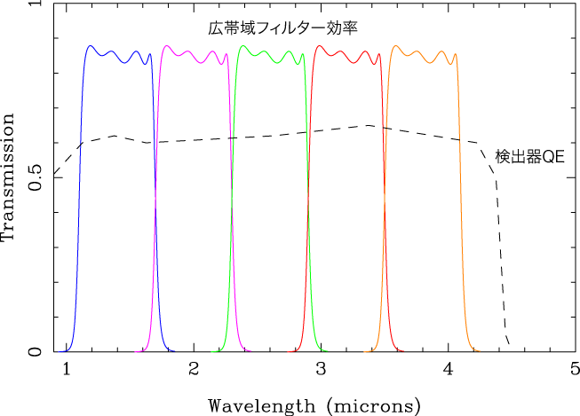
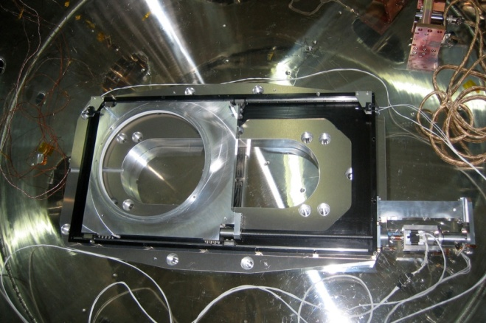
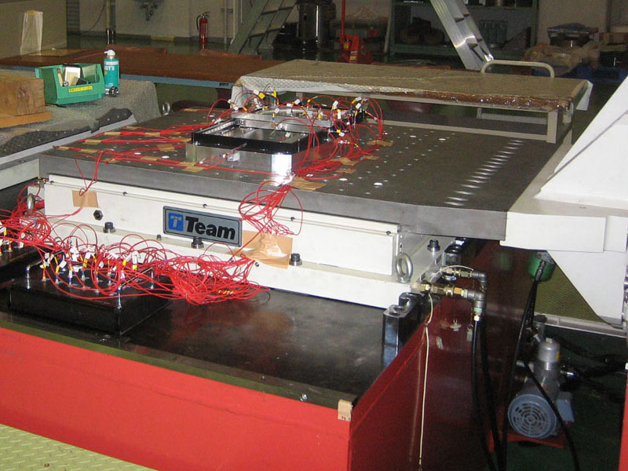
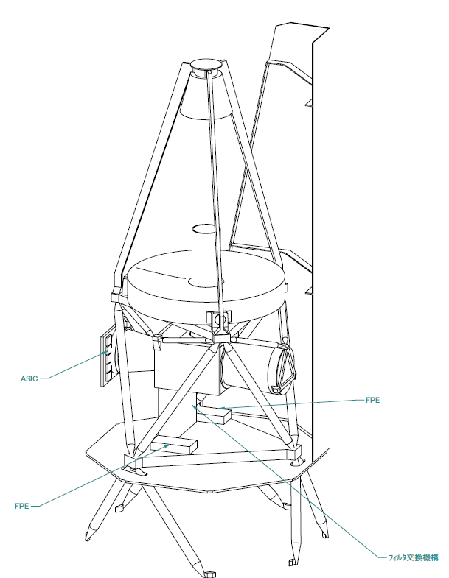
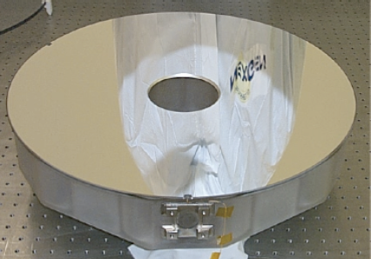
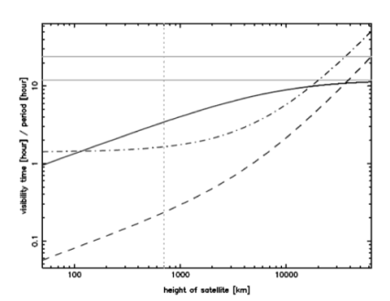
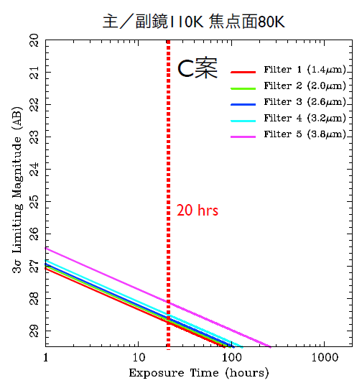
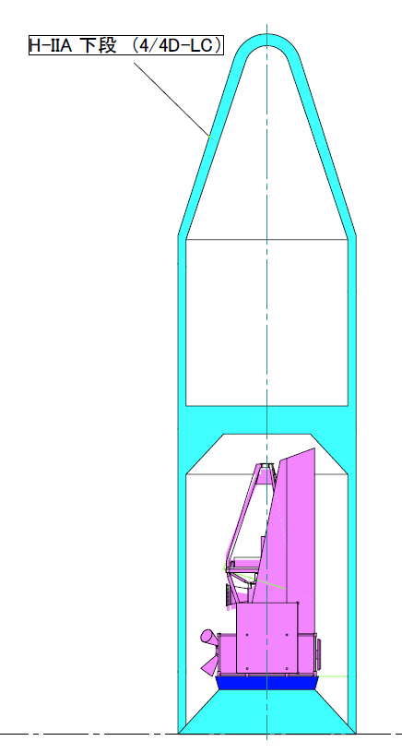
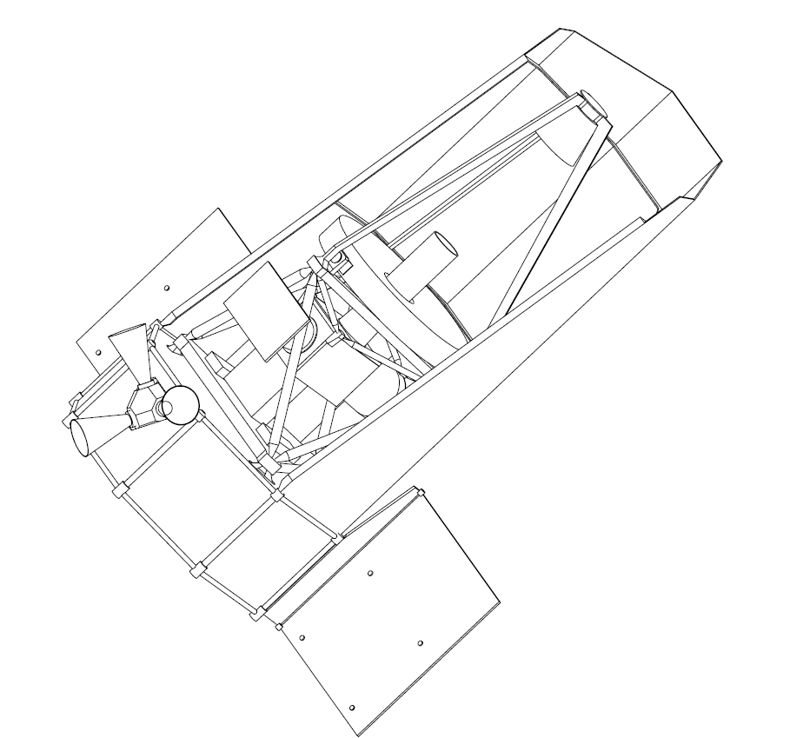
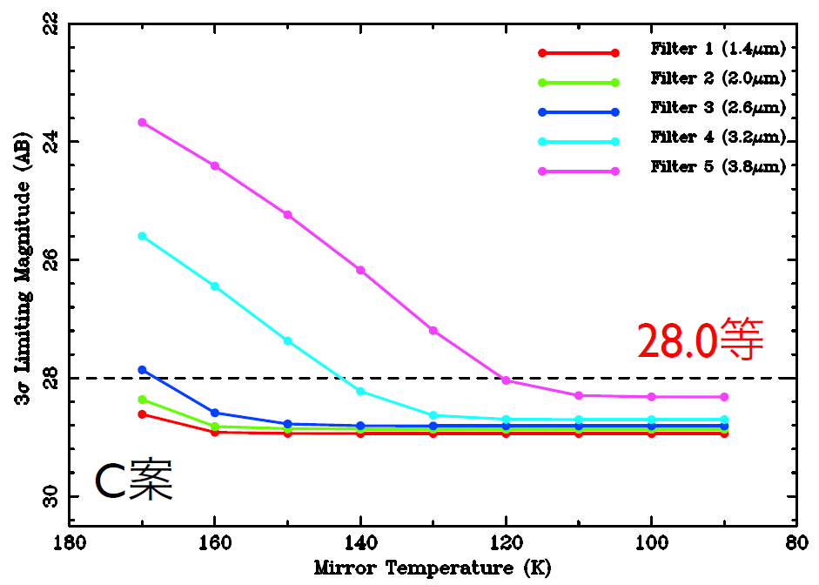
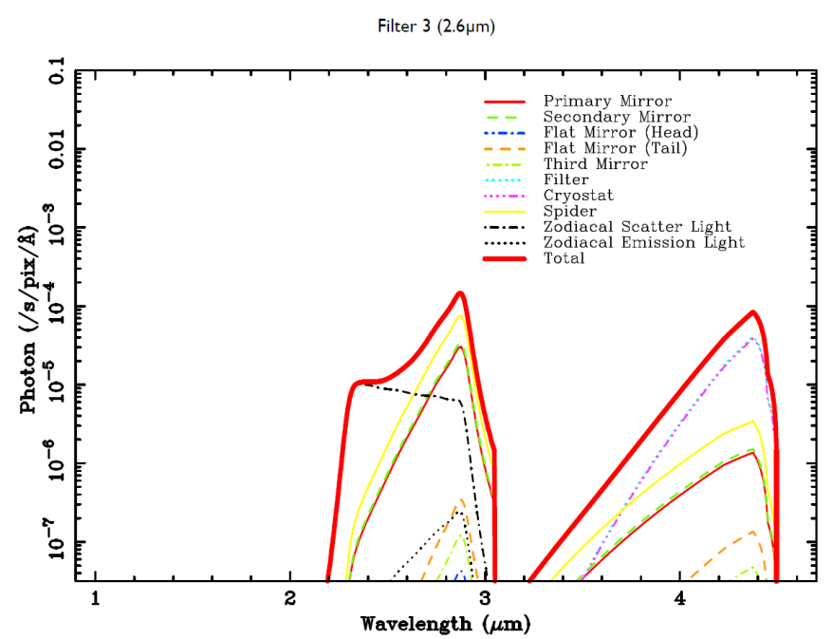
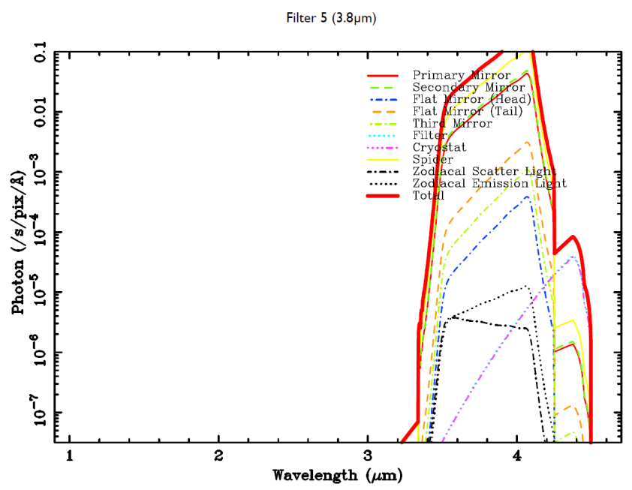
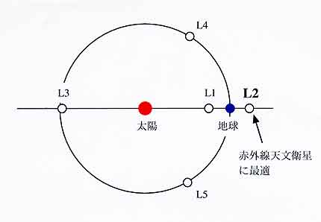
WISH upon a first galaxy:
Wide-Field Imaging Surveyor for High Redshift
click
wishmission
Toru Yamada (Tohoku University)
WISH team： Ikuru Iwata, Saku Tsuneta, Tomoki Morokuma, Tadayuki Kodama, Yutaka Komiyama (NAOJ), Chihiro Tokoku (Tohoku University)
Hideo Matsuhara, Takehiko Wada, Shinki Oyabu (ISAS JAXA), Nobuyuki Kawai (TITEC), Kouji Ohta, Kiyoto Yabe (Kyoto University),
Mamoru Doi, Naoki Yasuda, (University of Tokyo), Tomo Goto (UH), Yuji Ikeda (Photcoding), Satoru Iwamura (MRJ)
WISH is a newly proposed space science mission whose primary goal is to reveal the first-generation galaxies in the early young universe. We launch a 1.5m-aperture telescope equipped with ~1000-arcmin² wide-field NIR camera by middle/late 2010's in order to conduct ultra-deep and wide-area sky survey with the depth that cannot have been achieved by previous ground-base telescopes. WISH should be a very powerful and unique facility not only for the search for first-generation objects but also for study of dark energy, and many other fields in astronomy.
Development of the mission concept including the Preliminary Design of the Optical Layout, Optical Elements, Telescope Structure,
Filter-exchanging System, Filters, and FPA Assembly is being proceeded under the JAXA/ISAS WISH Working Group (PI:Toru Yamada).
WISH:
Wide-field Imaging Surveyor for High-redshift
● Unique new Deep and Wide-area space mission in NIR wavelength (1-5μm)
● Exploring the early universe in the era of reionization
to study the 1st generation of galaxies
➔ Ultimate frontier in the history of galaxies
● 1.5m Primary Mirror, Wide field （~1000 sq. arcmin）
Dedicated , Single-task Facility with Simple optics
● Complementary with TMT (ELTs), JWST, SPICA, Subaru [HSC]
Survey | Limiting mag. | Number of Filters | Area
Ultra Deep Survey | 28 AB | 3 | 100 deg²
Multi-Band Survey | 27-28 AB | 5 | Sub WISH-UDS
Ultra Wide Survey | 24-25 AB | 2-3 | 1000 deg²
WISH
Survey Plan
IV. WISH 望遠鏡 （w37b w38b 参照）
II. WISH Science Goals
WISH
M31 Phot: R.Gendler
[1] Discovery of the First Generation Objects
in very distant and early universe.
IV. WISH Development
[2] Study of the expansion history of the universe
and properties of dark energy by using type-Ia
supernovae luminosity at rest-frame NIR wavelength
WISH Basic Optical Layout (Yuji Ikeda)
ＷＩＳＨ
Strehl ratio
A design of
focal plane layout
and an example of
survey matrix
[3] Extensive study of galaxy formation and evolution
utilizing the unique wide-area NIR observations
Expected number of the detected 1st Gen galaxies (in WISH-UDS)
galaxies brighter than 27AB in their rest-frame UV light
No Evolution from z=7 (LF at z=6-7)
Evolution: 1.0-mag luminosity evolution from z>7
Evolution: Proportional to the DM halo evolution
Prediction by a Semi-Analytic Model (Kobayashi, M. WISH SW)
Subaru
Redshift | (A) | (B) | (C) | (D)
z=7-8 | 220,000 | ← | 54,000 | 160,000
z=8-11 (J-drop) | 180,000 | 26,000 | 1,100 | 60,000
z=11-14 (H-drop) | 68,000 | 6,300 | 0 | 1,000
Det
QE
Tentative plan for the WISH
band-pass filters
A lot of new exciting science cases were proposed and discussed in WISH Science-WS
(2009/04,Japan), including Galactic structure, Exo-planets, Solar system Objects, etc.
Large-area filter exchange system
(warm test for sliding system)
Heritage of the
Hinode 50cm Mirror
III. WISH Specifications & Sensitivity
Data production rate r_{DG} | 3-4 [Mbps]
Data Downlink rate r_{DL} | <10.0[Mbps]
Filter exchanger
(TBD)
ITEM | Comments
Telescope
Primary Mirror Diameter | 1.5m, 80-100K
Wavelength | 1-5μm
Field of View | ∼1,000 arcmin² (or 35' diameter)
Focal Plane Temperature | <80K, Passive Cooling
Wide-Field Near-IR Camera
Detector | HgCdTe (18μm/pixel is assumed)
Sampling | 0.15"/pix
Operation Temperature | 40K, Passive Cooling
Filters | 5 broad-band filters covering 1μm to 5μm, Narrow-band filters or slitless spectroscopy (TBD)
Spacecraft / Launcher
Orbit | SE-L2
Rocket | HII-A
Total Weight | 1.3t (matched to HII-A dual launch)
Others
Mission Lifetime | ∼5 years
The limiting magnitude is
calculated considering the ZL
and thermal background from
various components.
M1/M2 110K FP 80K
V. WISH Launcher, Orbit, Spacecraft
Weight budget
 | Subsystem |  | Weight
Mission Instrument | Telescope | M1, M2, lenses | 320.0 | 661.0
 |  | Support structures | 82.0
 |  | Optical bench | 27.0
 | Focal Plane Arrays |  | 120.0
 | Thermal controls | Sun Shield | 52.0
 |  | Radiator | 60.0
 | Mechanical Cooler |  | 0.0
Bus | Buttery | Solar Panels | 19.0 | 493.5
 |  | others | 33.0
 | Data Communication Systems |  | 30.3
 | Data Analysis Systems |  | 24.3
 | Pointing Systems |  | 93.9
 | Thruster Systems |  | 82.0
 | Body |  | 158.0
 | Thermal Control Systems |  | 20.0
 | Others |  | 3.0
 | Electronics Systems |  | 30.0
Dry Weight |  |  |  | 1154.5
Fuel |  |  |  | 120.0
Weigh at Launch |  |  |  | 1274.5
AB
Sun-Earth L2 Orbit is selected for realizing
the stable temperature environment
for passive cooling
HIIA rocket is assumed for the
Launcher. WISH fits for HIIA Dual Launch
Sun
Earth
S-E L2 Orbit from JAXA SPICA web page

