Slide 1
WISH
upon a first galaxy….

Slide 2
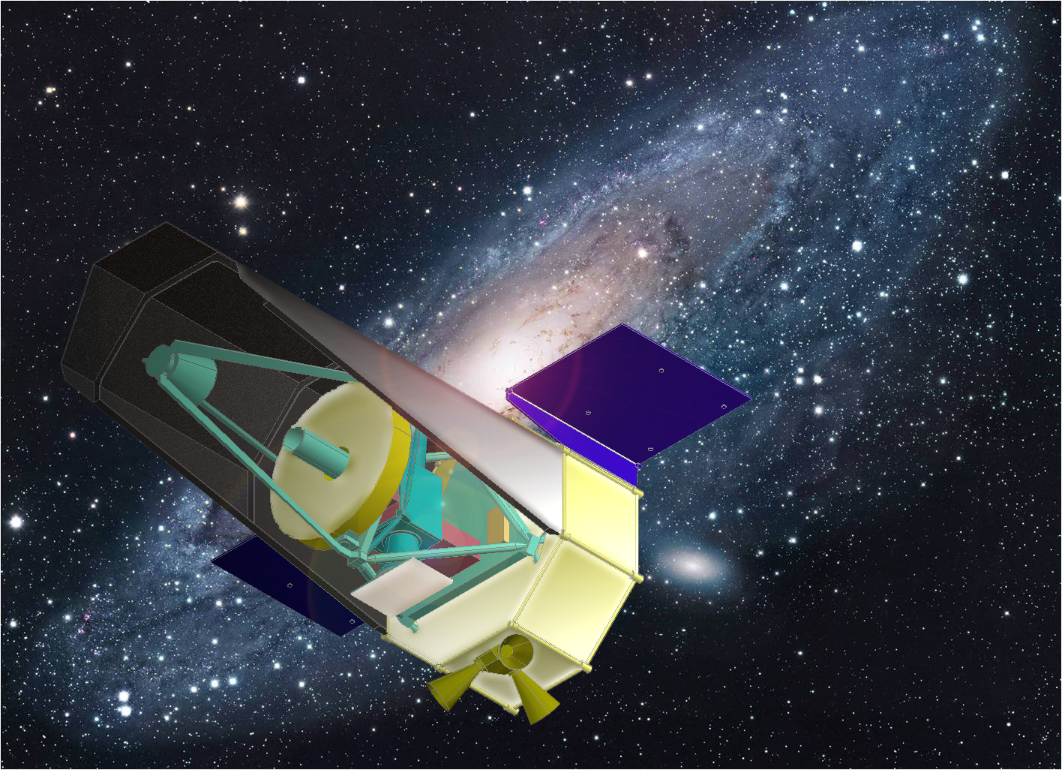
WISH
Wide-field Imaging Surveyor for High-Redshift
超広視野初期宇宙探査衛星
WISH Working Group
http://www.wishmission.org/en/index.html
M31 Phot: R.Gendler

Slide 3
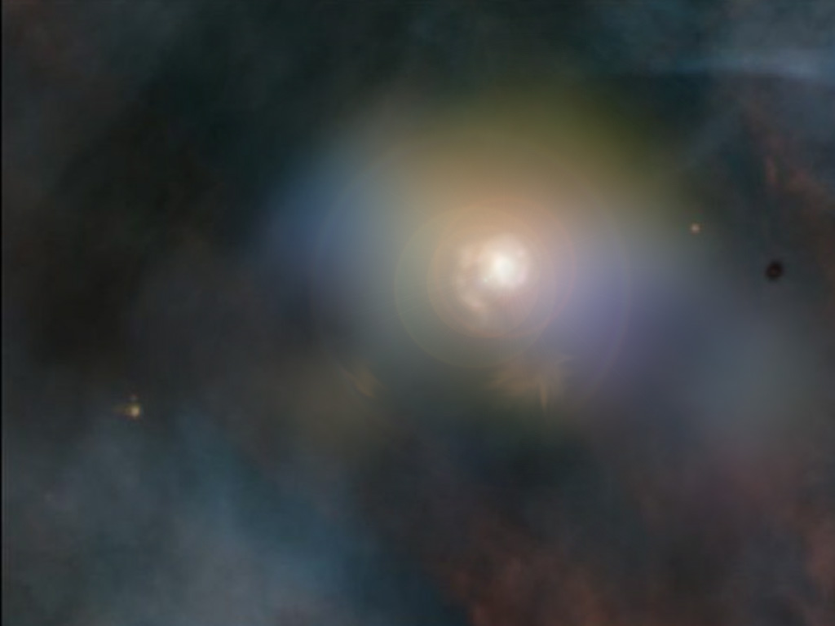
WISH WG Members
Toru Yamada, Chihiro Tkokku (Tohoku University)
Ikuru Iwata, S.Tsuneta,
T.Morokuma, T.Kodama, Y.Komiyama (NAOJ)
H.Matsuhara, T.Wada, Y.Oyabu (JAXA/ISAS)
K.Ohta, K.Yabe (Kyoto University)
M.Doi, N.Yasuda (University of Tokyo)
N.Kawai (TiTEC)
A.Inoue (Osaka Sangyo University)
Y.Ikeda (Photocoding)
T.Iwamura (M.R.J)
CG of a 1st –gen galaxy, by Toru Yamada

Slide 4
WISH Mission
● Very Wide-field & Deep Imaging Surveyor at 1-5μm
● Exploring First-Generation Objects (Galaxies) in Early Universe
● 1.5m Primary Mirror, Camera Field of View 1000 sq. arcmin
Simple Optics, Dedicated for Wide-field NIR Imaging
● Complementary / Synergy
with JWST / Extremely-Large Telescope (TMT, EELT)
ALMA / Subaru HSC
compared with JDEM/Euclid
unique capability at 2-5μm imaging
optimized survey strategy for z=7-15 search

Slide 5
WISH Specifications Quick Summary
Primary Mirror Diameter 1.5m
Wavelength Coverage 1-5μm
Image Quality achieving diffraction limit to the FoV edge
at 1-5 μm
Spatial Sampling 0.15”/18μm (optimized at 1.5μm )
Limiting Magnitude ~28 AB/10-20h ~20nJy (3sigma)
Camera Field of View ~１０００acmin²
Orbit SE-L2
Launcher Japanese HIIA (fit to the Dual Launch)

Slide 6
WISH Specification
Telescope
Primary Mirror | 1.5m
Wavelength Coverage | 1μm – 5μm
Field of View | 1000 arcmin²
Temperature | <100K (40-80K near focal plane) , only passive cooling
Very Wide Field IR Imager
Detector Arrays | HgCdTe (18μm/pixel)
Pixel scale | 0.15”/pix(18μm)
operation temp. | 40-80K
filters | 5 broad-band filters which cover 1-5 μm TBD: Narrow-band/Grism
Launcher/Orbit
Orbit | S-EL2
Launcher | HIIA (JAXA)
Weight | 1.3t (TBD)
Others
Mission Lifetime | 5 years

Slide 7
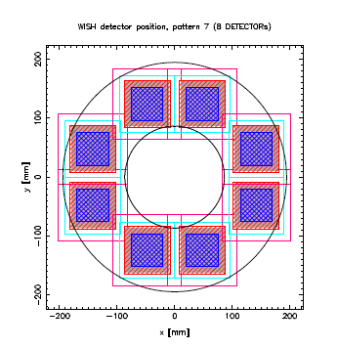
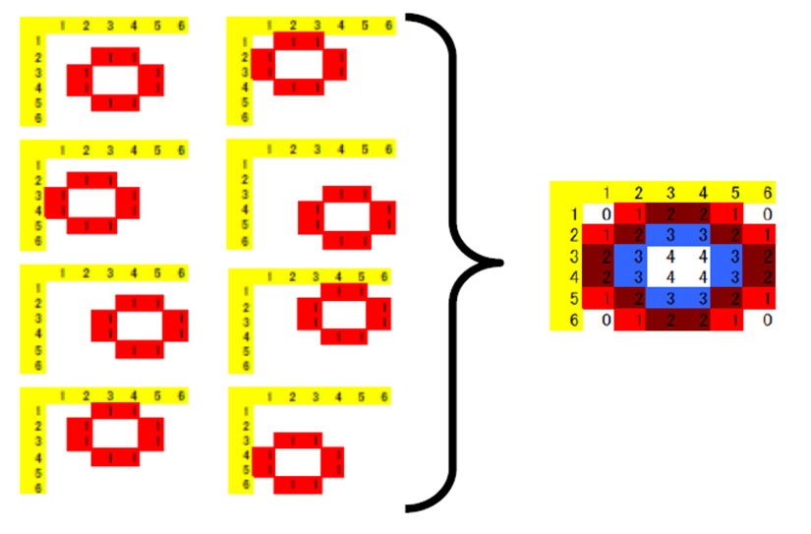
WISH Optical Layout
A design of
focal plane layout
and an example of
survey matrix

Slide 8
WISH Science Goals
[1] Discovery of the First Generation Objects
and Study Galaxy Formation at EoR.
[2] Study of the expansion history of the universe
and properties of dark energy by using type-Ia
supernovae luminosity at rest-frame
NIR(i-band) wavelength
[3] Extensive study of galaxy formation and
evolution utilizing the unique wide-area
NIR observations

Slide 9
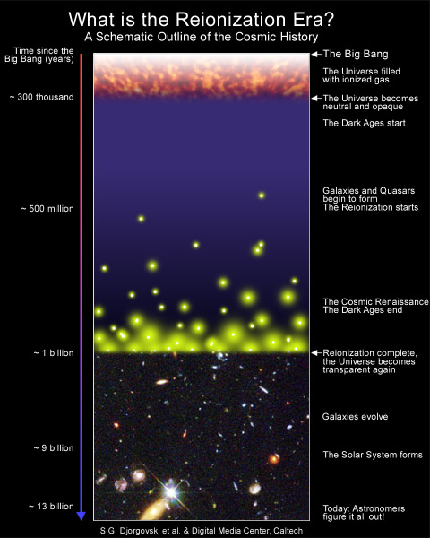
Cosmic Microwave
Background (CMB)
Universe: Neutral
WISH
First-Generation
Galaxies
Ultimate Frontier
of Galaxies
Universe: Ionized
Subaru
VLT
…………
Hubble Space Telescope

Slide 10
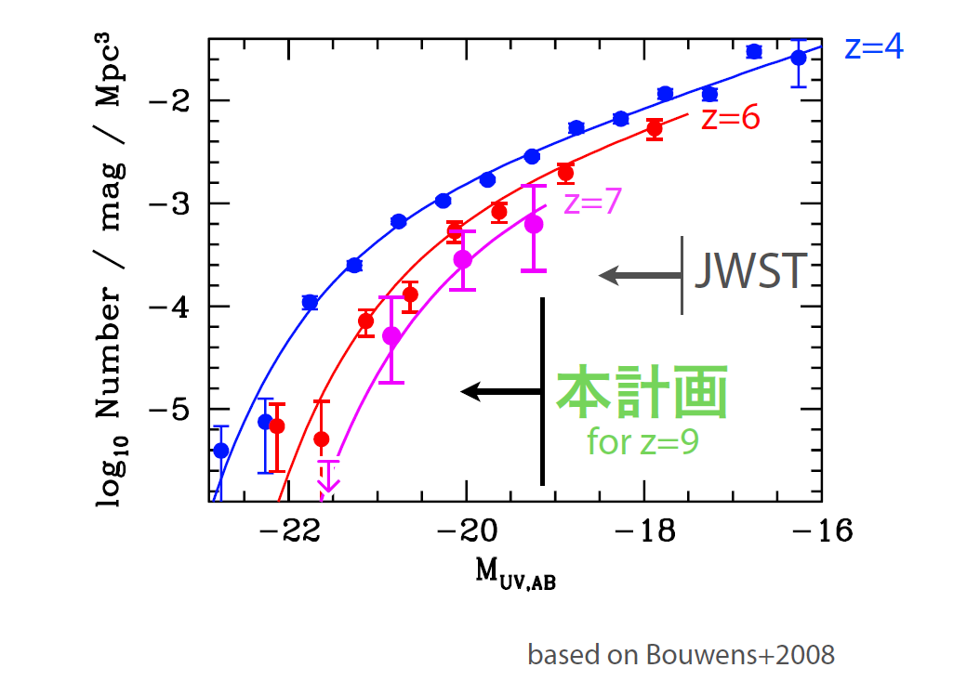
~10arcmin²
WISH

Slide 11
Why Space?
● Emission from galaxies at z>7 are redshifted
above 1 μm
● Objects are fainter than the nominal detection
limit of 8-10m class telescope with natural seeing
(~26AB @ 2μm) due to the atmospheric background
(OH lines)
● Ground-based AO (incl. GRAO, MCAO) cannot
cover large area simultaneously

Slide 12
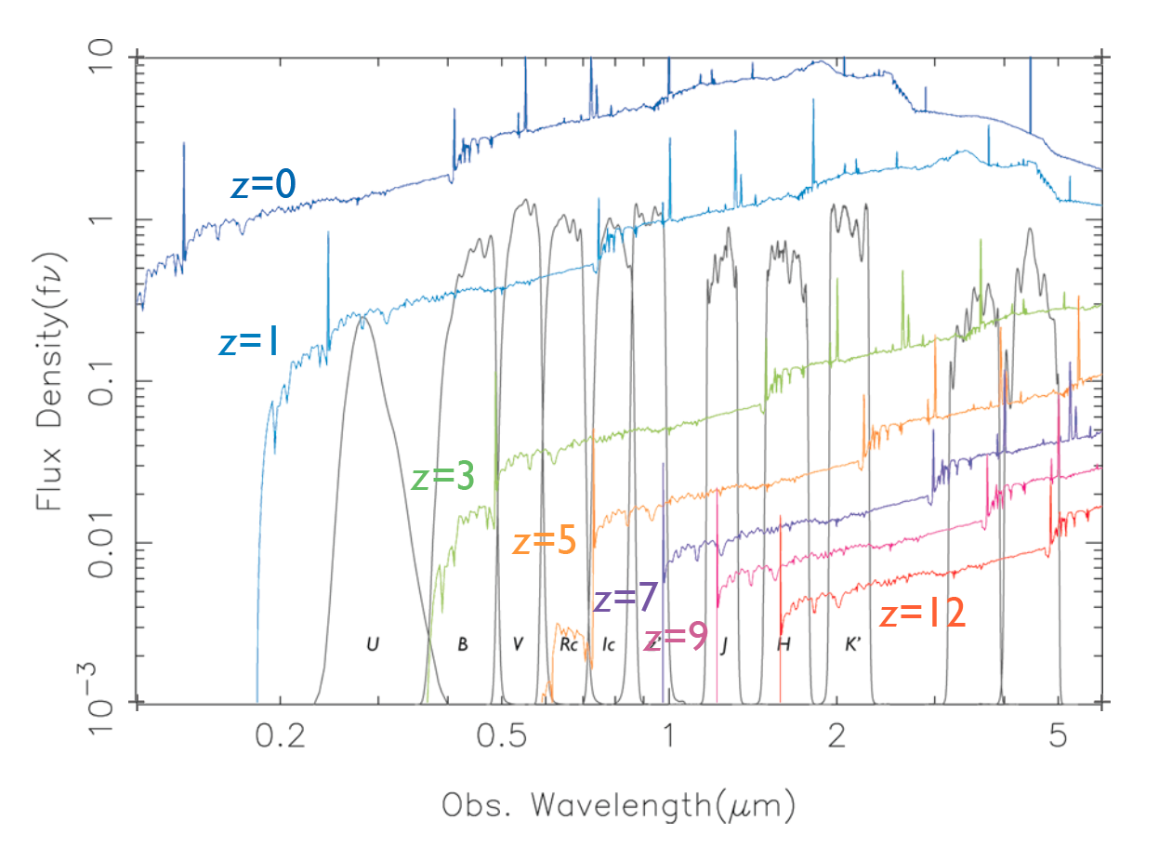
Expected Spectra of z=0-12
star-forming (Lyman Break) galaxies
Iwata et al.

Slide 13
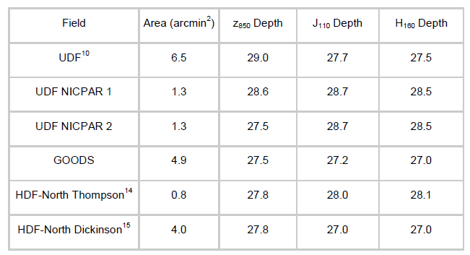
Search for z=7-8 galaxies by HST NICMOS
Bouwens et al. (2007)

Slide 14
The deepest ground-based NIR imaging: MOIRCS Deep Survey
Ichikawa et al. 2006; Kajisawa et al. 2009; Yamada et al. 2009
 |  | ch1 |  | ch2
Field | Band | FWHM | 3σlimit | FWHM | 3σlimit | Exposure
GT1 | J | 0.59 | 25.8 | 0.59 | 25.7 | 8.0
 | H | 0.58 | 25.2 | 0.59 | 25.0 | 2.5
 | K | 0.58 | 25.5 | 0.53 | 25.6 | 8.3
GT2 | J | 0.48 | 26.6 | 0.49 | 26.6 | 28.2
 | H | 0.46 | 25.7 | 0.46 | 25.6 | 5.7
 | K | 0.45 | 26.5 | 0.46 | 26.5 | 28.0
GT3 | J | 0.57 | 25.8 | 0.58 | 25.7 | 6.3
 | H | 0.55 | 25.0 | 0.55 | 25.0 | 3.2
 | K | 0.59 | 25.6 | 0.60 | 25.5 | 10.7
GT4 | J | 0.58 | 25.7 | 0.59 | 25.7 | 9.1
 | H | 0.58 | 25.2 | 0.59 | 25.1 | 4.3
 | K | 0.59 | 25.4 | 0.60 | 25.5 | 9.8
F.o.V. ~ 28 sq. arcmin (~0.007 sq. deg)
VLT HAWK-I 2x
ultra-VISTA ~1.5deg²
AO(GLAO/MCAO) go deeper for
unresolved object, but FoV smaller

Slide 15
Why 1-5um?
● Searching for galaxies up to z ~ 15
(at least 2 filter bands above the Lyα Break, ~2μm at z=15)
● Efficient removal of the interlopers
(cool stars, dusty red galaxies)
● Optical Observations (below 1μm) can be done
with Subaru Hyper Suprime Cam (HSC)

Slide 16
Expected Spectra of z=0-12
star-forming (Lyman Break) galaxies
Iwata et al.

Slide 17
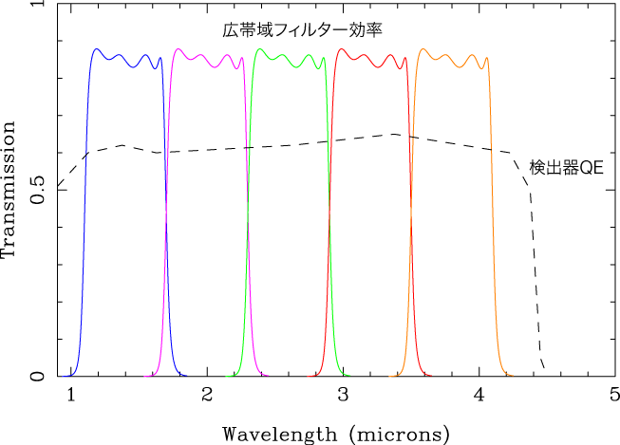
An working example of the broad-band filters for WISH
Det

Slide 18
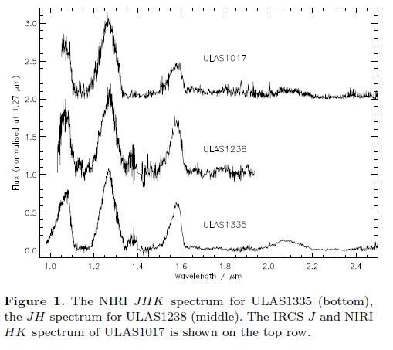
Contaminants: very cool stars

Slide 19
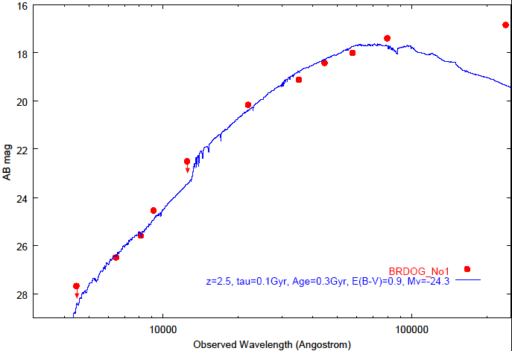
Contaminants: dusty red galaxies at lower-z

Slide 20
Why Wide-Field?
● High-z galaxies are rare, strongly biased
● Only ~10 (or less) galaxies at z=11-14
above AB27mag / 1 deg² are expected
(SAM)

Slide 21
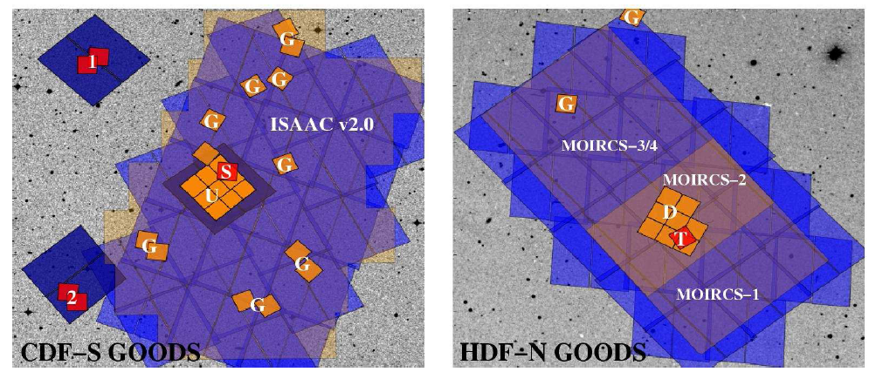
Why Wide-Field?
Current HST NICMOS – fov (50”x50” NIC3) is too small --
Bowuens et al. 2008
What’s Coming
HST WFC3 <1.7μm, 2’ x 2’ ➔ ~ 1 deg2
Spitzer WARM Mission 3.6, 4.5um shallow , source confusion
JWST NIRC

Slide 22
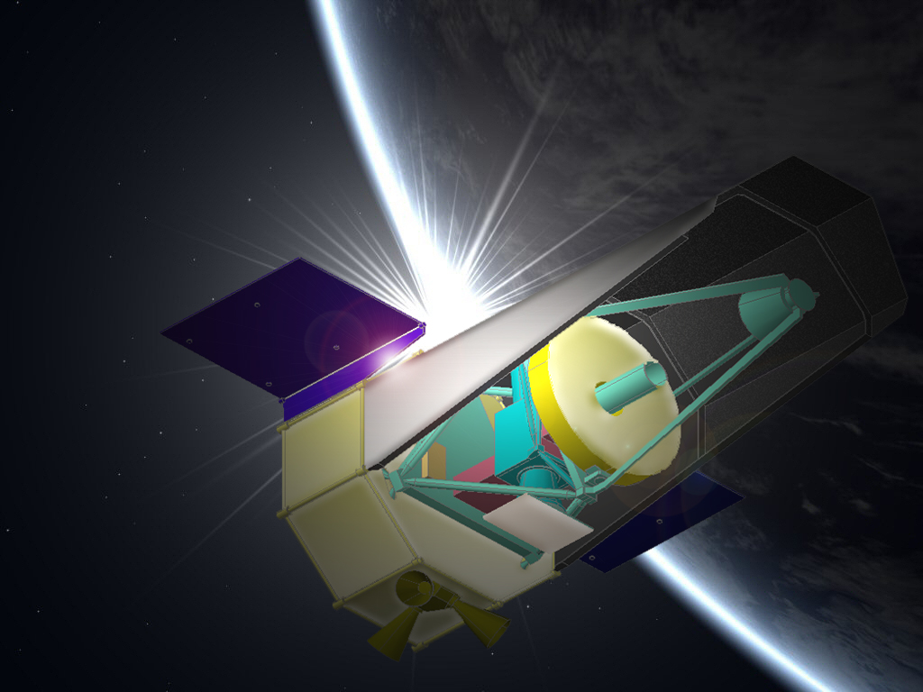
What is your WISH ?
● High sensitivity from Space
● Optimized NIR coverage for z=7-15
● Large Field of View, which makes
~100deg2 area survey feasible
● Optimized, dedicated survey strategy

Slide 23
WISH Survey Goals
Within the Mission Lifetime of 5 Yrs
Survey | Limiting mag. (3sigma ) | Number of Filters | Area
Ultra Deep Survey | 28 AB | 3-4 (TBD) | 100 deg²
Multi-Band Survey | 27-28 AB | 5 (TBD) | Sub WISH-UDS
Ultra Wide Survey | 24-25 AB | 2-3 | 1000 deg²

Slide 24
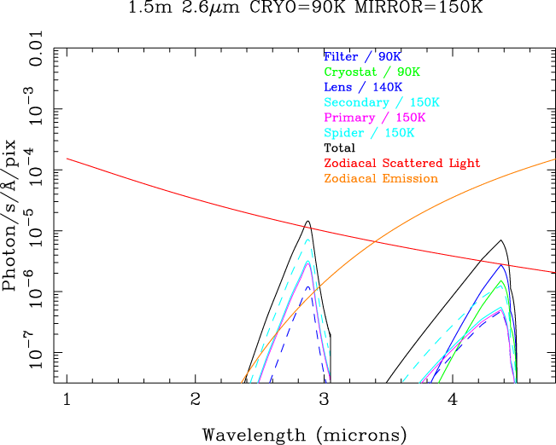
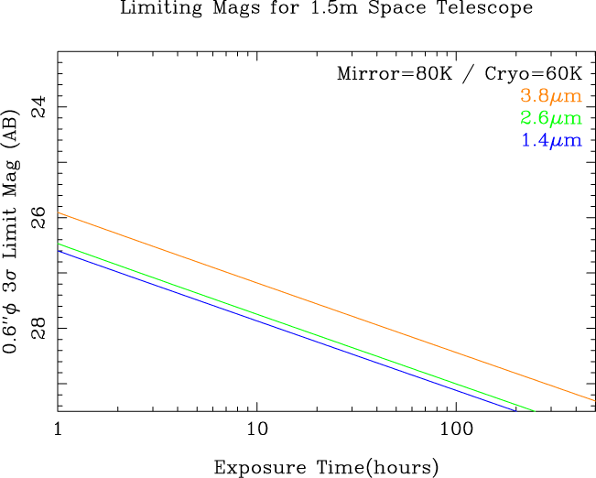
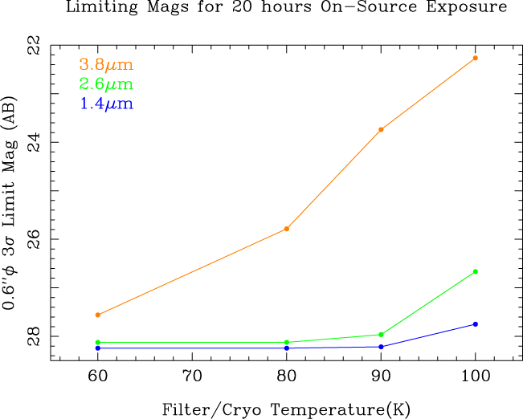
WISH Sensitivity
●1.5m
● 0.15” /pix
●Zodiacal Light,
Thermal Background

Slide 25
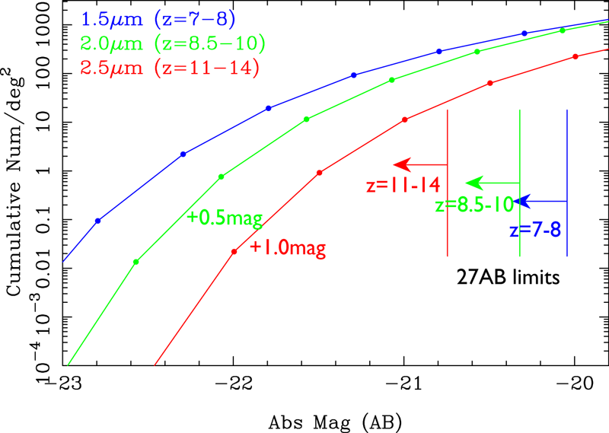
WISH Survey Goals

Slide 26
WISH Survey Goals
Redshift | (A) No | (B) 1mag | (C) DMH | (D) SAM
z=7-8 | 220,000 | ← | 54,000 | 160,000
z=8-11 (J-drop) | 180,000 | 26,000 | 1,100 | 60,000
z=11-14 (H-drop) | 68,000 | 6,300 | 0 | 1,000
Expected number of the detected 1st Gen galaxies (in WISH-UDS)
galaxies brighter than 27AB in their rest-frame UV light
No Evolution from z=7 (LF at z=6-7)
Evolution: 1.0-mag luminosity evolution from z>7
Evolution: Proportional to the DM halo evolution
Prediction by a Semi-Analytic Model (Kobayashi, M. WISH SW)

Slide 27
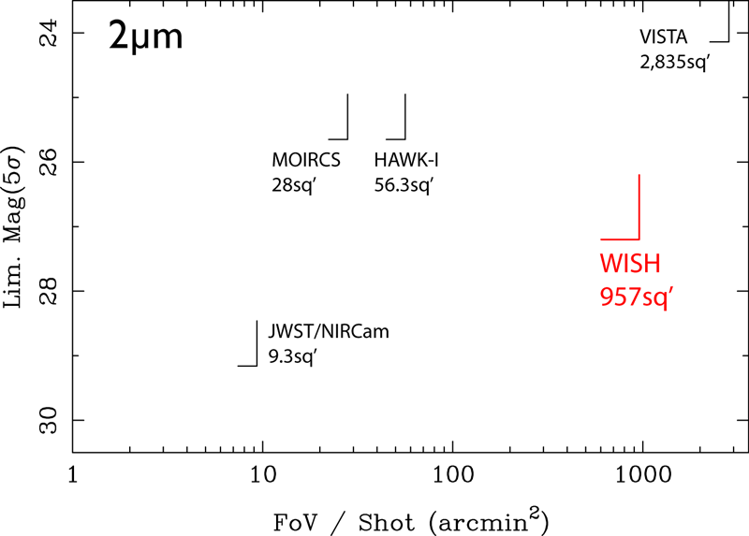
ＷＩＳＨ Survey Goals
Unique Survey Capability
● Wide-Field
● High Spatial Resolution
over wide area
● High Sensitivity
from space

Slide 28
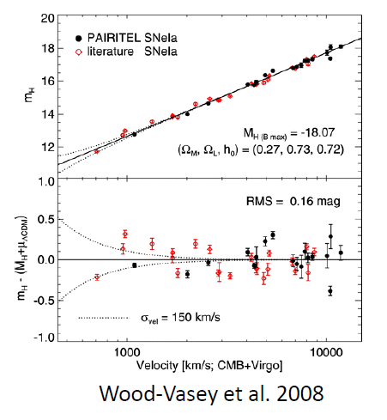
Probing Type Ia SNe with WISH
Rest-frame Band | Redshift range | # of SNeIa / f.o.v.
B-band | z > 1.9 | 31
I-band | 0.6 < z < 1.6 | 33
H-band | 0.0 < z < 0.9 | 9
WISH UDS – x 400 (fov)
N.Yasuda WISH SW 2009

Slide 29
For Multi-wavelength Study of Re-ionization Era
● 2D cross correlation with HI;
at z>10, WISH sources will be very sparse, and
HI bubble overlap will be small
➔ though the Δz of the WISH sources is large,
2D clustering may still be seen significantly.
● Redshift-space cross correlation with HI;
Spectroscopic follow-up for WISH sources
- grism spectroscopy by WISH (for bright sources)
- JWST (if still there)
- ELT

Slide 30
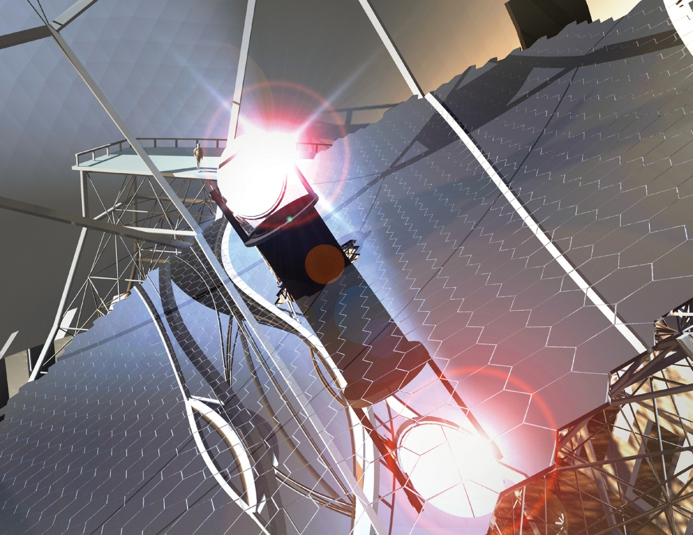
The imaging detection limit of WISH
~ AO NIR spectroscopic sensitivity limit of TMT
26AB for ~1 hour
Early-light instrument
IRMS ~2’x 2’
2nd-Gen. Instrument
IRMOS ~ 10-20 AO spectroscopy in ~10-20’

Slide 31
WISH Proposed Schedule
FYr | Items
FYr0 (2008) | Project launched JAXA/ISAS Working Group Conceptual Study for Specification
FYr1-2 | Conceptual Study, R&D Mission Definition Review Mission Proposal
FYr3 | Phase A / Proto Models
FYr4-5 | Proto Models / Test Preliminary Design Review Primary Mirror / Detector fabrication start
FYr6-7 | Proto Models Test Critical Design Review Flight Model
FYr8 | Flight Model / Test
FYr8-9 (NET 2017) | Flight Model / Test Launch

Slide 32
Summary
● WISH mission, which realize
very Wide-field & Deep survey at 1-5μm
optimized for detecting galaxies at z=7-15
● 1.5m Primary Mirror,
Camera Field of View ~1000 sq. arcmin
Simple Optics, Dedicated for Wide-field Imaging
● Development of the mission concept including the
Preliminary Design of the Optical Layout, Optical Elements,
Telescope Structure, Filter-exchanging System,
Filters, and FPA Assembly is being proceeded under
the JAXA/ISAS WISH Working Group (PI:Toru Yamada).

Slide 33
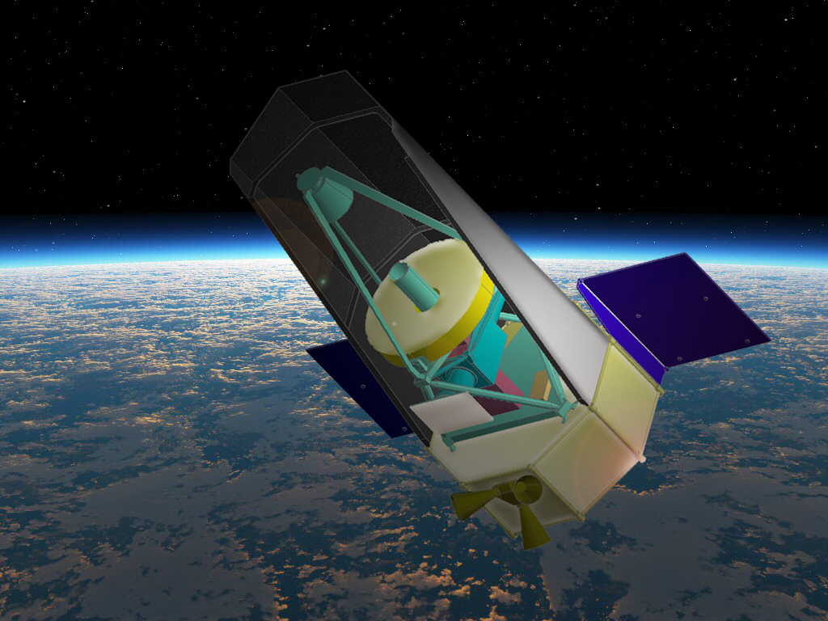
wishmission
Click
Stay Tuned !

