Slide 1
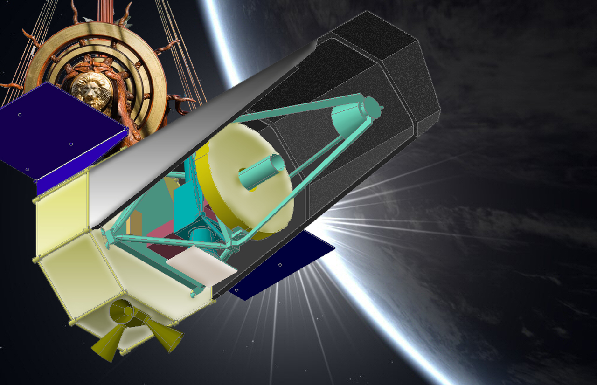
WISH
WISH: Wide-field Imaging Surveyor for High-Redshift
超広視野初期宇宙探査衛星
Tomoki Morokuma (University of Tokyo)
on behalf of
WISH Working Group
http://www.wishmission.org/en/index.html

Slide 2
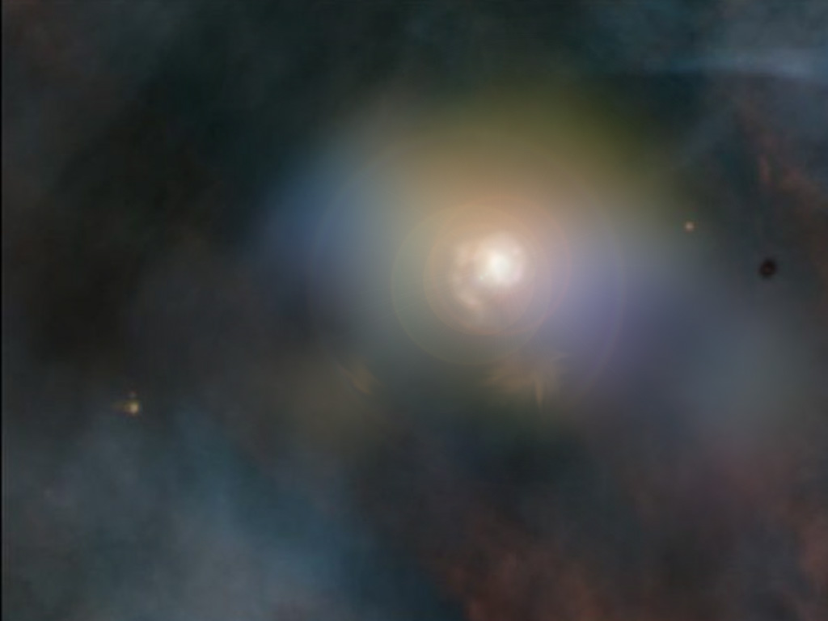
WISH WG Members
Toru Yamada, K.Mawatari, M.Kubo (Tohoku University)
Ikuru Iwata, S.Tsuneta,
H.Nakaya, T.Kodama, Y.Komiyama (NAOJ)
H.Matsuhara, T.Wada, Y.Oyabu (JAXA/ISAS)
H.Sugita, Y.Sato, A.Okamoto (JAXA)
K.Ohta, K.Yabe , Tsutsui (Kyoto University)
T.Morokuma, Chihiro Tokoku
M.Doi, N.Yasuda (University of Tokyo)
N.Kawai (TiTEC), Yonetoku (Kanazawa U),
A.Inoue (Osaka Sangyo U.)
Y.Ikeda (Photocoding), S.Iwamura (M.R.J)

Slide 3
WISH Brief Summary
1.5m diameter telescope
Cooled to 90-100K (telescope)
SE-L2, JAXA HIIA
NIR Deep and Wide-field Imaging Surveyor
1-5 μm wavelength range
Very Wide-Field Imager ~900 arcmin² FoV
pixel scale: 0.155” / 18μm (f/16)
Exploring the 1st generation galaxies
Dedicated, ~100 deg², 28AB (~25nJy)
Concept being developed under JAXA/ISAS
(the WG was selected in Sept 2008)
to be launched in late 2010’s (NET2018)

Slide 4
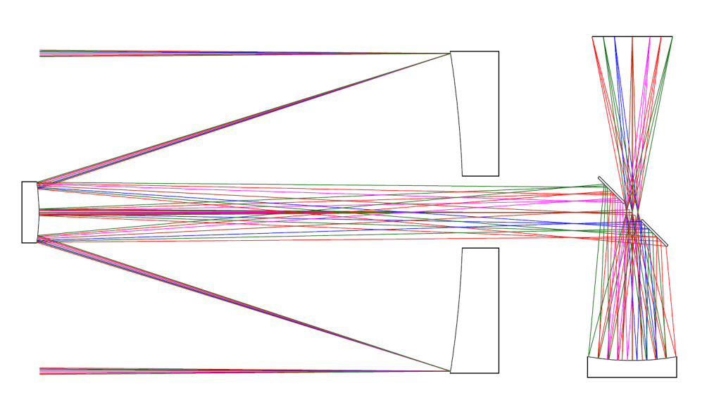
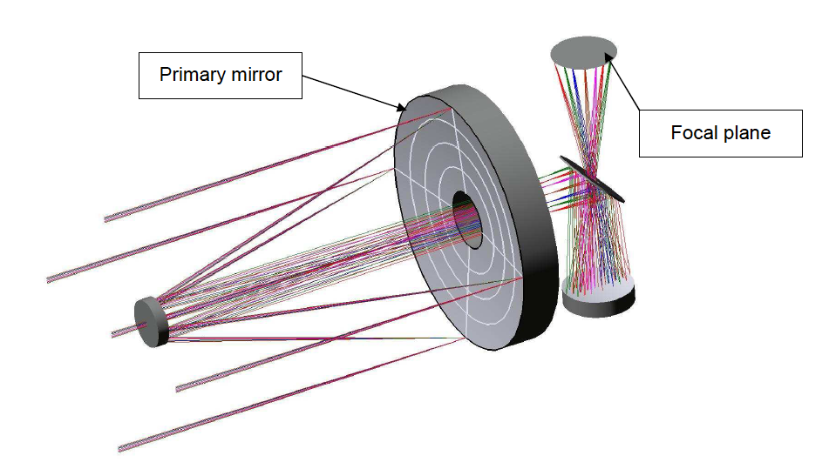
WISH Development: Optical Layout
Focal Plane
M1
M2
M1: Ellipsoidal
M2: Hyperboloid
M3: Ellipsoidal
Cold stop
M3
- Very flat focal plane
Diffraction-limited
images to φ ~50’
at 1-5 μm
Yuji Ikeda et al.
(photocoding)
Notes:
Offner optics

Slide 5
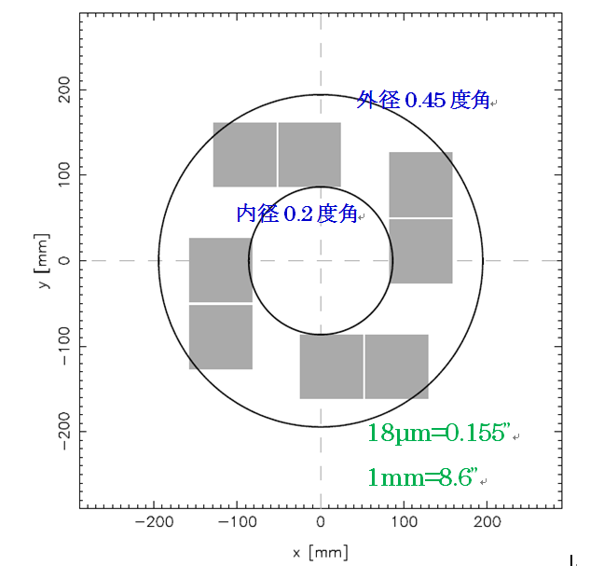
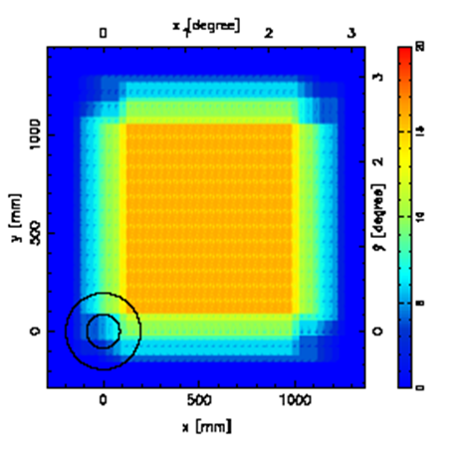
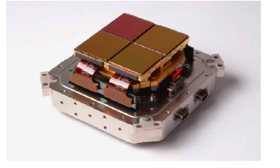
Focal Plane
Diffraction Limited Image at 1-5μm
R=0.2, 0.325, 0.4 deg @ 1.25um
R(out)=0.45deg
R(in)=0.2deg
@ 2.2um
4 x 2kx2k FPA

Slide 6
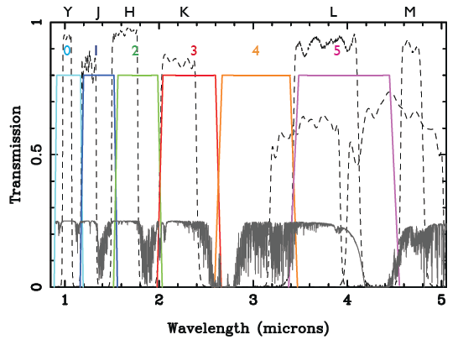
WISH: Survey Strategy
set of 6 broad-band filters + 5 custom filters

Slide 7
WISH: Survey Strategy
A Base-Line Survey Plan
 | Depth (3σ) (AB mag) | Area | Example of the Filters (a plan, to be determined)
Ultra Deep Survey (UDS) | 28 | 100 deg² | 1.0, 1.4,1.8, 2.3, 3.0 μm
+ Filter 5 | 28 | 10 deg² | 4.0μm
Ultra Wide Survey (UWS) | 24-25 | 1000 deg² | 1.4, 1.8, 2.3
Extreme Survey | 29-30 | 0.25 deg² | 1.0, 1.4, 1.8
UDS 1500 days (with 50% overhead)
UWS 50-60 days Filter5 150 days
ExS 20 days/FoV
Nominal 5 Years

Slide 8
WISH Science Goals
● Exploring the Ultimate Frontier of Galaxies
Detection of 1st-generation galaxies and
studying cosmic reionization over z=7-15
● NIR search and light curves for SNe Ia
History of cosmic expansion and Dark Energy
● Transients: high-z GRB, luminous SNe
● Huge statistics and New discovery

Slide 9
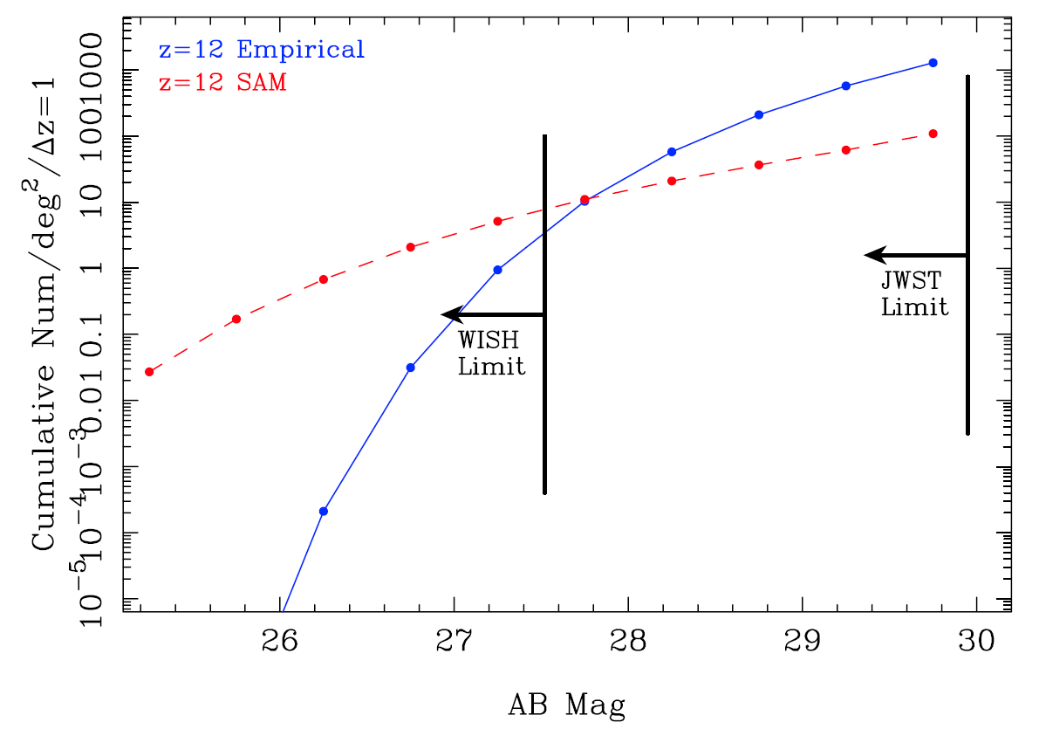
In the observers’ frame…
Limit of
AB>27-28 is
needed
z=12
Empirical
luminosity evolution
Semi-analytic
Model prediction
FoV JWST NIRCam 2.2’x2.2’ x 2ch (per filter)
~ 2.8x10⁻³ deg²
~10⁴ galaxies at z=8-9,
~10³⁻⁴ galaxies at z=11-12,
~50-100 galaxies at z=14-17

Slide 10
WISH SN Ia
Ultra Deep Survey 3-4 band AB28mag
N=10 times/year (@z~1 … Δt~10 days）
➔ magnitude limit: 26.8 (N=10)
1mag margin: m<25.8(N=10)
 | Rest-frame I-band | Rest-frame H-band
N=10 | z=0.2-1.6 2000 SNe Ia in 22 deg² | z=0.-1.0 2000 SNe Ia in 67 deg²
Rest-frame B-band: z~<3
Flux calibration is a key for cosmology.

Slide 11
WISH Schedule (expectation)
FYr | Items
FYr0 (2008) | Project launched JAXA/ISAS Working Group Conceptual Study for Specification
FYr1-4 (2009-2012) | Conceptual Study, R&D Mission Proposal Mission Requrement/Definition Review
FYr4-5 | Phase A / Proto Models
FYr5-6 | Preliminary Design Review Proto Models / Test
FYr7-8 | Proto Models /Test Critical Design Review Primary Mirror / Detector fabrication start Flight Model
FYr9 | Flight Model / Test
FYr10 (NET 2018) | Flight Model / Test Launch

Slide 12
Summary
● NIR Deep and Wide-field Imaging Surveyor
● 1.5m aperture, 0.15”/pix
● Exploring the 1st generation galaxies
● Dedicated, ~100 deg², 28AB (~25nJy)
● ~10⁴ galaxies at z=8-9, ~3-6x10³ at z=11-12,
and ~50-100 galaxies at z=14-17
● Variety of science with deep NIR Survey
● >1000 SNe Ia at z~1 discovered.
● Concept developed under JAXA/ISAS WG
to be launched in late 2010’s

