Slide 1
期待される LBG・LAE 検出数
：準解析的モデルからの見積り
[WISH Science Workshop @ 国立天文台三鷹 2009/04/08]
小林正和
国立天文台 光赤外研究部
学振特別研究員（PD）

Slide 2
我々の銀河形成モデル
MARK, Totani, & Nagashima (2007, 2009)
○ ベース＝準解析銀河形成モデル（三鷹モデル Nagashima & Yoshii 04）
・近傍銀河の観測量を再現
・任意の z の銀河の物理量（星形成史、金属量、星・ガス質量など）を計算
○ ＋ 最新の種族合成モデル（Schaerer 03）
・低金属量星の進化トラックの最新モデル
・各銀河の星形成史、金属量 など（三鷹モデルから）
➔ UV 連続光、HI 電離光子放射数（intrinsic Lyα 輝線光度）などを計算
○ ＋ Lyα 離脱率の現象論的モデル
・Lyα 輻射輸送の理論計算・近傍銀河の観測からの示唆を考慮
・各銀河の UV 連続光、intrinsic Lyα 輝線光度
➔ 観測される Lyα 輝線光度、Lyα 等価幅を計算

Slide 3
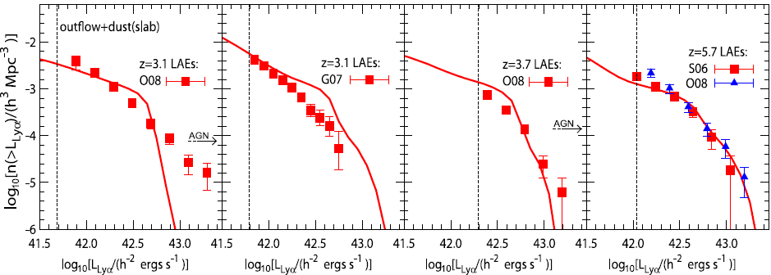
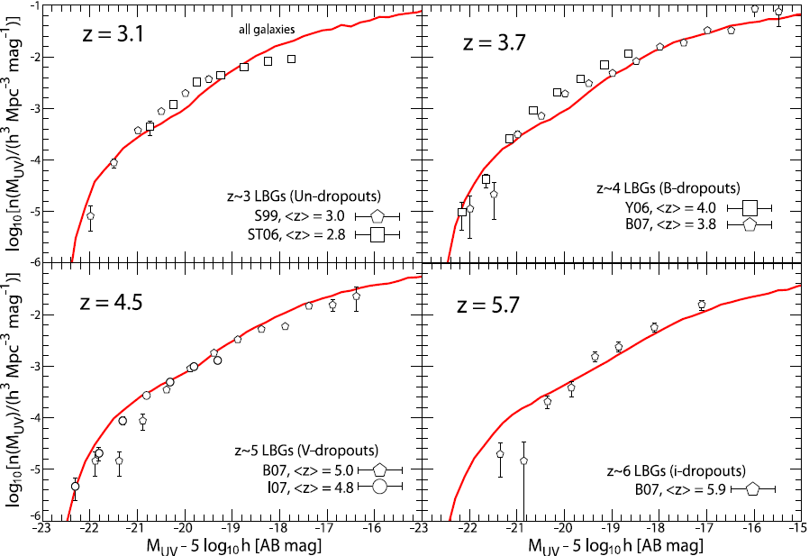
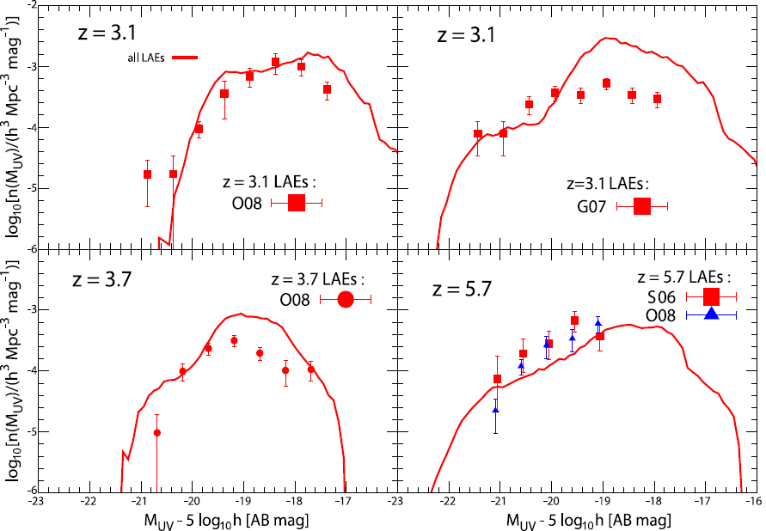
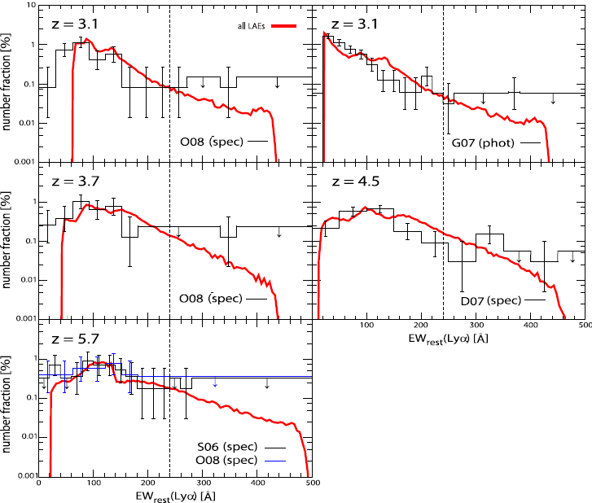
既存の LAE・LBG 観測データとの比較

Slide 4
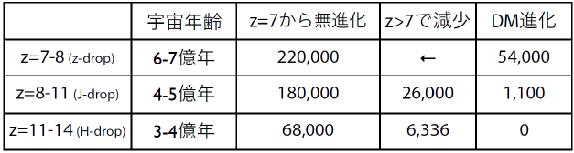
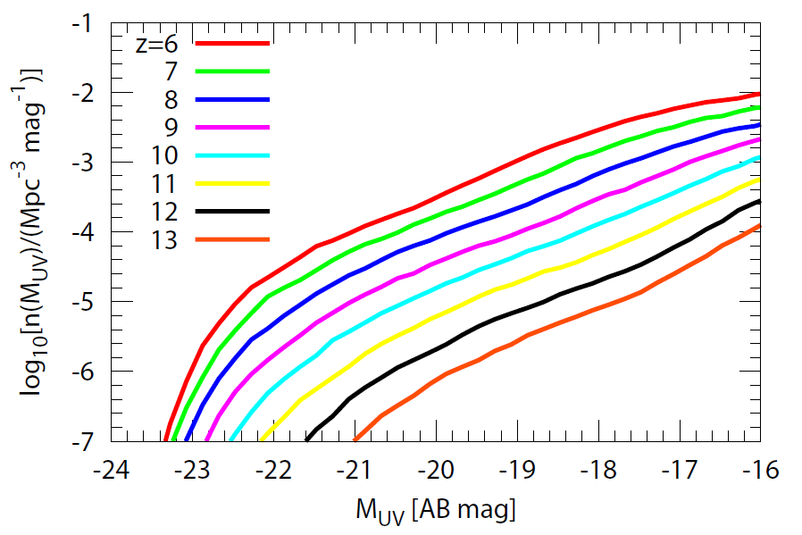
z > 6 LBG UV 光度関数
⬅ 岩田さんの評価
（山田さん、岩田さん講演）

Slide 5
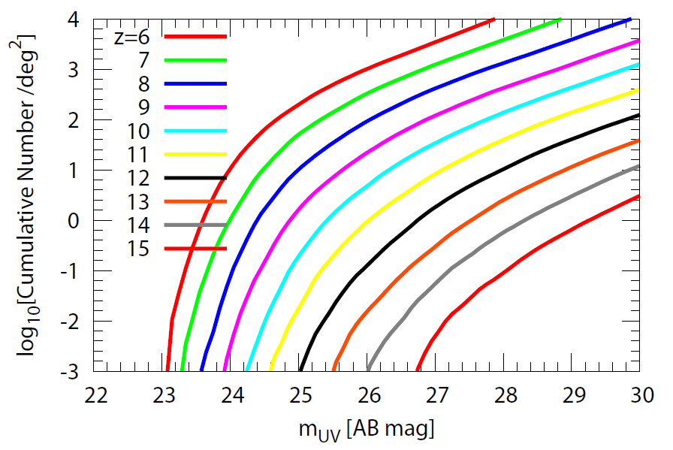
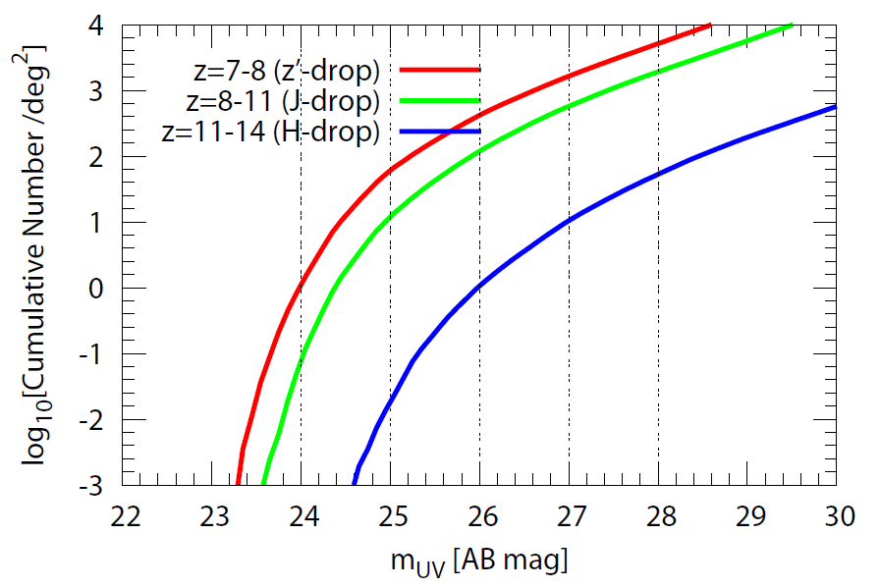
z > 6 LBG Number Count
○ 100 deg² で m_{UV} < 27 mag な LBG 検出数
‐z=7-8：163,422 個
‐z=8-11：57,646 個
‐z=11-14：1,014 個
⬅ 岩田さんの評価
（山田さん、岩田さん講演）

Slide 6
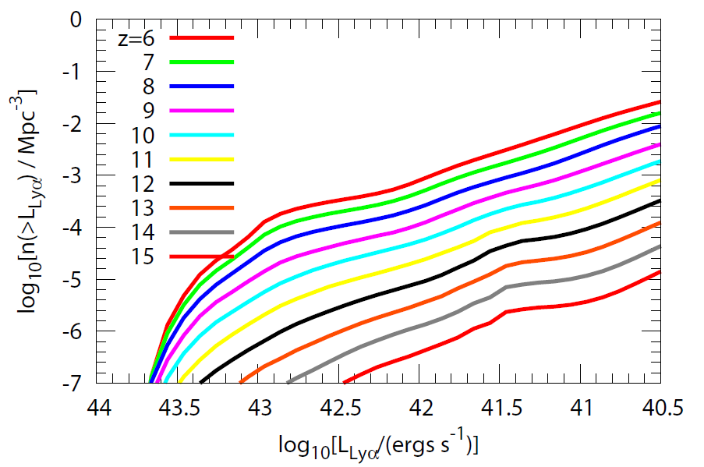
z > 6 LAE Lyα 光度関数

Slide 7
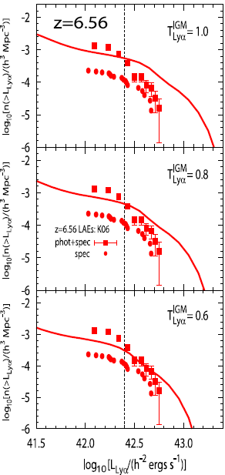
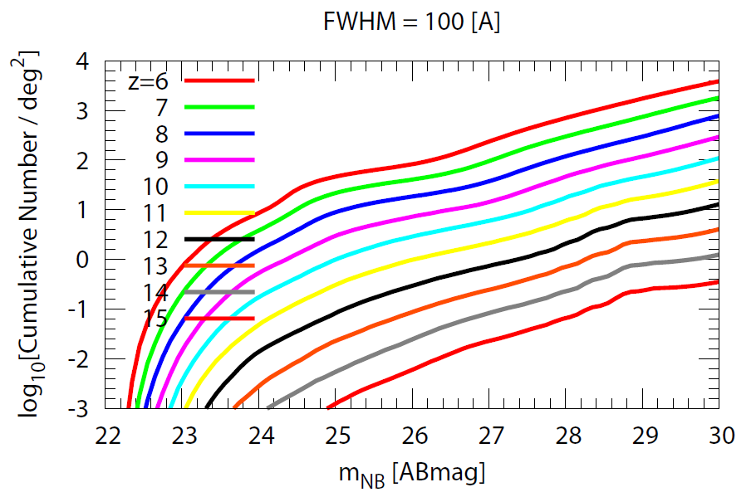
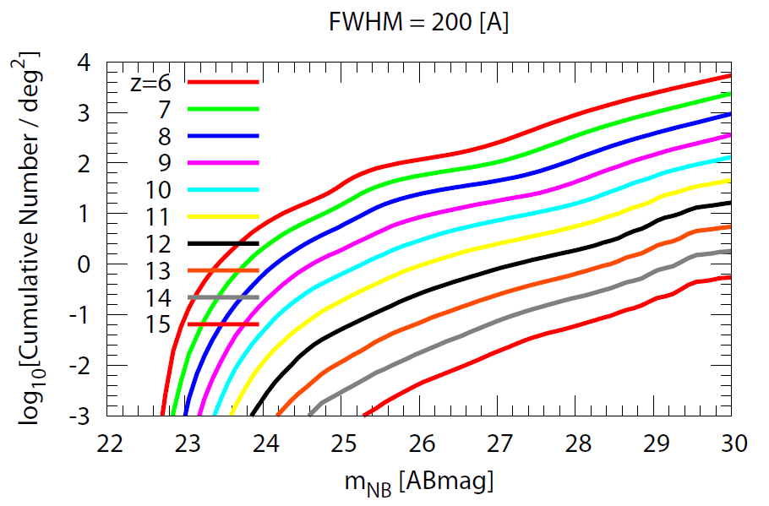
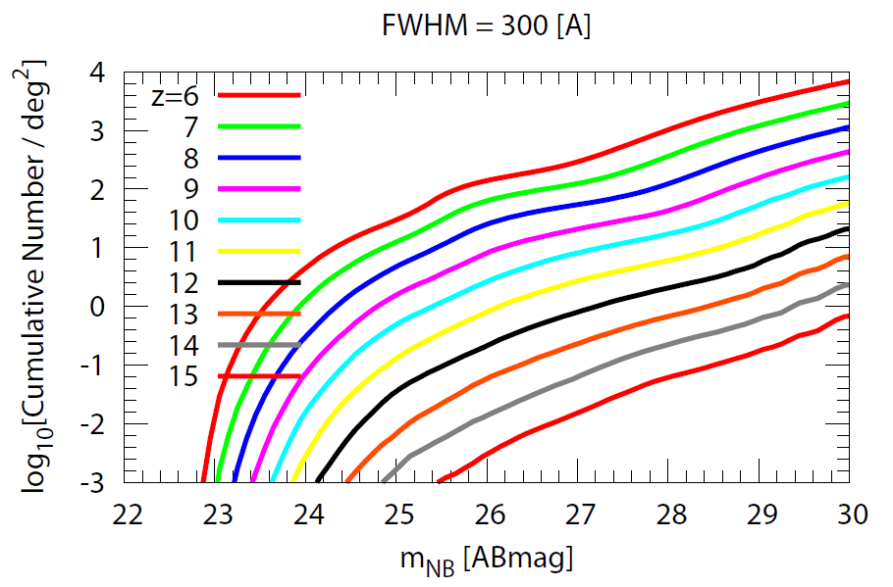
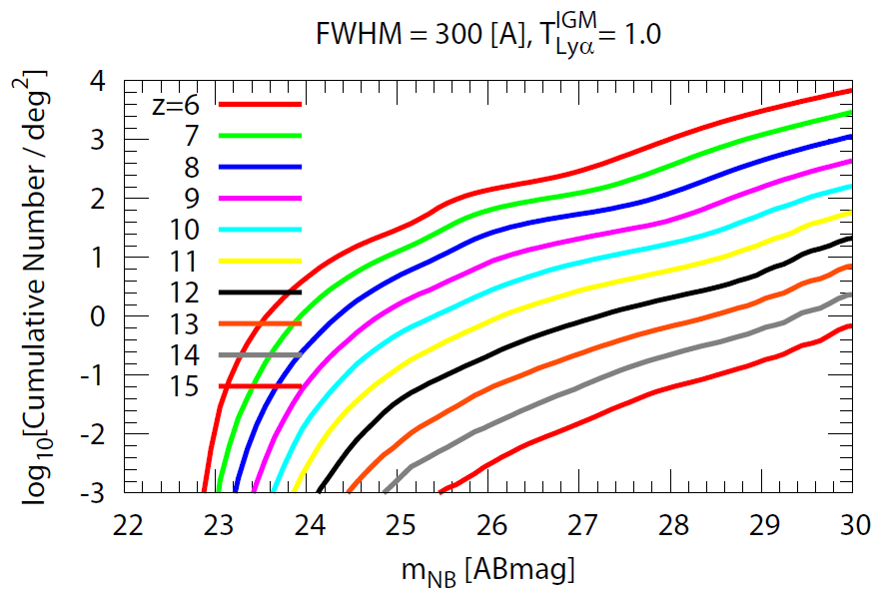
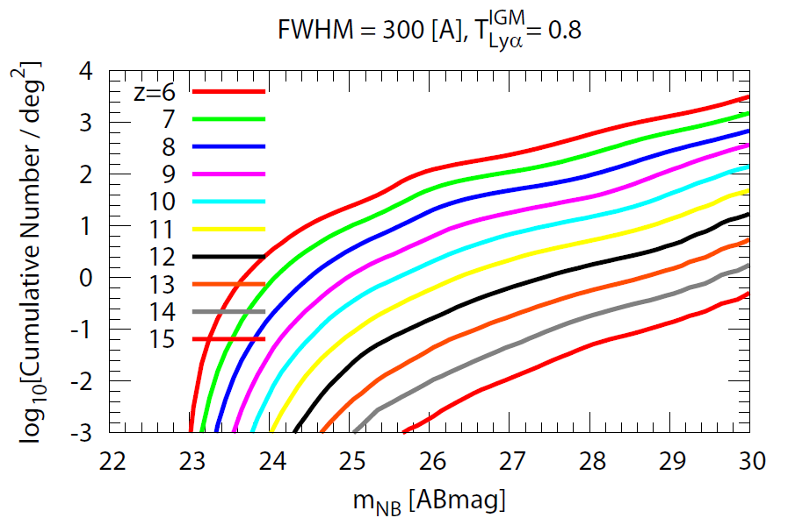
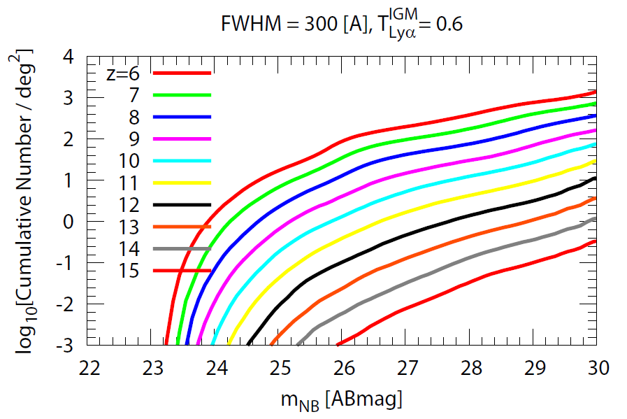
z > 6 LAE Number Count
○ 100 deg² で m_{NB} < 27 mag な LAE (EW > 20 A) 検出数
➔ FHWM 大ほど多
☆ FWHM = 100 A → Δz = ±0.04
○ 再電離の効果も加味した LAE (EW > 20 A) 検出数
➔ z=5.7 に比べた Lyα
透過率 T^{IGM} による
L^{obs} = T^{IGM} * L^{emit}
Lyα
Lyα
Lyα
Lyα
z | 100 [A] | 200 [A] | 300 [A] | 300 [A], 0.8 | 300 [A], 0.6
8 | 3,792 | 4,442 | 5,438 | 5,024 | 4,270
10 | 625 | 736 | 828 | 680 | 534
12 | 75 | 78 | 78 | 61 | 48

Slide 8
~まとめ~
○ 100 deg² を 27 mag まで掃けば・・・
LBG：~ 160,000 個（z ~ 7-8）、 ~ 60,000 個（z ~ 8-11）、
~ 1,000 個（z ~ 11-14）
LAE：~ 4,000 個（z ~ 8）、~ 700 個（z ~ 10）、
~ 80 個（z ~ 12）
↑ Lyα の IGM 吸収が z=5.7 と同じ場合
○ IMF、ダスト減光曲線の不定性もあるが、これらによってこの評価より少なくなることは多分ない
○ LAE @ z > 8 の実際の検出数がこれより少なければ、
再電離の効果と考えられる

Slide 10
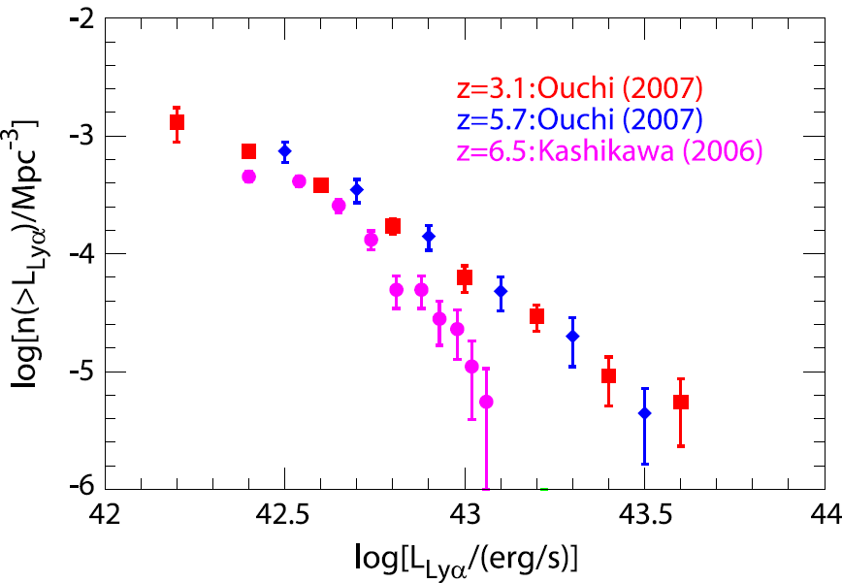
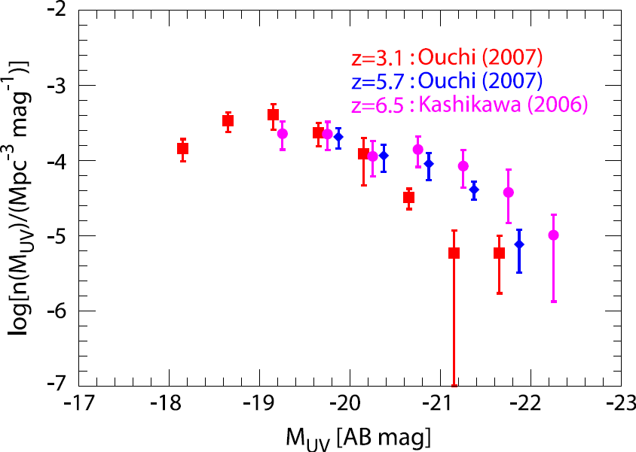
Observational Data of LAEs (1)
LAE luminosity functions (LFs): Lya LF & UV LF
(1) UV LF: almost no-evolution @ z = 3-7
or somewhat brighter at higher-z
(2) Lya LF: no-evolution @ z < 6, decrease @ z > 6
→ Lya extinction in IGM (= cosmic reionization)?
Lya LF
UV LF
Important information about LAEs
is imprinted in these obs. LFs

Slide 11
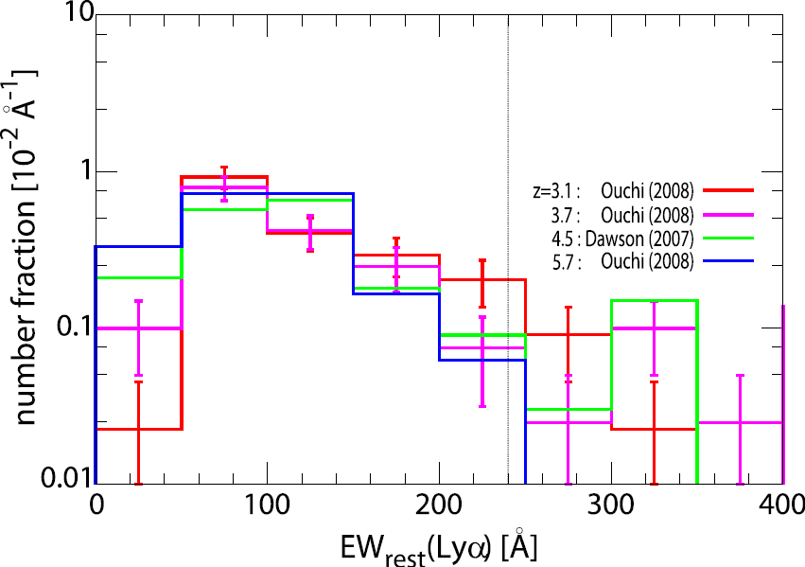
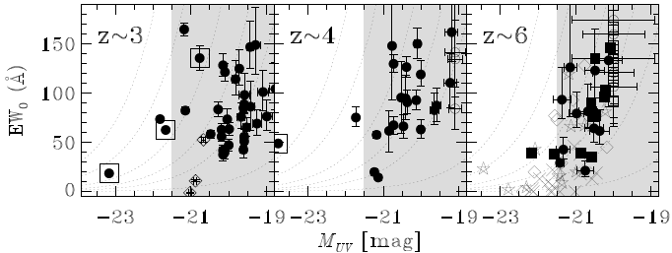
Observational Data of LAEs (2)
Lya Equivalent Width (EW) Distribution
some LAEs @ z = 3-6 have
EW(Lya) > 240 A
➔ include Pop III stars
and/or top-heavy IMF?
Distribution in M(UV)-EW(Lya) plane
deficiency of UV-bright LAE w/ large-EW
Ouchi+ ’08

Slide 12
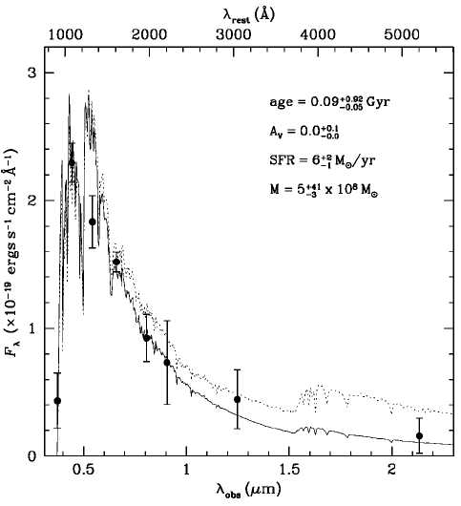
Physical properties of LAEs@high-z
stacking broad-band fluxes (Gawiser+ ’06)
z ~ 3 LAEs
・ high SFR
・ young (10-100 Myr)
・ almost dust-free
・ low stellar mass

Slide 13
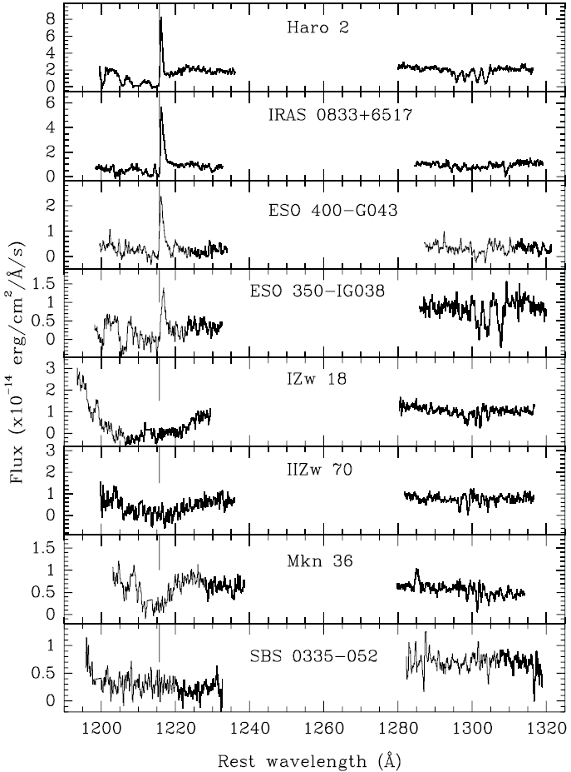
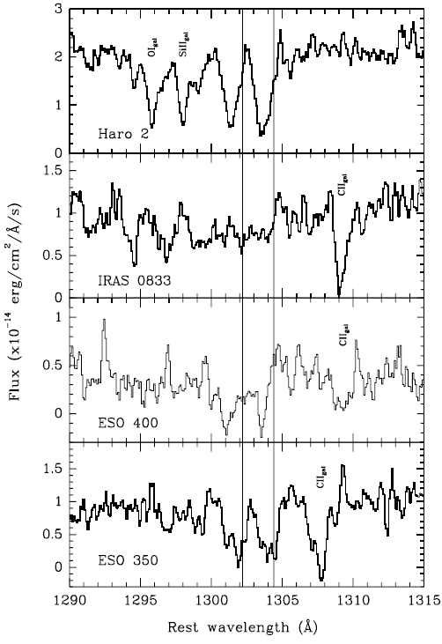
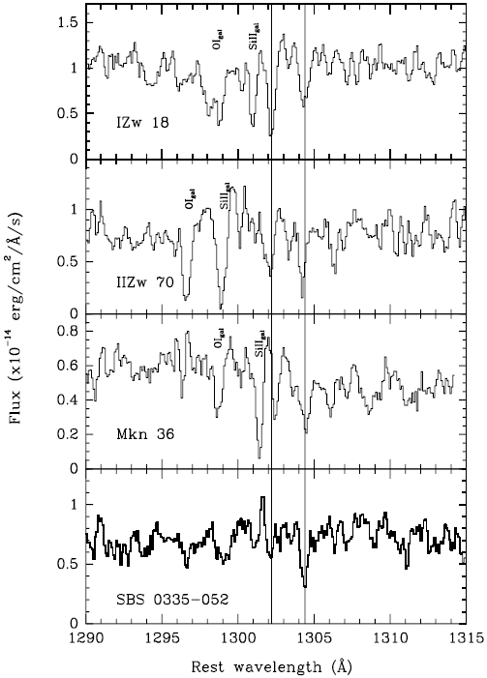
Lyα Emission from low-z galaxies
interstellar absorption line features (Kunth+ ’98)
← gals
w Lyα
emission
gals →
w/o Lyα emission

Slide 14
Theoretical Works & f_{esc}
Lya
Several models with different approaches exist
analytic: e.g., Haiman & Spaans ’99, Dijkstra+ ’07
- semi-analytic: Le Delliou+ ’05 & ’06, Orsi+ ’08
SPH: e.g., Barton+ ’04, Nagamine+ ’08
* in all model, Lya escape fraction f_{esc} is oversimplified
f_{esc} = const or exp(-tau_{d}) ← tau_{d} : dust opacity for continuum
Lya
Lya
Implications for f_{esc} from theories of Lya transfer
Lya
massive stars
Lya: a resonance line of HI
→ random-walk before escape
- f_{esc} is highly sensitive to dust geometry &
ISM dynamics; f_{esc} is not constant
and not equal to exp(-tau_{d})
cloud
dust
Lya
Lya
Lya
ISM
dust
effects of dust geometry & outflow should be incorporated in f_{esc}
Lya

Slide 15
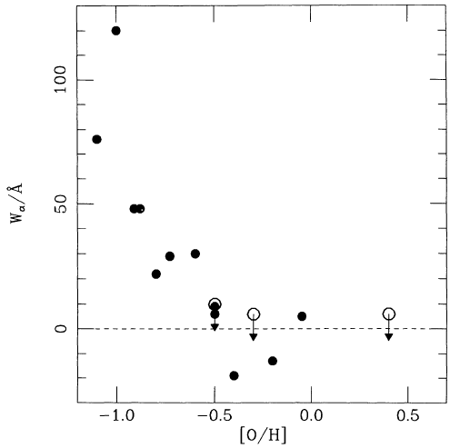
Lya
Implications for f_{esc} from Observations (1)
Metallicity Dependence (Charlot & Fall ’93)
Lya
high f_{esc} at low-metallicity
(⬄ low-dust content)
- consistent with theoretical
expectation (Neufeld ’90)
EW(Lya)-metallicity relation of local star-forming galaxies
Lya: resonance line of H I
➔ large cross-section
ISM
(including dust)
EW(Lyα) [A]
Lya
UV cont.
gas clump
[O/H]
massive star

Slide 16
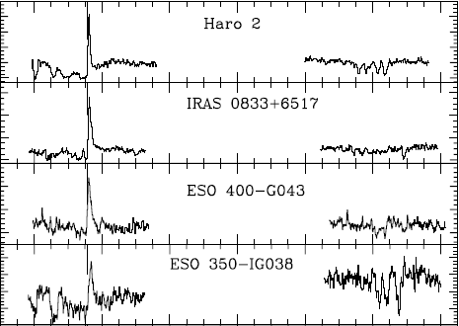

Lya
Implications for f_{esc} from Observations (2)
gas-dynamics (outflow)
(Kunth+ ’98)
Lya
high f_{esc} in outflowing
condition
UV spectra of local galaxies
with Lya emission

Slide 17
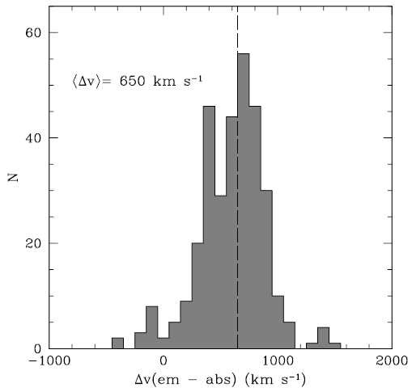
Lya
Implications for f_{esc} from Observations (2)
gas-dynamics (outflow)
(Kunth+ ’98)
Lya
high f_{esc} in outflowing
condition
z ~3 LBG with Lya emission
Shapley+ ’03

Slide 18
Lya
Implications for f_{esc} from Observations (2)
gas-dynamics (outflow)
(Kunth+ ’98)
Lya
high f_{esc} in outflowing
condition
- consistent with theoretical expectation
➔ galactic-scale outflow drastically reduce the effective
opacity of Lya (Hansen & Oh ’05)
outflowing ISM
(including dust)
interstellar dust extinction & outflow effect should be incorporated into f_{esc} model
Lya
UV cont.
Lya
outflowing
gas clump
massive star

Slide 19
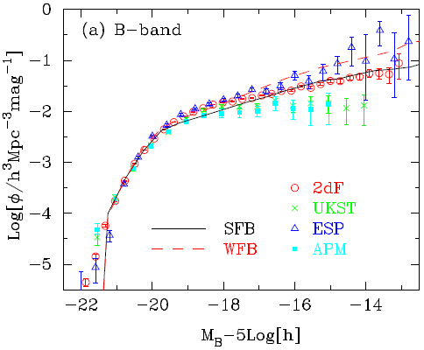
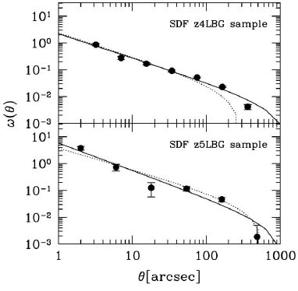
Base of Our Theoretical Model
semi-analytic model of hierarchical galaxy formation
- reproduce most of the obs. properties of local galaxies
(Nagashima & Yoshii ’04; Nagashima+ ’05),
and UVLFs & ACFs of LBGs @ z=4, 5 (Kashikawa+ ’06)
Nagashima+ ’05
Kashikawa+ ’06

Slide 20



Extension of the Mitaka Model for LAE
SFR in starburst galaxies
SFR(t)
0
M★ < M_{cold}：supernova (SN) feedback
determined by the Mitaka model
to reproduce the local LFs
t
0
Δt
t_{wind}
galactic wind blows and SF is terminated: similar to the traditional picture of galactic wind (Arimoto & Yoshii ’87)

Slide 21

How to Calculate L(Lya)
emit
Lya line luminosity emitted from each galaxy L_{Lya}
escape fraction of Lyman cont.
➔ f_{esc} = 0 (fiducial)
LyC
escape fraction of Lya
the maximum possible Lya line luminosity:
L_{Lya} in the case of f_{esc} = 0 & ionization equilibrium (case B)
LyC
← determined by using SFR, metallicity, age & SSPs of
Schaerer (2003)
obs
observed Lya line luminosity L_{Lya}
IGM transmission to Lya emission
➔ T_{Lya} = 1 (fiducial)
IGM

Slide 22

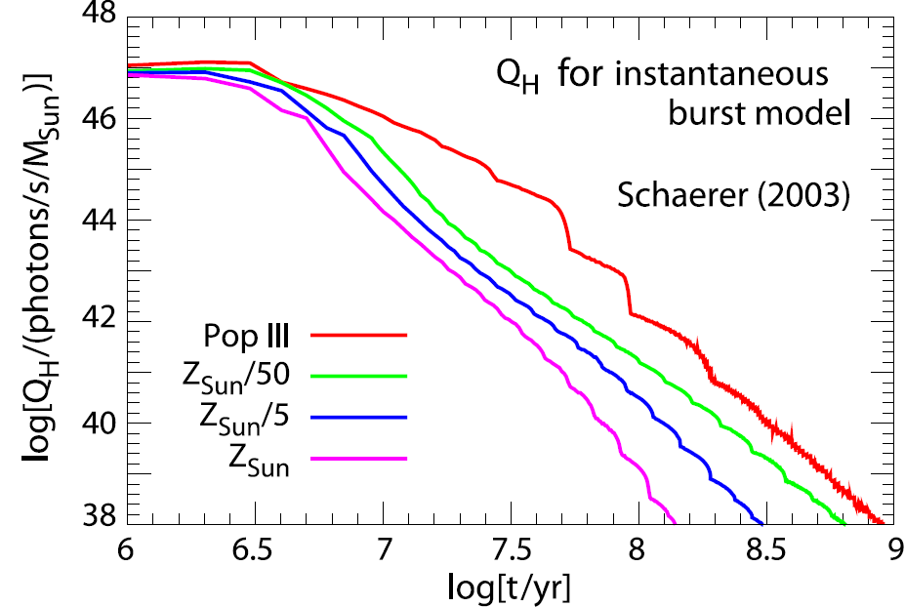

Calculate Lya Line Luminosity
escape fraction of Lya photon
max
maximally possible Lyα luminosity L_{Lya}
convolution of SFR with
HI ionizing photon
emission rate Q_{H}
obs
observed Lyα line luminosity L_{Lya}
IGM transmission to Lya emission

Slide 23
Our Model for f_{esc}
Lya
simply proportional model (e.g., Le Delliou+ ’06):
constant f_{esc} regardless physical properties of each galaxy
Lya
the outflow + dust model:
including interstellar dust extinction (next slide)
& galaxy-scale outflow induced as supernova feedback
Lya
f_{esc} @ t = 0 is determined by dust amount & geometry
f_{esc}
Lya
Lya
wind
outflow drastically reduces Lya: f_{esc} = f₀
wind
f₀
no cold gas to absorb LyC photons
(f_{esc} = 1) ➔ no Lya production
LyC
elapsed time after the onset of star-formation
0
t_{wind}
t_{wind}+t_{esc}

Slide 24
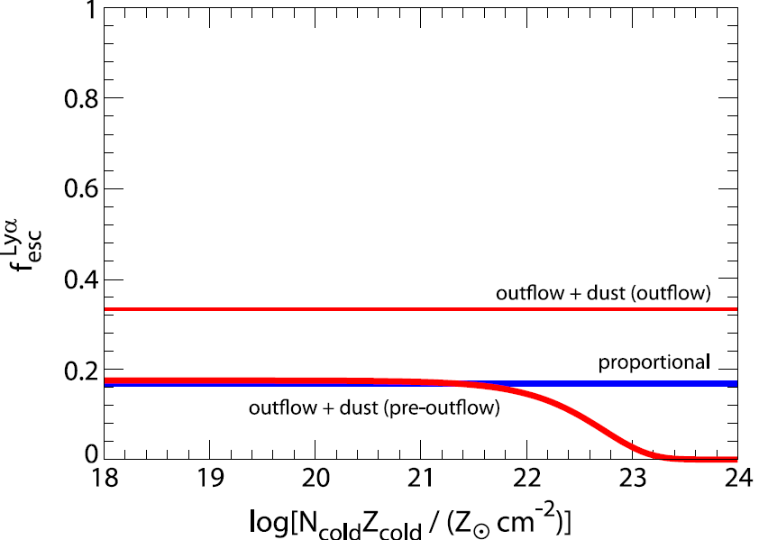
Resultant Lya Escape Fraction
f₀ : 0.153±0.02 (simply proportional)
0.160±0.03 (outflow+dust)
f₀ : 0.36
q: 0.25^{+0.16}
wind
-0.11

Slide 25
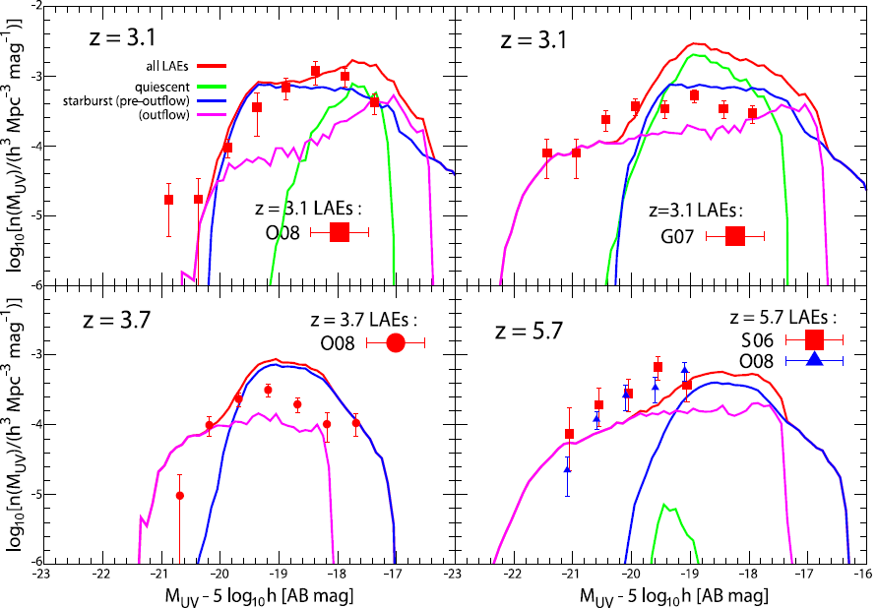
Comparison with LAE UV LF @ z<6

Slide 26
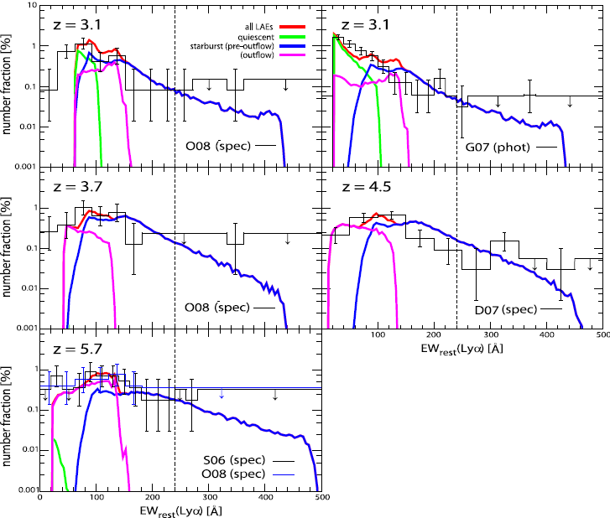

Comparison with LAE EW dist. @ z < 6

Slide 27
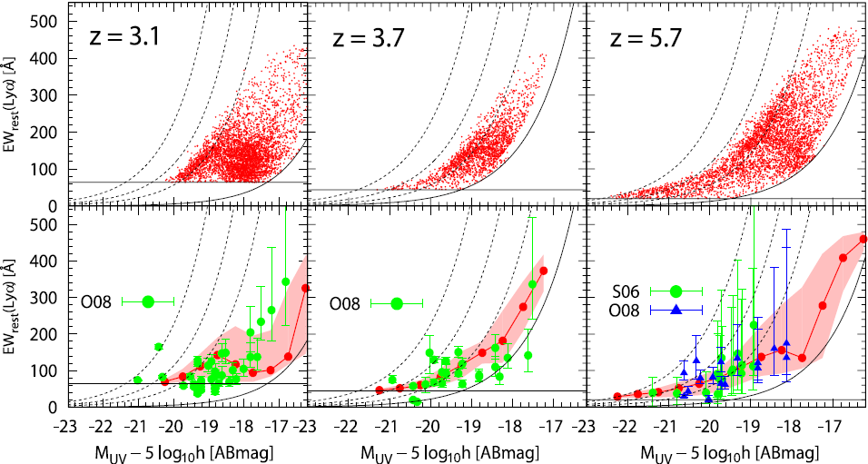
Comparison in M(UV)-EW(Lya) plane @ z < 6

Slide 28
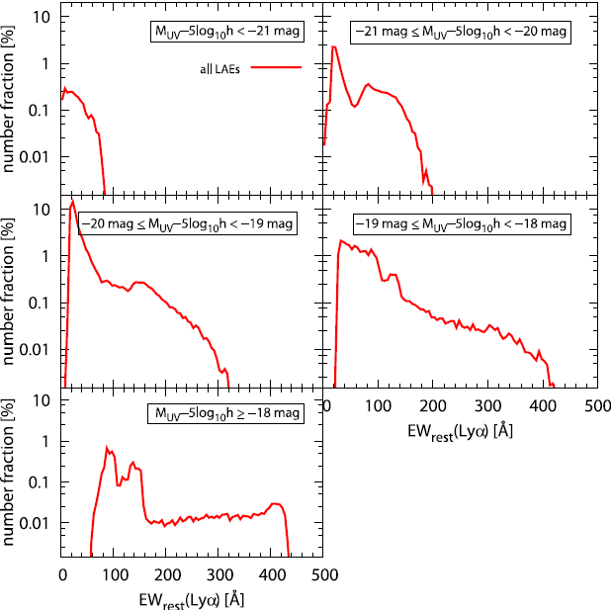
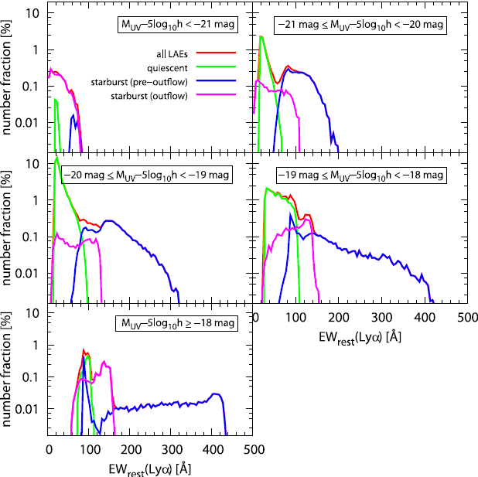
Comparison in M(UV)-EW(Lya) plane @ z < 6

Slide 29
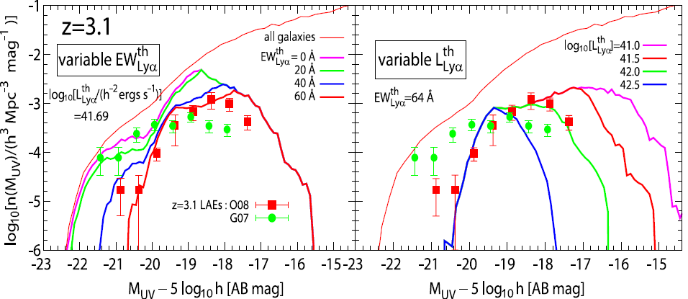
Characteristics in LAE UVLF

Slide 30
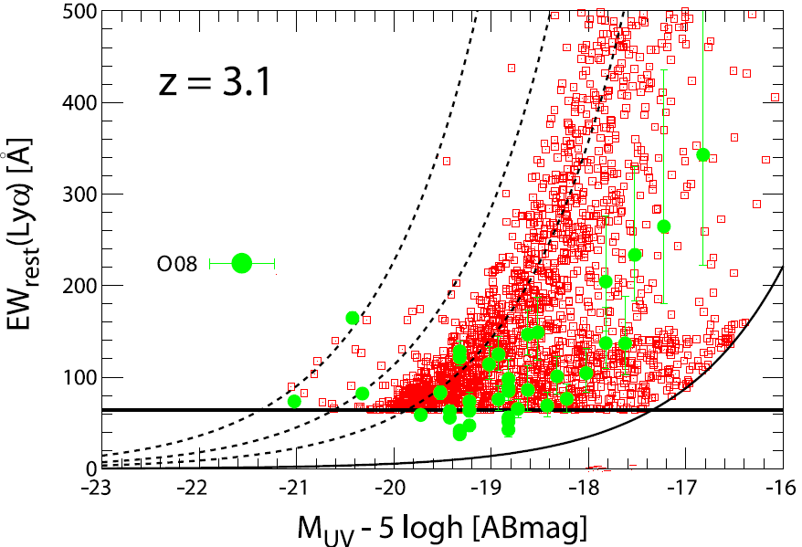
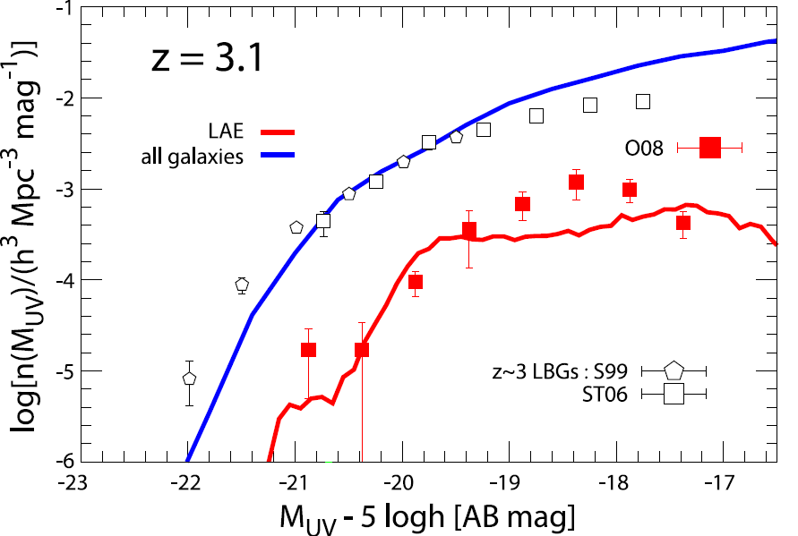
Characteristics in UV LF
EW(Lya) dist
UV LF

Slide 31
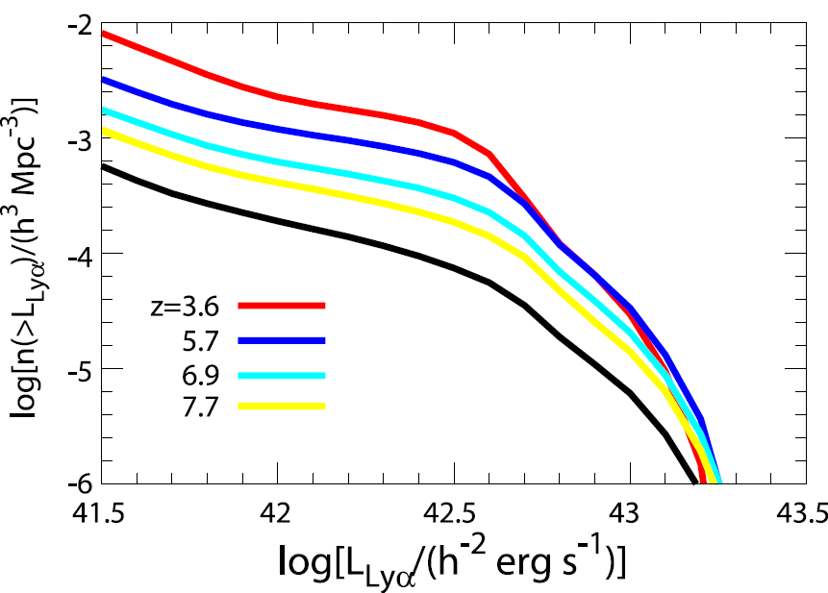
Prediction to Redshift Evolution of Lya LF
Lya LF evolution is suppressed by considering the effect of f_{esc}
Lya
a critical L(Lya)
~ Lcr =2*10⁴³ h⁻² erg/s
: n(>Lcr) < 10⁻⁶ h³/Mpc³
regardless of source z

Slide 32
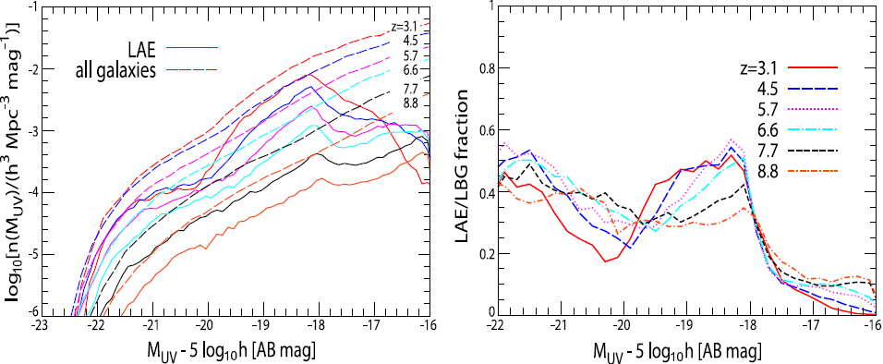
Redshift Evolution of LAE UVLF

Slide 33
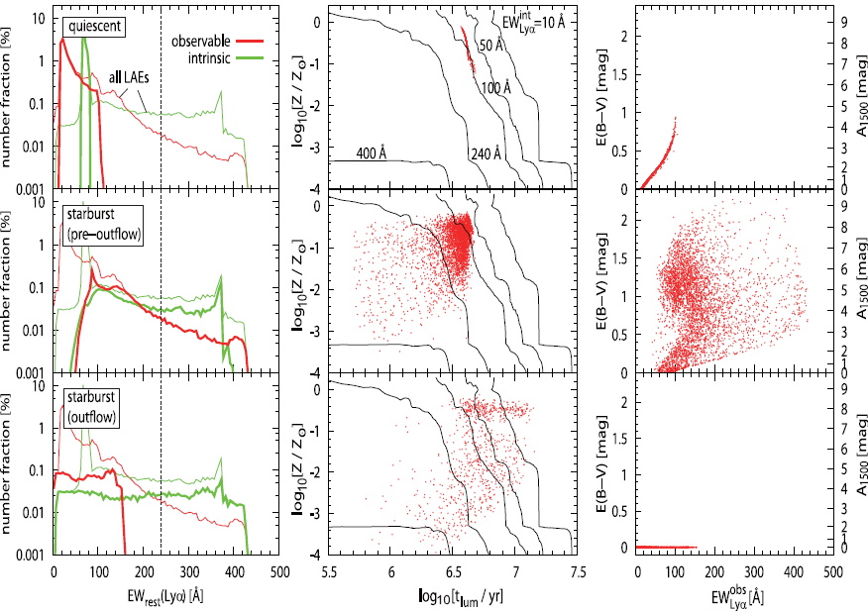

Nature of LAEs with EW > 240 A

Slide 34
Lyα と UV 連続光の dust opacity
○ τ_{Lyα} ：Lyα line に対する dust opacity
← Lyα 光度関数とのフィットで決めた
○ τ_{c}：Lyα 波長付近の連続光に対する dust opacity
← 近傍銀河の観測量とのフィットで決めた（三鷹モデル）
➔ τ_{Lyα} / τ_{c} ≣ q：geometry parameter (Finkelstein+ 08)
τ_{Lyα} ＝ qτ_{c}
cloud
dust
stars
‐ q >> 1：homogeneous ISM
‐ q << 1： clumpy interstellar dust
Lyα
ISM
dust

Slide 35
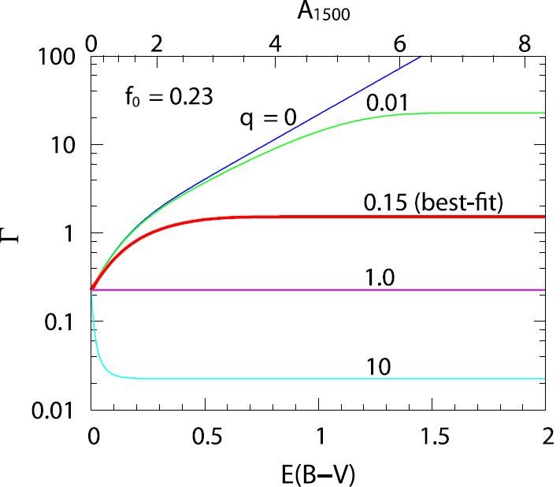
geometry parameter q と EW(Lyα)
○ q＝１ でなければ、dust extinction を受ける前後で
EW(Lyα) は変わる：EW_{dust} / EW_{int} ≣ Γ(τ_{c})
Γ(τ_{c})＝（f₀ / q）× [1 - exp(-qτ_{c})] / [1 - exp(-τ_{c})]
for quiescent and pre-outflow starburst
f₀ / q for outflow starburst
wind
‐best-fit ： q = 0.15 < 1
➔ clumpy ISM を示唆
‐best-fit ： q = 0.15
➔ ダスト減光が大きいほど Γ 大
Γ → (f₀ / q) = 1.5
for E(B-V) → ∞

Slide 36
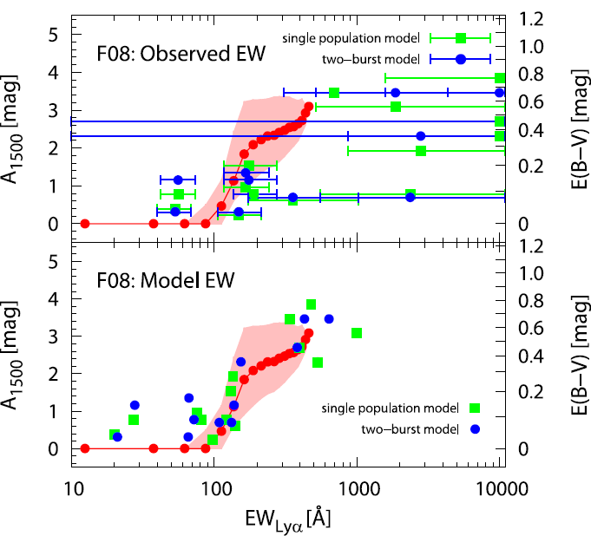
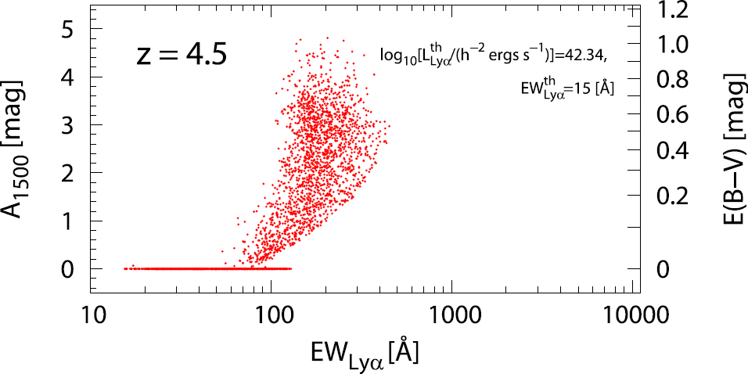
Model Prediction
○ τ_{c} 大ほど Γ 大
➔ ダスト減光と EW(Lyα) との相関が予言
：ダスト減光が強い LAE ほど、EW(Lyα) が大きくなる

Slide 37
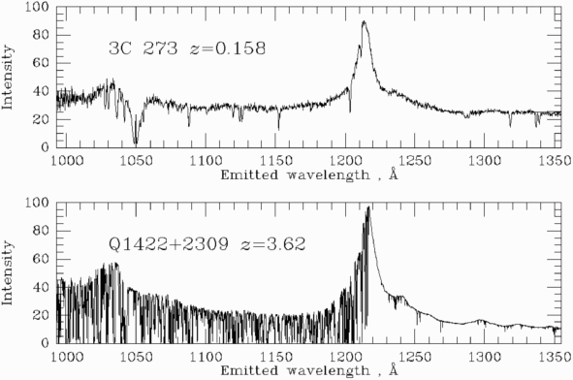
Cosmic Reionization
Gunn-Peterson test (Gunn & Peterson 1968)
Bill Keel’s website：http://www.astr.ua.edu/keel/agn/

Slide 38
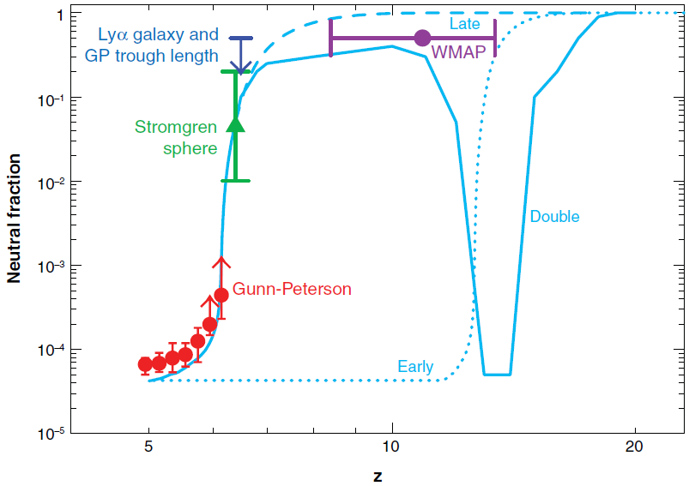
Cosmic Reionization
◆ Lya emission from LAE is attenuated in IGM where
IGM neutral fraction (x_{HI}) > 0.1 (Santos ’04)
1
0.1
10⁻²
neutral fraction x_{HI}
10⁻³
10⁻⁴
Fan+ ’06
10⁻⁵
5
10
20
redshift
observed LAE Lya LF will be dimmer @ z > 6.5 than those at z < 6

Slide 39
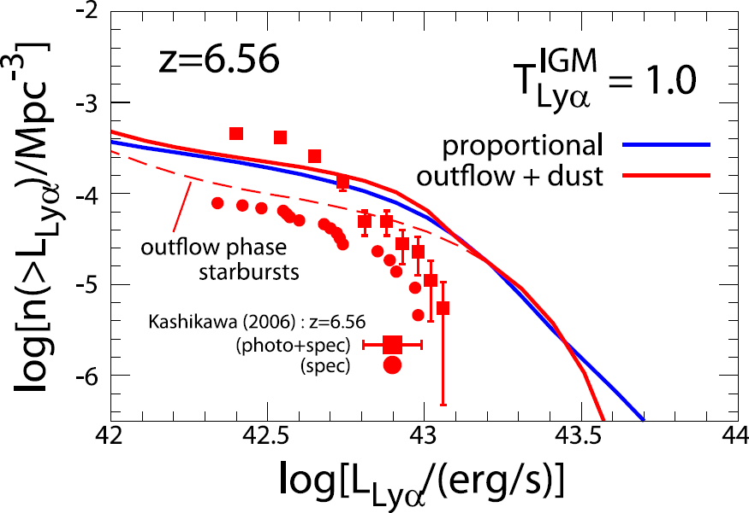
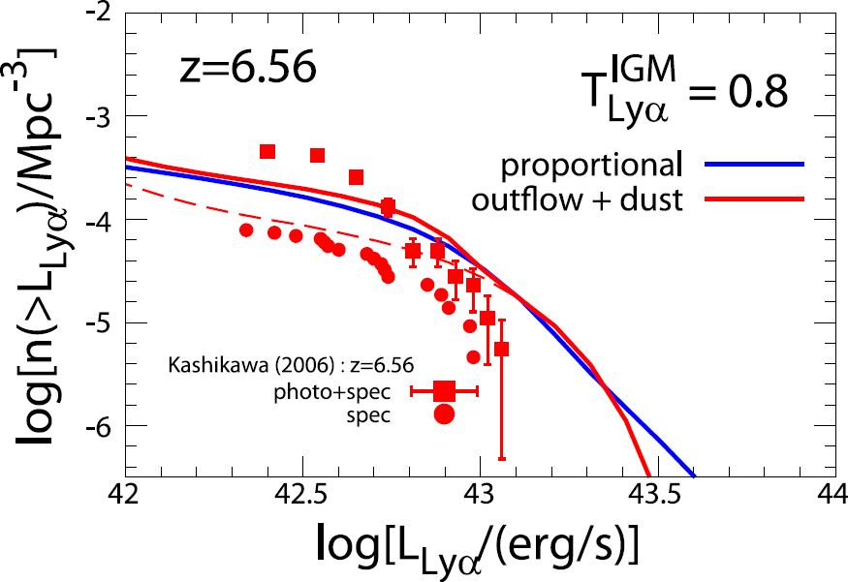
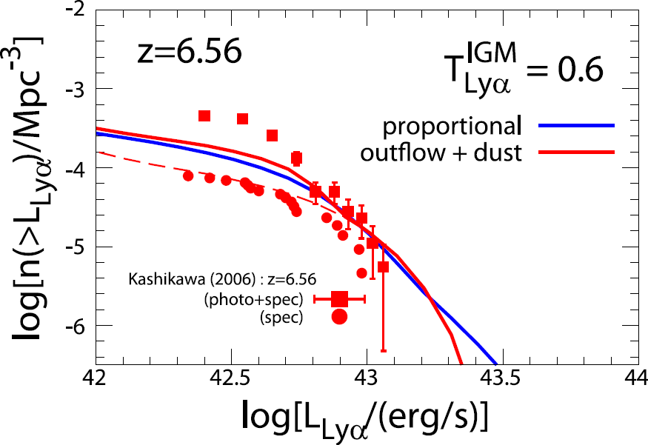
Comparison with Lya LF: z > 6
IGM
requirement of T_{Lya} < 1 implies that x_{HI} rapidly increases at z>6

Slide 40

LAE Statistical Quantities @ z > 6

