Slide 1
期待される LAE 検出数
：準解析的モデルからの見積り
[WISH Science Workshop @ 国立天文台三鷹 2010/03/10]
小林正和 (MARK)
国立天文台 光赤外研究部
学振特別研究員（PD）

Slide 2
Mock Catalog for High-z Galaxies
○ ベース＝準解析銀河形成モデル（三鷹モデル Nagashima & Yoshii 04）
・任意の z の銀河の物理量（星形成史、金属量、星・ガス質量など）を計算
○ ＋ 最新の種族合成モデル（Schaerer 03）
・低金属量星（Z < 10⁻⁴）の進化トラックの最新モデル
・三鷹モデルの星形成史と convolve → N_{LyC}、L_{Lyα}、L₁₅₀₀ など
○ ＋ Lyα 離脱率の現象論的モデル（MARK+ 07, 10）
・Lyα 輻射輸送の理論計算・近傍銀河の観測からの示唆を考慮
・z=3-7 LAE の Lyα・UV 光度関数、Lyα 等価幅分布を再現
○ ＋ nebular emission (Schaerer & de Barros 09)
・continuum + lines (H, He, C, N, O, S, etc.：金属量に依存)

Slide 3
Mock Catalog の補足
○ 近傍銀河で得られた星形成などの経験則を、そのまま high-z に適用
・ダスト減光曲線＝MW、metal-to-dust mass ratio＝MW
➔ high-z での星形成が本質的に変わる場合もありうる
○ 個々の銀河は、個数ではなく個数密度
➔ サーベイ体積を与えれば、その中の銀河の個数が求まる
・銀河 “１つ” の個数密度はホストハローの質量に依存
○ Schaerer 03 には限られた情報（N_{LyC}、UBV… mag など）しかない
➔ 他のバンドにおける等級は、Kodama & Arimoto (1997) から計算
任意のバンドが選べるため、今回 WISH BB filters (Set 3, 4, 3e, 4e)、
NB filters (FWHM=100A, 300A, λ/100, λ/50) を全て計算
○ 主に計算＆解析に使っていた PC が 2010/02/19 に死亡
➔ 廃棄予定だった PC（5年前の製品）を譲り受けたが、セットアップに時間を
取られ、その後も低スペックに苦しめられている。。。

Slide 4
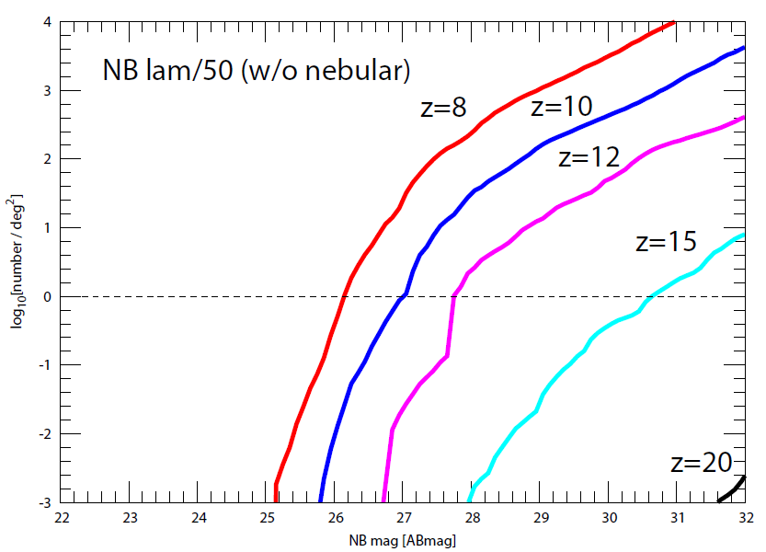
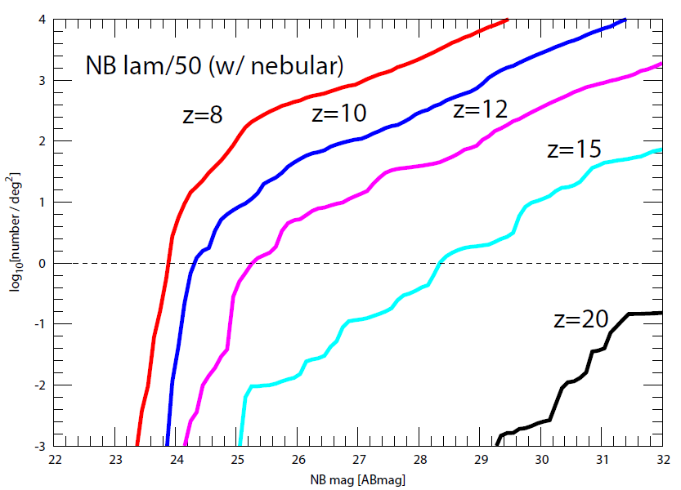
z > 8 NB Number Count
10 時間
100 時間

Slide 5
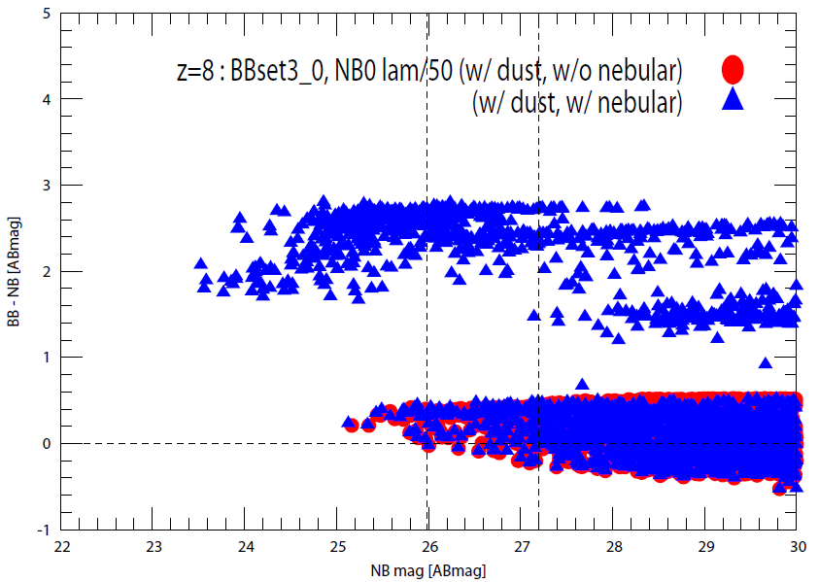
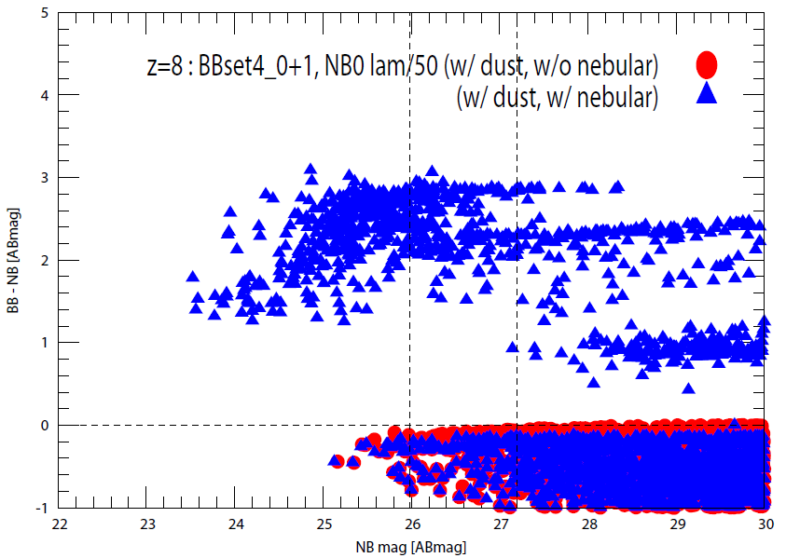
z = 8 NB vs. BB-NB CMD

Slide 6
~まとめ~
○ 1 deg² を各 NB (FWHM=λ/50) で掃けば・・・
・10 hour exp.(S/N > 3)
z=8: ~ 500 個、z=10: ~ 50 個、z=12: ~ 5 個、z=15: ~ 0.01 個
・10 hour exp.(S/N > 3)
z=8: ~1,000個、z=10: ~ 100個、z=12: ~ 10個、z=15: ~ 0.1個
↑ Lyα の IGM 吸収が z=5.7 と同じ場合
○ EW(Lyα) に閾値を設ければ検出数は減るが、コンタミも減る
➔ mock catalog の CMD 上の分布から評価
○ 理論的な high-z galaxies の不定性（IMF、ダスト減光）は
上記見積もりを増やす方向
➔ LAE @ z > 8 の実際の検出数がこれより少なければ、
再電離の効果と考えられる

Slide 8
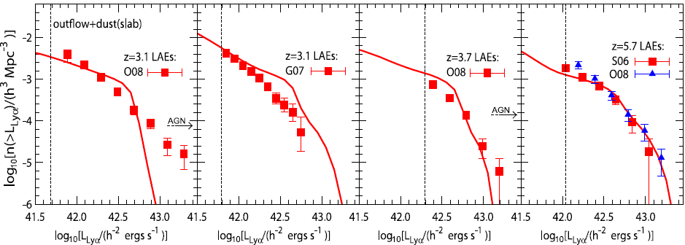
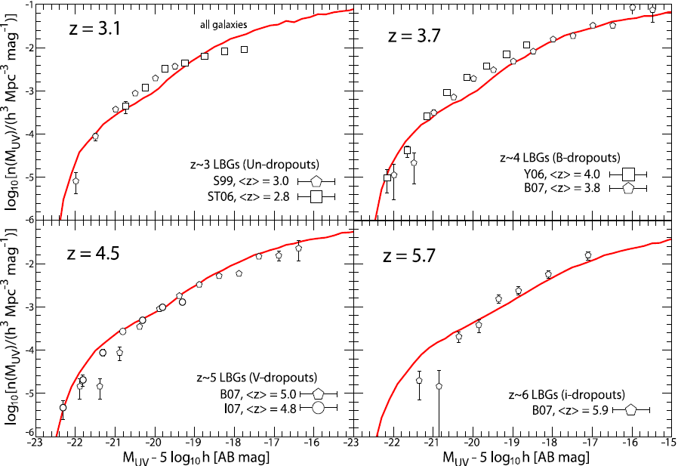
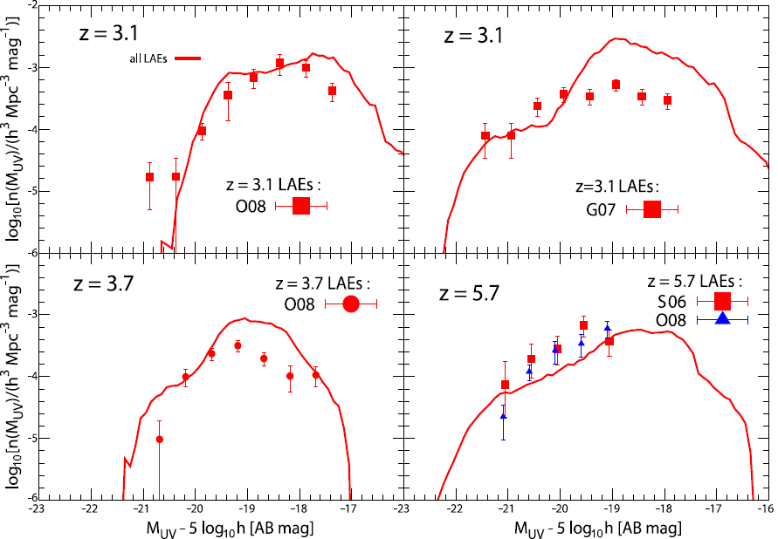
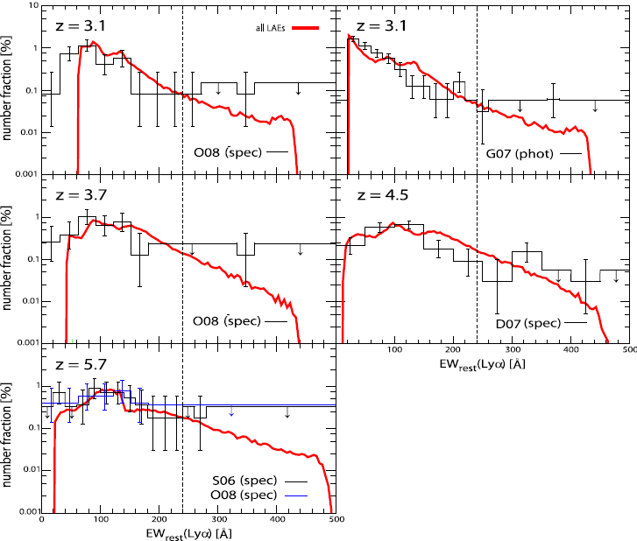
既存の LAE・LBG 観測データとの比較

Slide 9
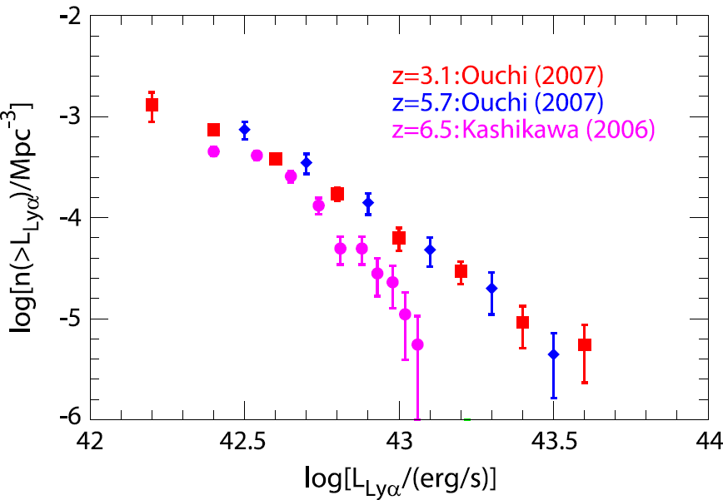
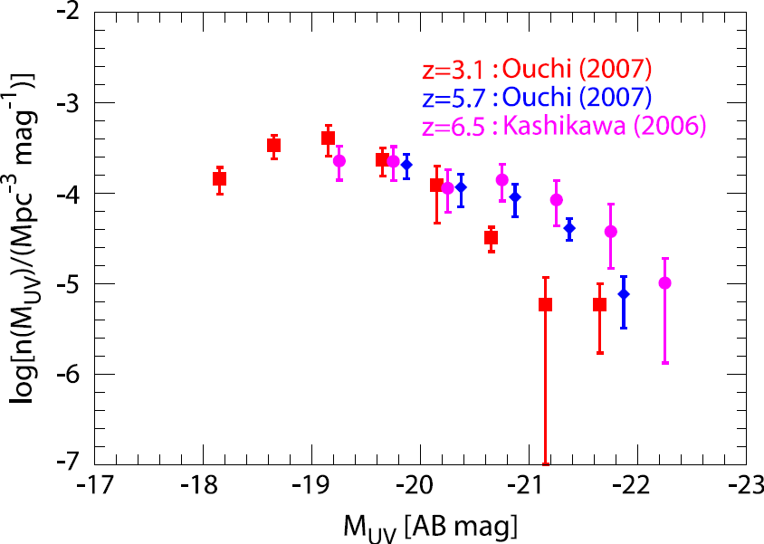
Observational Data of LAEs (1)
LAE luminosity functions (LFs): Lya LF & UV LF
(1) UV LF: almost no-evolution @ z = 3-7
or somewhat brighter at higher-z
(2) Lya LF: no-evolution @ z < 6, decrease @ z > 6
→ Lya extinction in IGM (= cosmic reionization)?
Lya LF
UV LF
Important information about LAEs
is imprinted in these obs. LFs

Slide 10
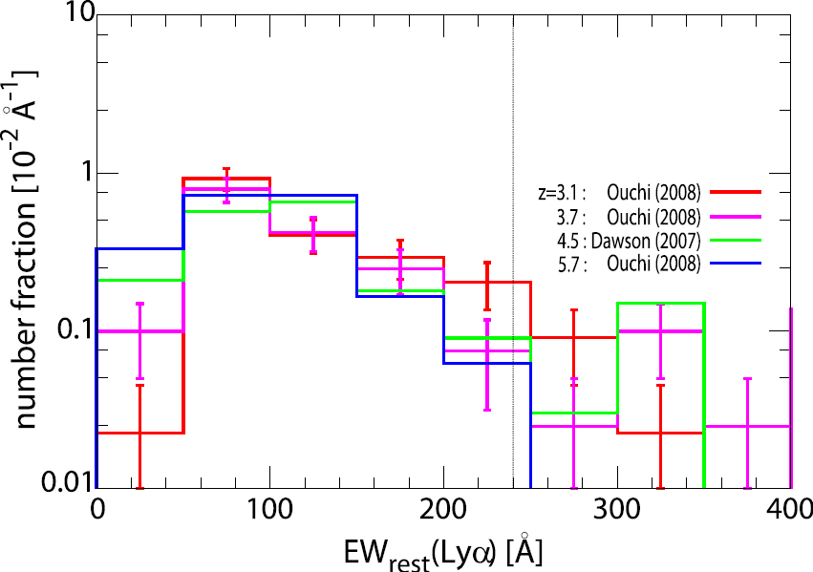
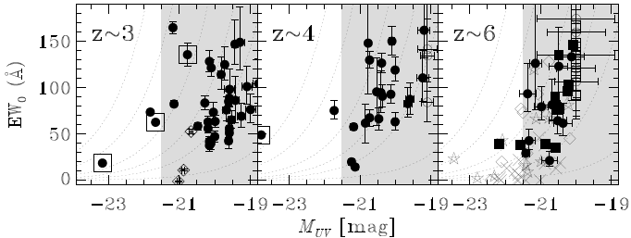
Observational Data of LAEs (2)
Lya Equivalent Width (EW) Distribution
some LAEs @ z = 3-6 have
EW(Lya) > 240 A
➔ include Pop III stars
and/or top-heavy IMF?
Distribution in M(UV)-EW(Lya) plane
deficiency of UV-bright LAE w/ large-EW
Ouchi+ ’08

Slide 11
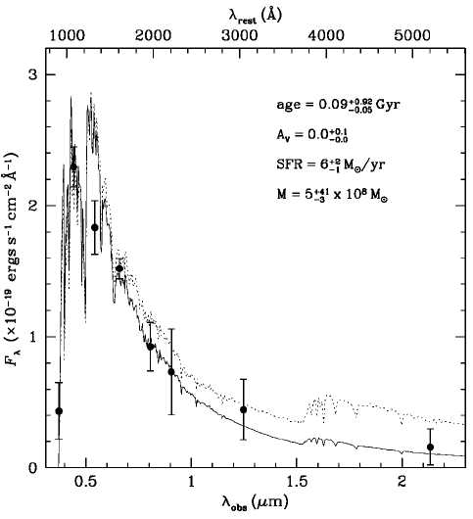
Physical properties of LAEs@high-z
stacking broad-band fluxes (Gawiser+ ’06)
z ~ 3 LAEs
・ high SFR
・ young (10-100 Myr)
・ almost dust-free
・ low stellar mass

Slide 12
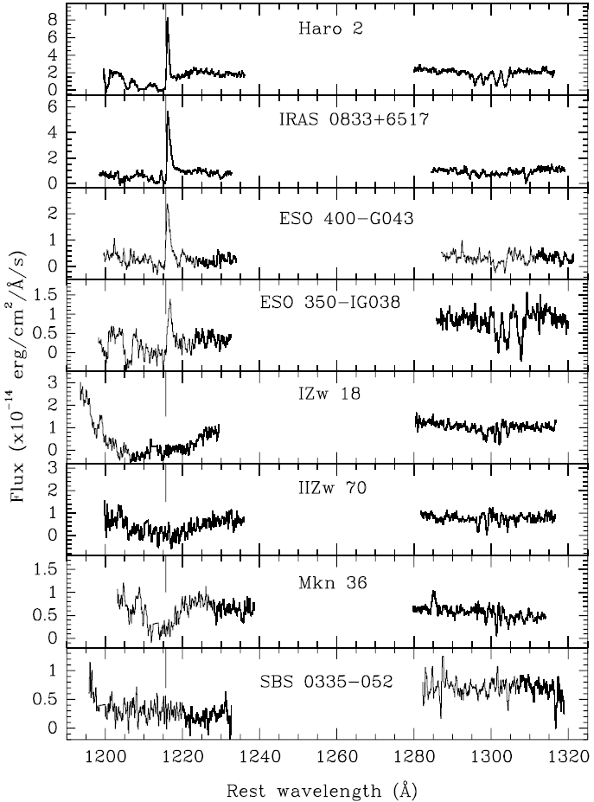
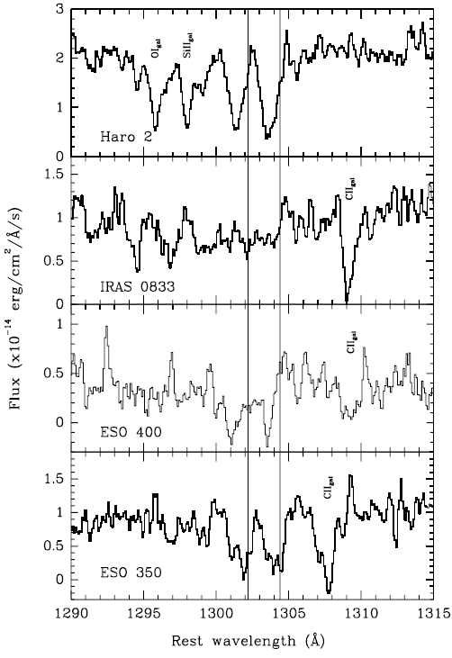
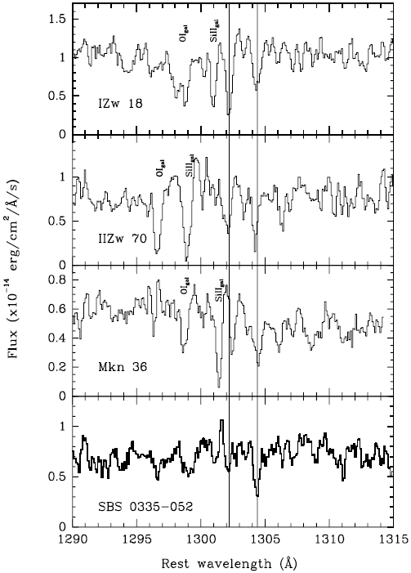
Lyα Emission from low-z galaxies
interstellar absorption line features (Kunth+ ’98)
← gals
w Lyα
emission
gals →
w/o Lyα emission

Slide 13
Theoretical Works & f_{esc}
Lya
Several models with different approaches exist
analytic: e.g., Haiman & Spaans ’99, Dijkstra+ ’07
- semi-analytic: Le Delliou+ ’05 & ’06, Orsi+ ’08
SPH: e.g., Barton+ ’04, Nagamine+ ’08
* in all model, Lya escape fraction f_{esc} is oversimplified
f_{esc} = const or exp(-tau_{d}) ← tau_{d} : dust opacity for continuum
Lya
Lya
Implications for f_{esc} from theories of Lya transfer
Lya
massive stars
Lya: a resonance line of HI
→ random-walk before escape
- f_{esc} is highly sensitive to dust geometry &
ISM dynamics; f_{esc} is not constant
and not equal to exp(-tau_{d})
cloud
dust
Lya
Lya
Lya
ISM
dust
effects of dust geometry & outflow should be incorporated in f_{esc}
Lya

Slide 14
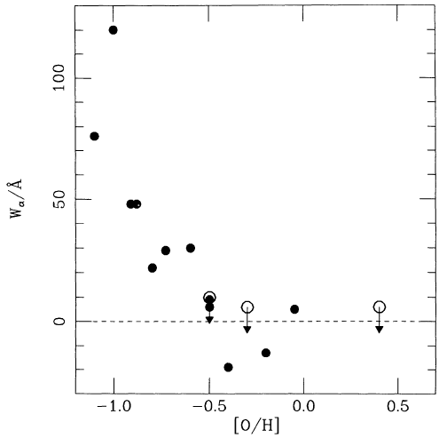
Lya
Implications for f_{esc} from Observations (1)
Metallicity Dependence (Charlot & Fall ’93)
Lya
high f_{esc} at low-metallicity
(⬄ low-dust content)
- consistent with theoretical
expectation (Neufeld ’90)
EW(Lya)-metallicity relation of local star-forming galaxies
Lya: resonance line of H I
➔ large cross-section
ISM
(including dust)
EW(Lyα) [A]
Lya
UV cont.
gas clump
[O/H]
massive star

Slide 15
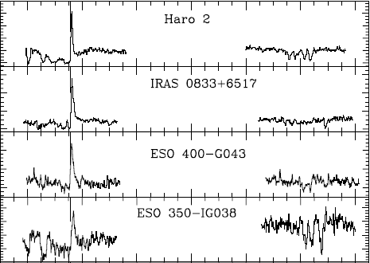

Lya
Implications for f_{esc} from Observations (2)
gas-dynamics (outflow)
(Kunth+ ’98)
Lya
high f_{esc} in outflowing
condition
UV spectra of local galaxies
with Lya emission

Slide 16
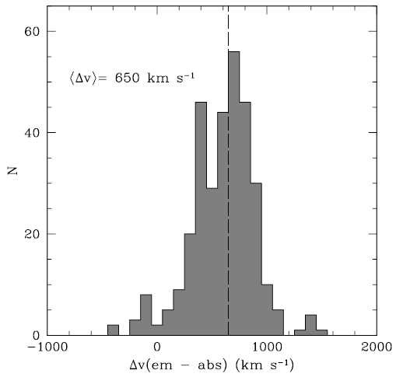
Lya
Implications for f_{esc} from Observations (2)
gas-dynamics (outflow)
(Kunth+ ’98)
Lya
high f_{esc} in outflowing
condition
z ~3 LBG with Lya emission
Shapley+ ’03

Slide 17
Lya
Implications for f_{esc} from Observations (2)
gas-dynamics (outflow)
(Kunth+ ’98)
Lya
high f_{esc} in outflowing
condition
- consistent with theoretical expectation
➔ galactic-scale outflow drastically reduce the effective
opacity of Lya (Hansen & Oh ’05)
outflowing ISM
(including dust)
interstellar dust extinction & outflow effect should be incorporated into f_{esc} model
Lya
UV cont.
Lya
outflowing
gas clump
massive star

Slide 18
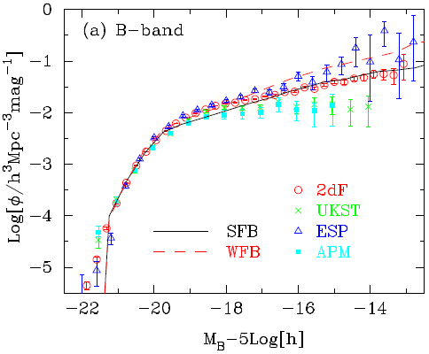
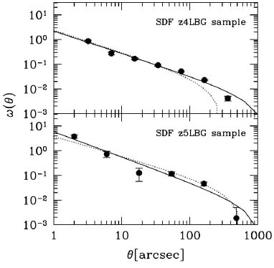
Base of Our Theoretical Model
semi-analytic model of hierarchical galaxy formation
- reproduce most of the obs. properties of local galaxies
(Nagashima & Yoshii ’04; Nagashima+ ’05),
and UVLFs & ACFs of LBGs @ z=4, 5 (Kashikawa+ ’06)
Nagashima+ ’05
Kashikawa+ ’06

Slide 19



Extension of the Mitaka Model for LAE
SFR in starburst galaxies
SFR(t)
0
M★ < M_{cold}：supernova (SN) feedback
determined by the Mitaka model
to reproduce the local LFs
t
0
Δt
t_{wind}
galactic wind blows and SF is terminated: similar to the traditional picture of galactic wind (Arimoto & Yoshii ’87)

Slide 20

How to Calculate L(Lya)
emit
Lya line luminosity emitted from each galaxy L_{Lya}
escape fraction of Lyman cont.
➔ f_{esc} = 0 (fiducial)
LyC
escape fraction of Lya
the maximum possible Lya line luminosity:
L_{Lya} in the case of f_{esc} = 0 & ionization equilibrium (case B)
LyC
← determined by using SFR, metallicity, age & SSPs of
Schaerer (2003)
obs
observed Lya line luminosity L_{Lya}
IGM transmission to Lya emission
➔ T_{Lya} = 1 (fiducial)
IGM

Slide 21

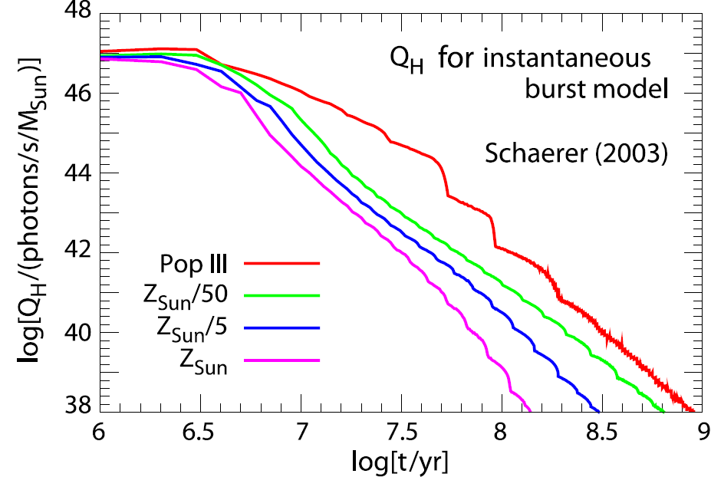

Calculate Lya Line Luminosity
escape fraction of Lya photon
max
maximally possible Lyα luminosity L_{Lya}
convolution of SFR with
HI ionizing photon
emission rate Q_{H}
obs
observed Lyα line luminosity L_{Lya}
IGM transmission to Lya emission

Slide 22
Our Model for f_{esc}
Lya
simply proportional model (e.g., Le Delliou+ ’06):
constant f_{esc} regardless physical properties of each galaxy
Lya
the outflow + dust model:
including interstellar dust extinction (next slide)
& galaxy-scale outflow induced as supernova feedback
Lya
f_{esc} @ t = 0 is determined by dust amount & geometry
f_{esc}
Lya
Lya
wind
outflow drastically reduces Lya: f_{esc} = f₀
wind
f₀
no cold gas to absorb LyC photons
(f_{esc} = 1) ➔ no Lya production
LyC
elapsed time after the onset of star-formation
0
t_{wind}
t_{wind}+t_{esc}

Slide 23
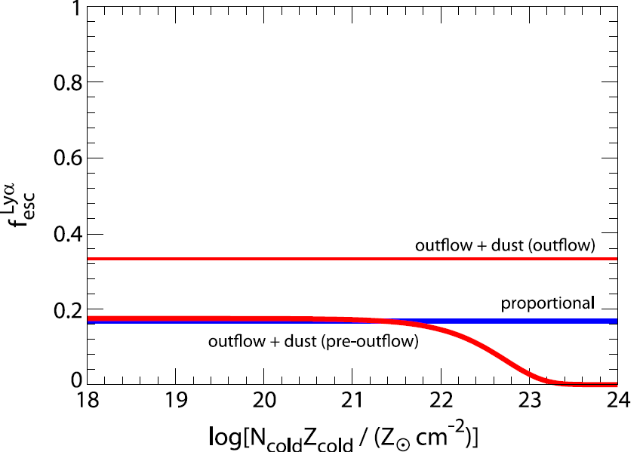
Resultant Lya Escape Fraction
f₀ : 0.153±0.02 (simply proportional)
0.160±0.03 (outflow+dust)
f₀ : 0.36
q: 0.25^{+0.16}
wind
-0.11

Slide 24
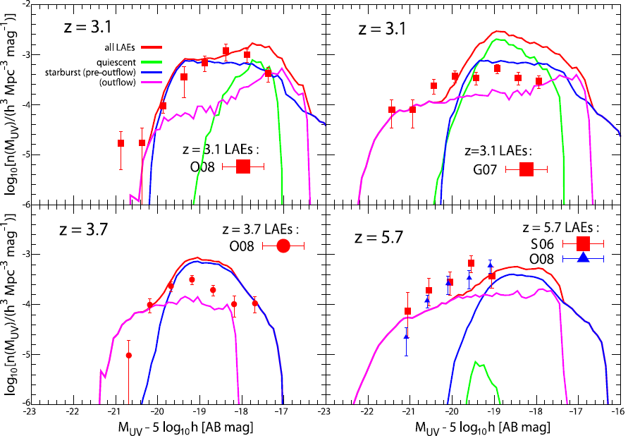
Comparison with LAE UV LF @ z<6

Slide 25
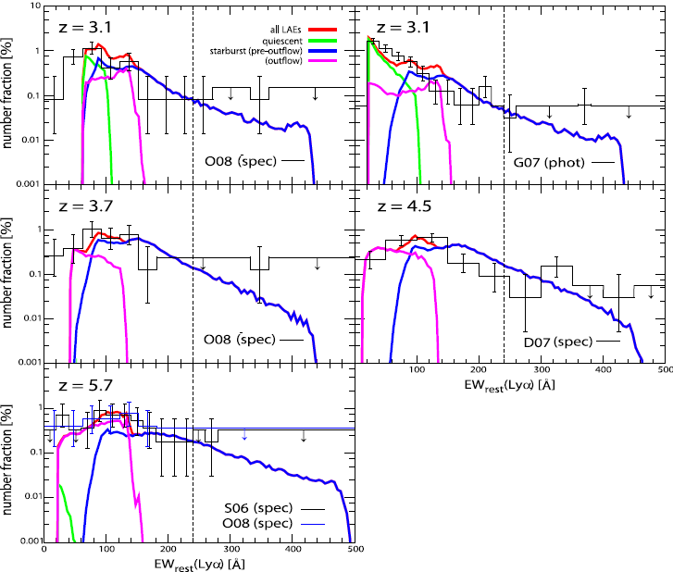

Comparison with LAE EW dist. @ z < 6

Slide 26
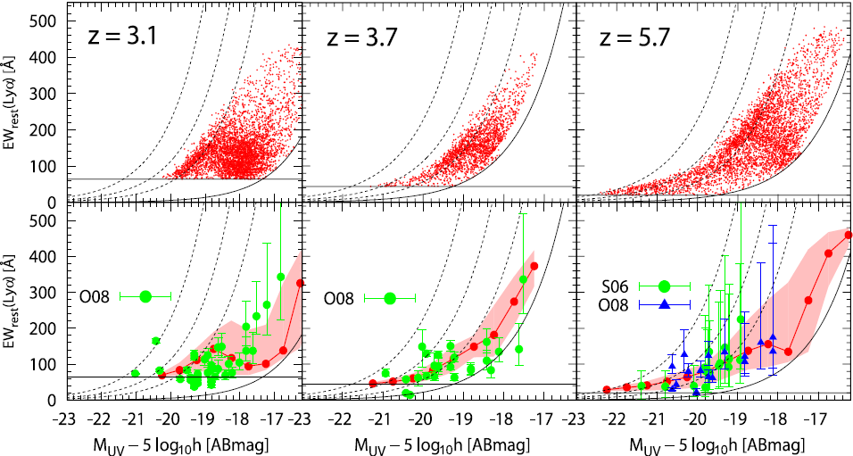
Comparison in M(UV)-EW(Lya) plane @ z < 6

Slide 27
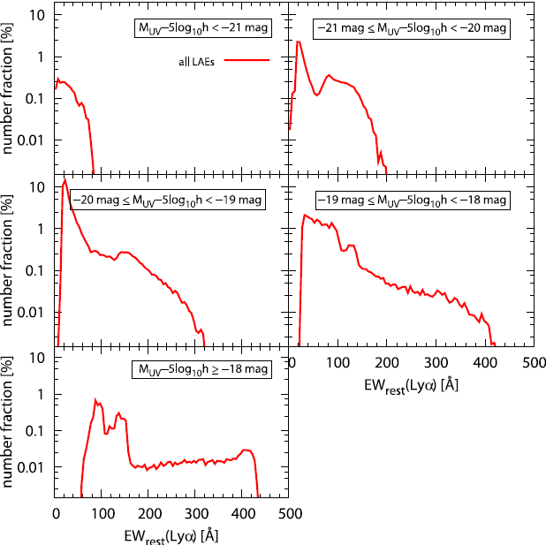
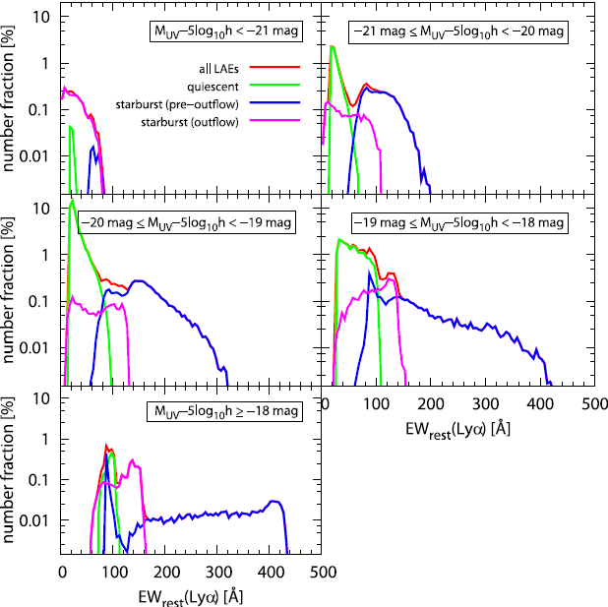
Comparison in M(UV)-EW(Lya) plane @ z < 6

Slide 28
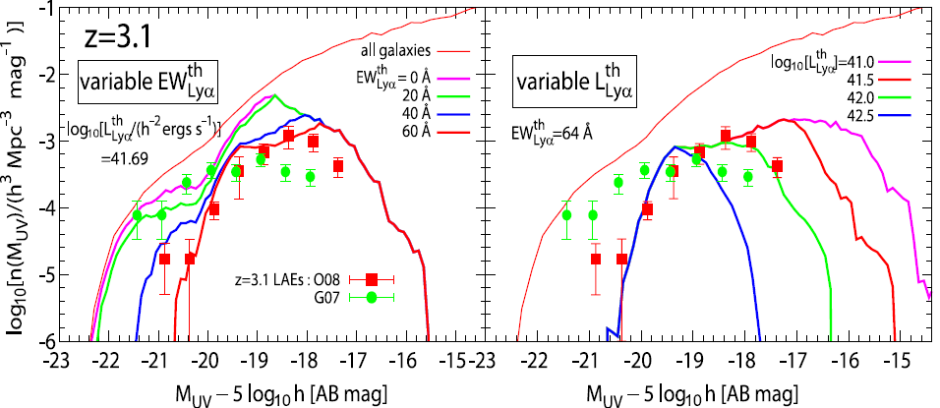
Characteristics in LAE UVLF

Slide 29
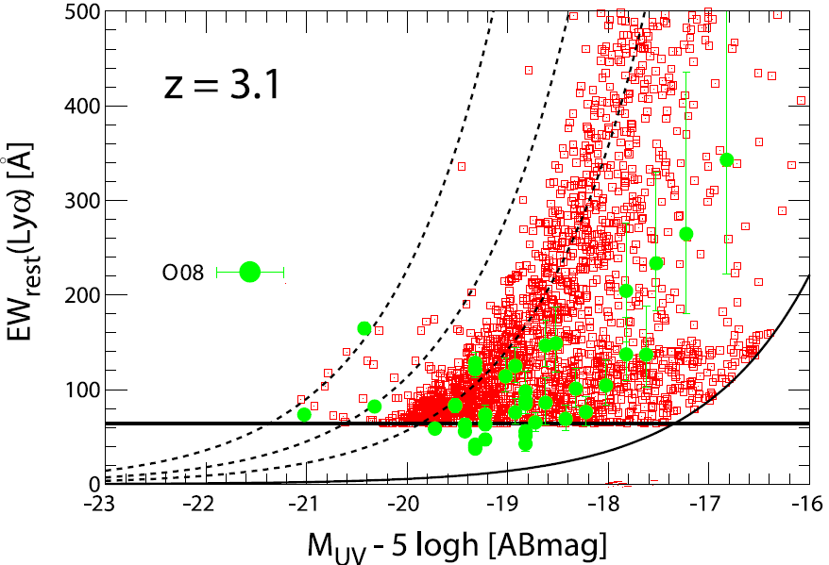
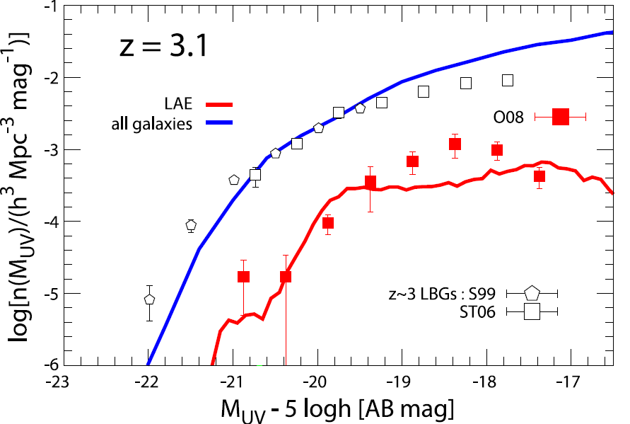
Characteristics in UV LF
EW(Lya) dist
UV LF

Slide 30
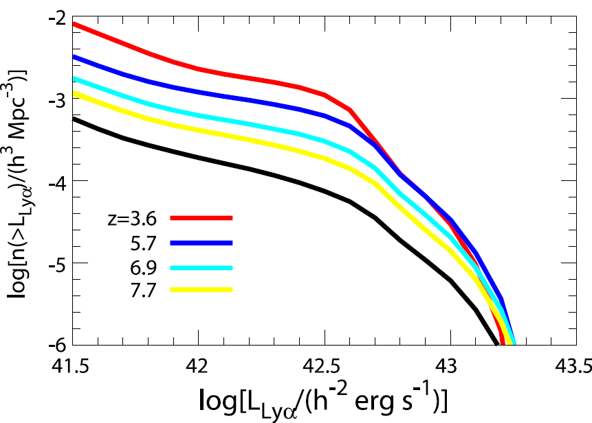
Prediction to Redshift Evolution of Lya LF
Lya LF evolution is suppressed by considering the effect of f_{esc}
Lya
a critical L(Lya)
~ Lcr =2*10⁴³ h⁻² erg/s
: n(>Lcr) < 10⁻⁶ h³/Mpc³
regardless of source z

Slide 31
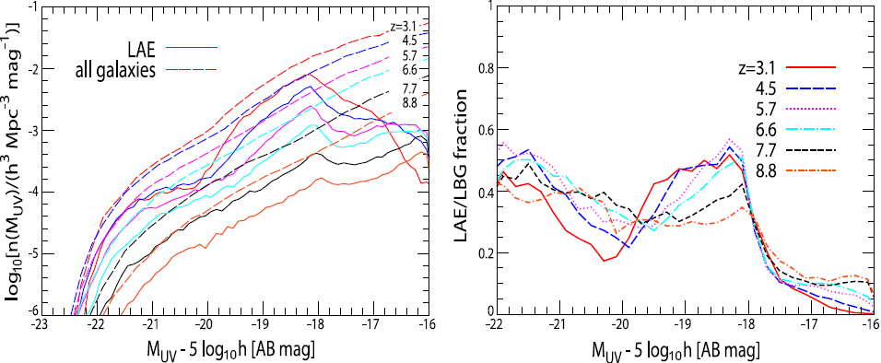
Redshift Evolution of LAE UVLF

Slide 32
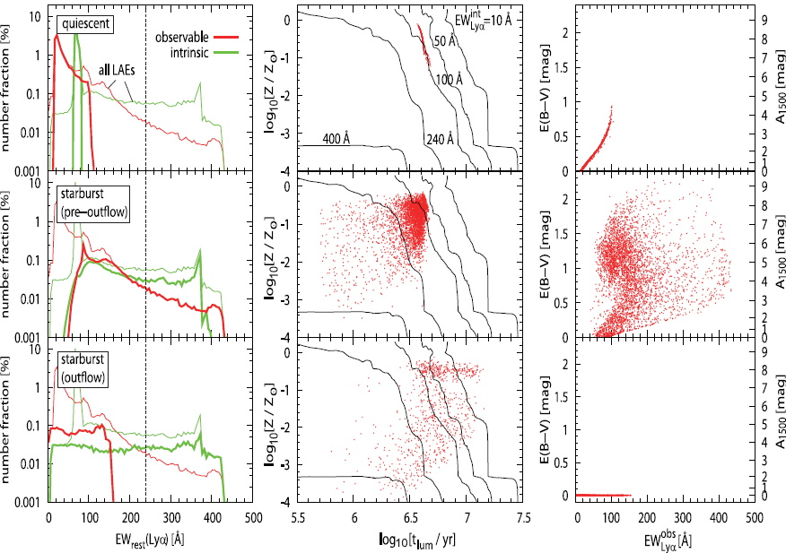

Nature of LAEs with EW > 240 A

Slide 33
Lyα と UV 連続光の dust opacity
○ τ_{Lyα} ：Lyα line に対する dust opacity
← Lyα 光度関数とのフィットで決めた
○ τ_{c}：Lyα 波長付近の連続光に対する dust opacity
← 近傍銀河の観測量とのフィットで決めた（三鷹モデル）
➔ τ_{Lyα} / τ_{c} ≣ q：geometry parameter (Finkelstein+ 08)
τ_{Lyα} ＝ qτ_{c}
cloud
dust
stars
‐ q >> 1：homogeneous ISM
‐ q << 1： clumpy interstellar dust
Lyα
ISM
dust

Slide 34
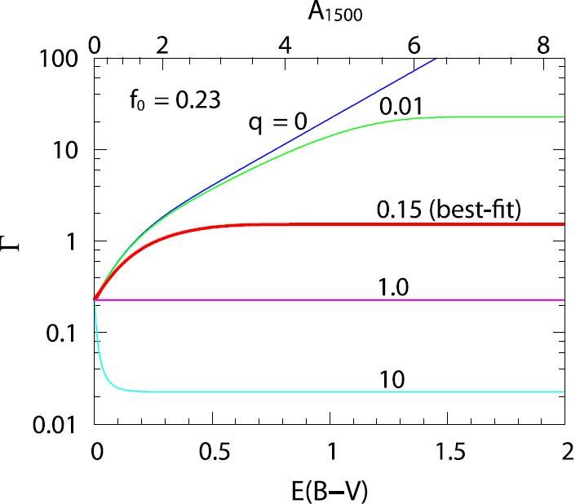
geometry parameter q と EW(Lyα)
○ q＝１ でなければ、dust extinction を受ける前後で
EW(Lyα) は変わる：EW_{dust} / EW_{int} ≣ Γ(τ_{c})
Γ(τ_{c})＝（f₀ / q）× [1 - exp(-qτ_{c})] / [1 - exp(-τ_{c})]
for quiescent and pre-outflow starburst
f₀ / q for outflow starburst
wind
‐best-fit ： q = 0.15 < 1
➔ clumpy ISM を示唆
‐best-fit ： q = 0.15
➔ ダスト減光が大きいほど Γ 大
Γ → (f₀ / q) = 1.5
for E(B-V) → ∞

Slide 35
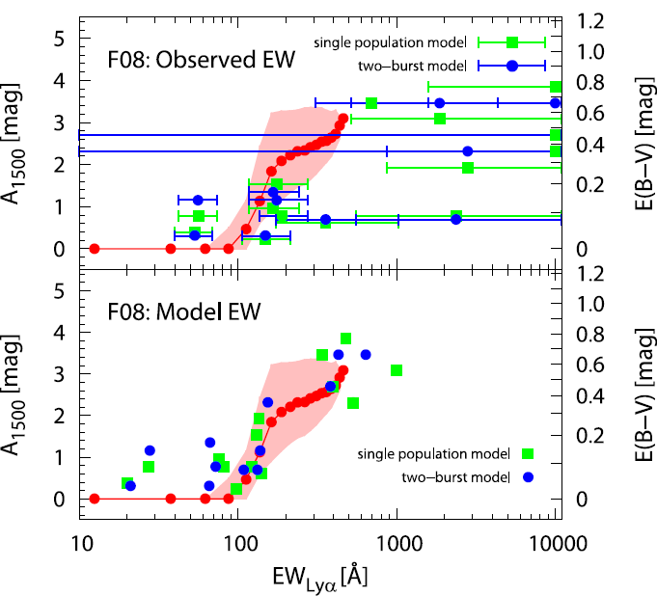
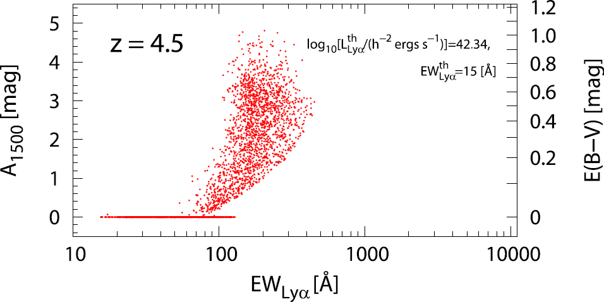
Model Prediction
○ τ_{c} 大ほど Γ 大
➔ ダスト減光と EW(Lyα) との相関が予言
：ダスト減光が強い LAE ほど、EW(Lyα) が大きくなる

Slide 36
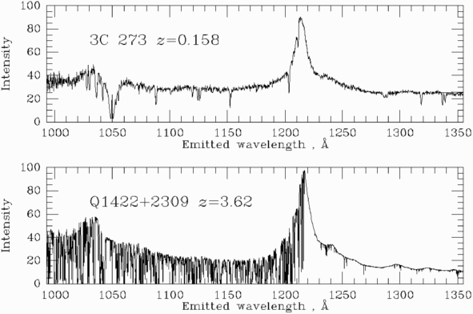
Cosmic Reionization
Gunn-Peterson test (Gunn & Peterson 1968)
Bill Keel’s website：http://www.astr.ua.edu/keel/agn/

Slide 37
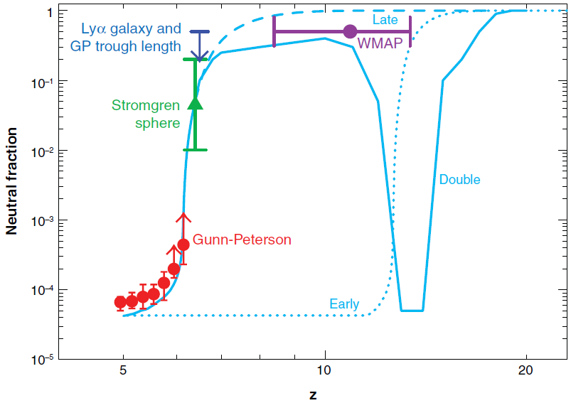
Cosmic Reionization
◆ Lya emission from LAE is attenuated in IGM where
IGM neutral fraction (x_{HI}) > 0.1 (Santos ’04)
1
0.1
10⁻²
neutral fraction x_{HI}
10⁻³
10⁻⁴
Fan+ ’06
10⁻⁵
5
10
20
redshift
observed LAE Lya LF will be dimmer @ z > 6.5 than those at z < 6

Slide 38
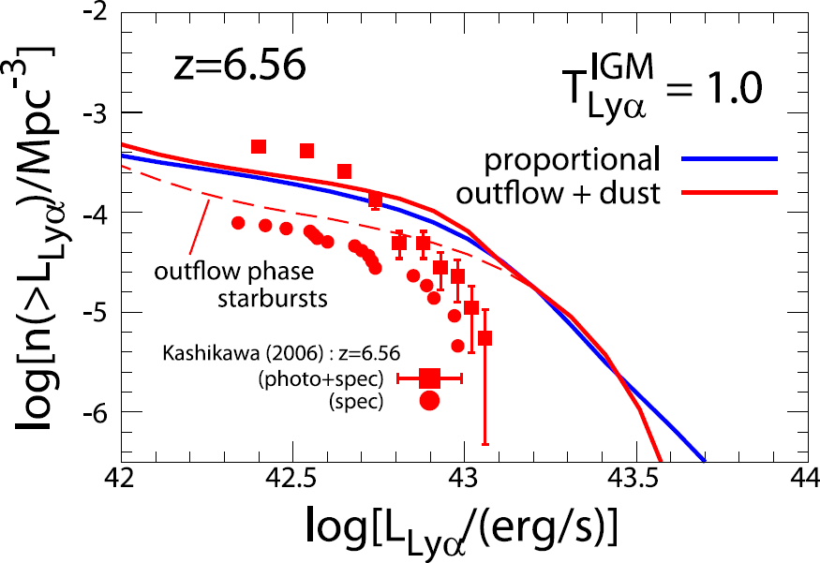
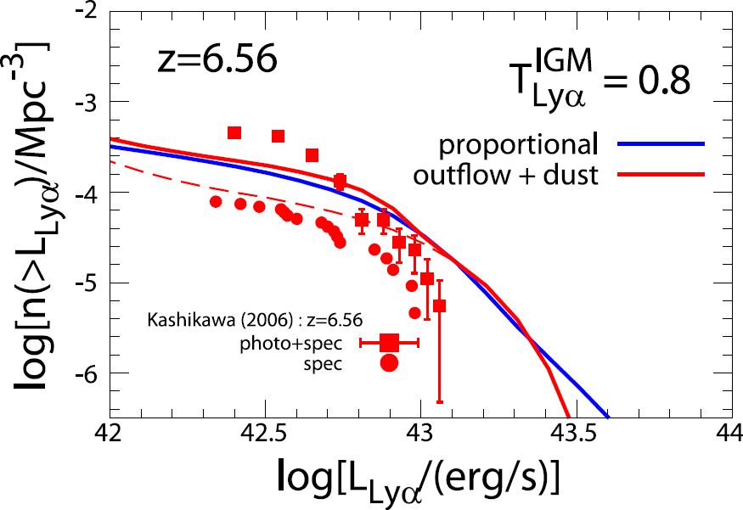
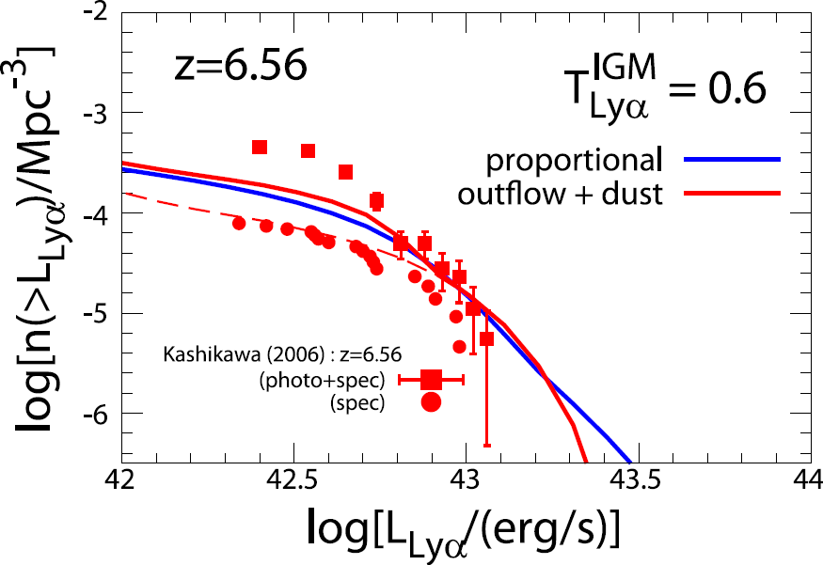
Comparison with Lya LF: z > 6
IGM
requirement of T_{Lya} < 1 implies that x_{HI} rapidly increases at z>6

Slide 39
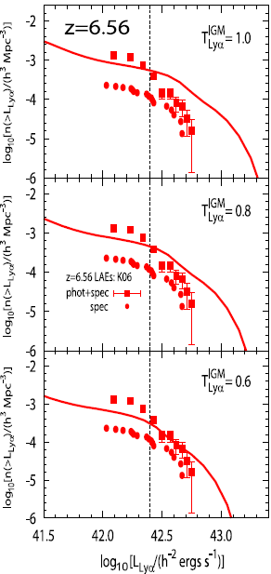
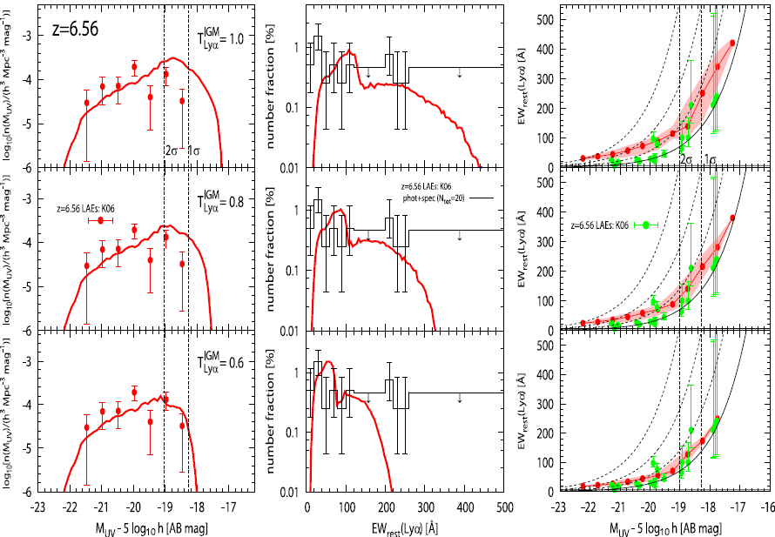
LAE Statistical Quantities @ z > 6

Slide 40
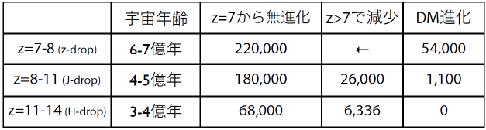
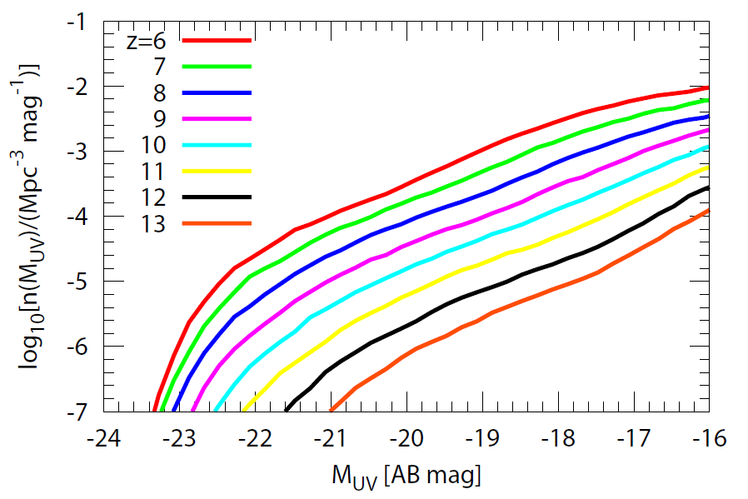
z > 6 LBG UV 光度関数
⬅ 岩田さんの評価
（山田さん、岩田さん講演）

Slide 41
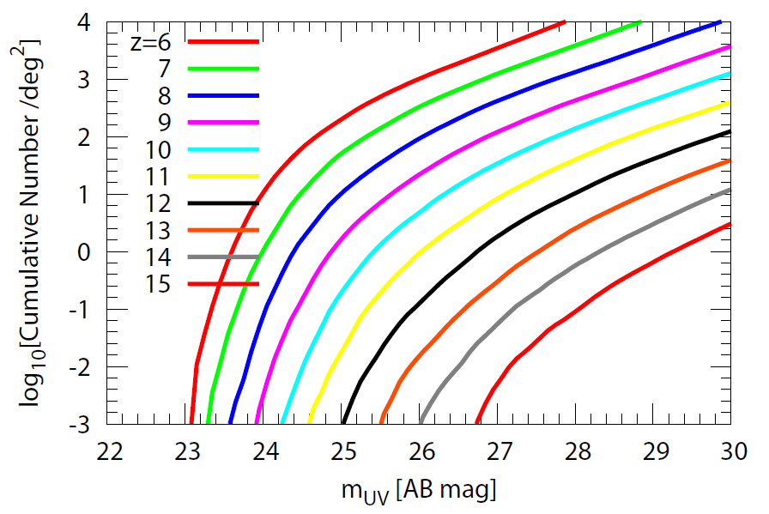
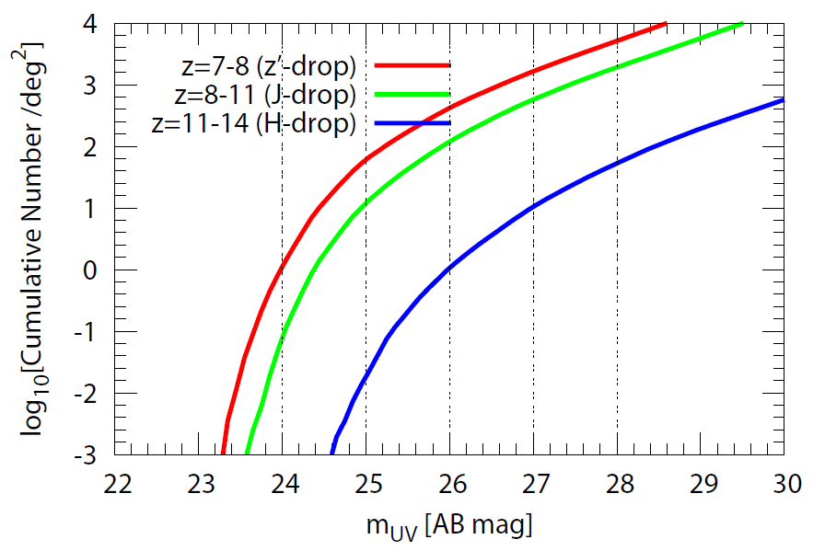
z > 6 LBG Number Count
○ 100 deg² で m_{UV} < 27 mag な LBG 検出数
‐z=7-8：163,422 個
‐z=8-11：57,646 個
‐z=11-14：1,014 個
⬅ 岩田さんの評価
（山田さん、岩田さん講演）

