Slide 1
WISH
upon a first galaxy….

Slide 2
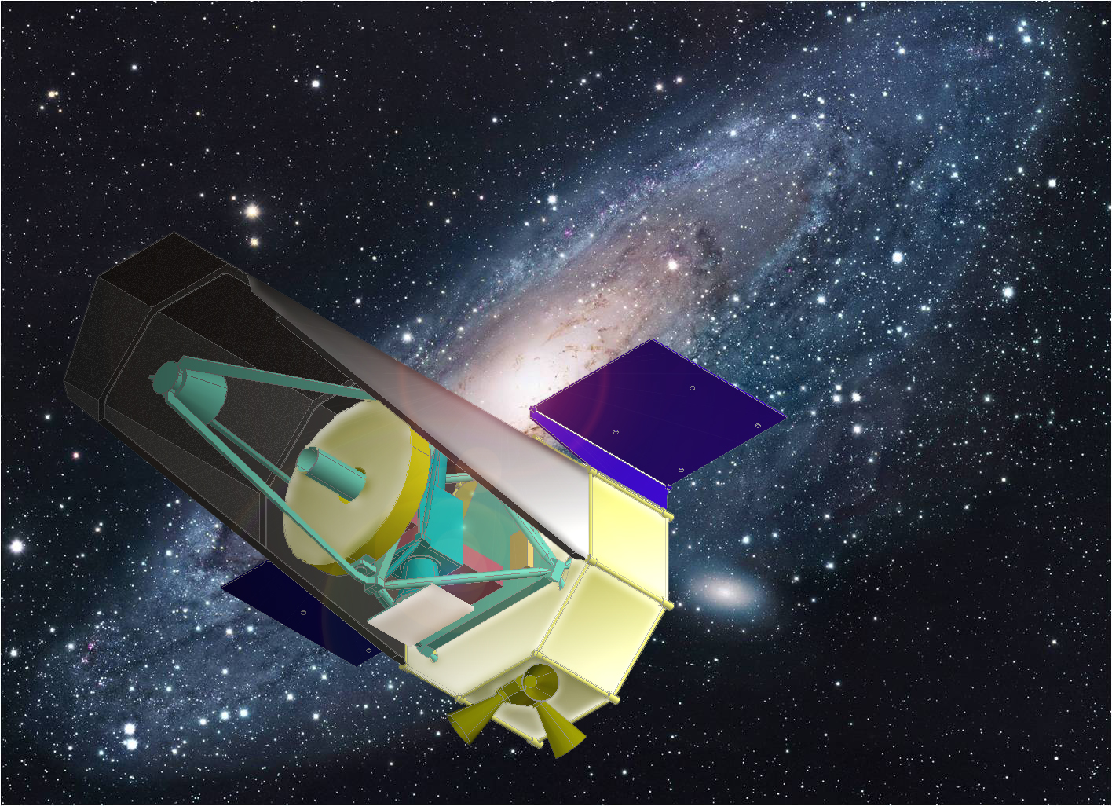
WISH
Wide-field Imaging Surveyor
for High-Redshift
WISH Working Group
M31 Phot: R.Gendler
http://www.wishmission.org/en/index.html

Slide 3
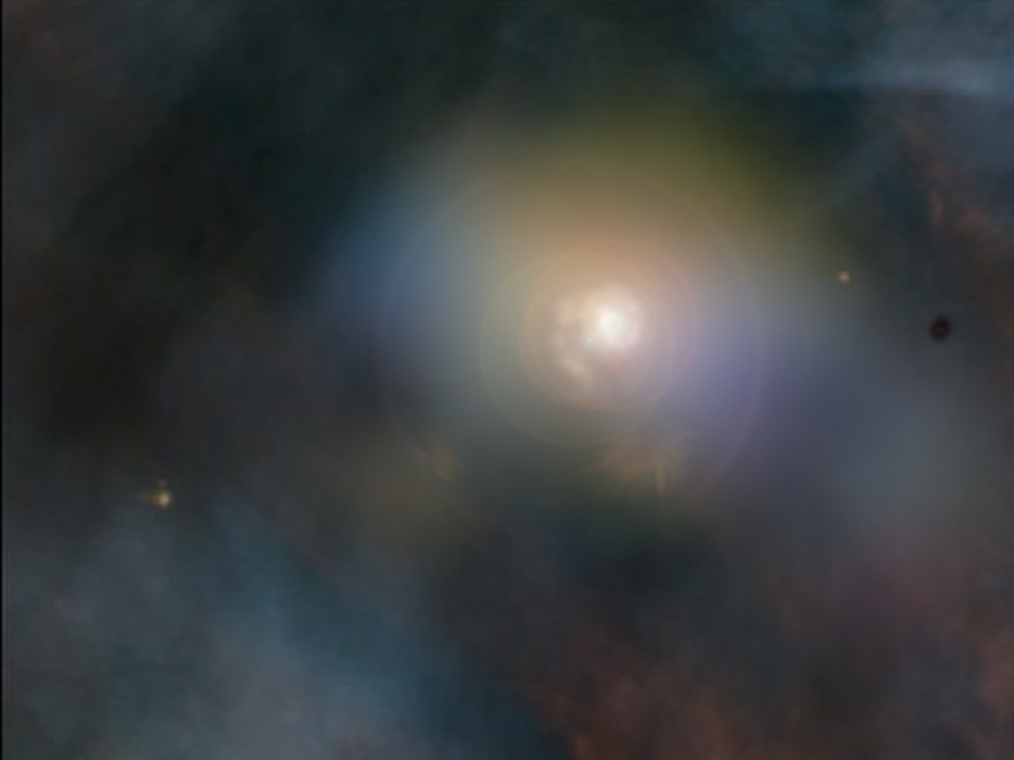
WISH WG Members
Toru Yamada, Chihiro Tokoku (Tohoku University)
Ikuru Iwata, S.Tsuneta,
T.Morokuma, T.Kodama, Y.Komiyama (NAOJ)
H.Matsuhara, T.Wada, Y.Oyabu (JAXA/ISAS)
H.Sugita, Y.Sato (JAXA)
K.Ohta, K.Yabe , Tsutsui (Kyoto University)
M.Doi, N.Yasuda (University of Tokyo)
N.Kawai (TiTEC), Yonetoku (Kanazawa U),
A.Inoue (Osaka Sangyo U.)
Y.Ikeda (Photocoding), S.Iwamura (M.R.J)

Slide 4
WISH: Brief Summary
WISH: Science Goals
WISH: Survey Strategy
WISH: Development

Slide 5
WISH Brief Summary (1)
● NIR Deep and Wide-field Imaging Surveyor
● Exploring the 1st generation galaxies
● Dedicated, ~100 deg², 28AB (~25nJy)
● Concept developed under JAXA/ISAS WG
to be launched in late 2010’s (NET2017)

Slide 6
WISH Brief Summary (2)
● 1-5 μm wavelength range
● 1.5m diameter telescope
● Very Wide-Field Imager
~1000 arcmin² FoV
● pixel scale: 0.15” / 18μm (f/16)
● Cooled to < 100K (telescope)
● SE-L2, JAXA HIIA

Slide 7
WISH Science Goals (1)
● Exploring the Ultimate Frontier of Galaxies
Detection of 1st-generation galaxies and
studying cosmic reionization over z=7-15
● NIR search and light curves for type-Ia SNe
History of cosmic expansion and Dark Energy
● Transients: high-z GRB, luminous SNe
● Huge statistics and New discovery

Slide 8
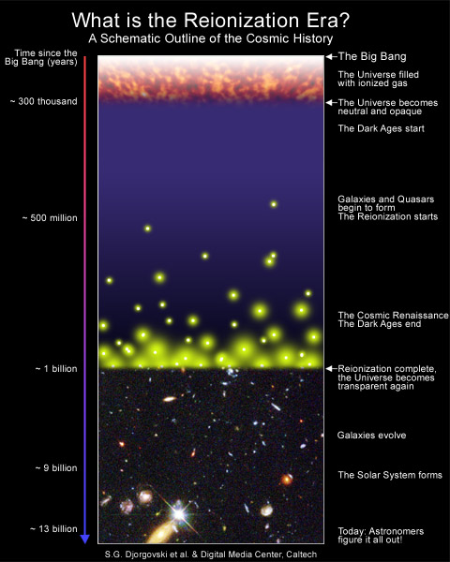
Redshift
z~15
JWST
WISH
Subaru
VLT,Keck,Gemini..
…………
Hubble Space Telescope
Redshift
z~6

Slide 9
Studying High-redshift (z=7-15) galaxies
Faint
Rare
Near Infrared
Space NIR Wide-field Imager
Dedicated Survey Strategy

Slide 10
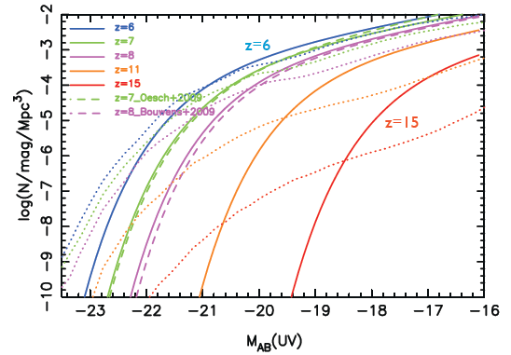
How deep, how large area should we observe?
Observed (z=6-8, HST WFC3) and
Predicted (z=6-15) UV Luminosity Function of Galaxies
Solid lines: empirical expectation (extrapolation) from z=6-8 luminosity function
Dotted lines: expectation based on galaxy models (semi-analytic treatment)

Slide 11
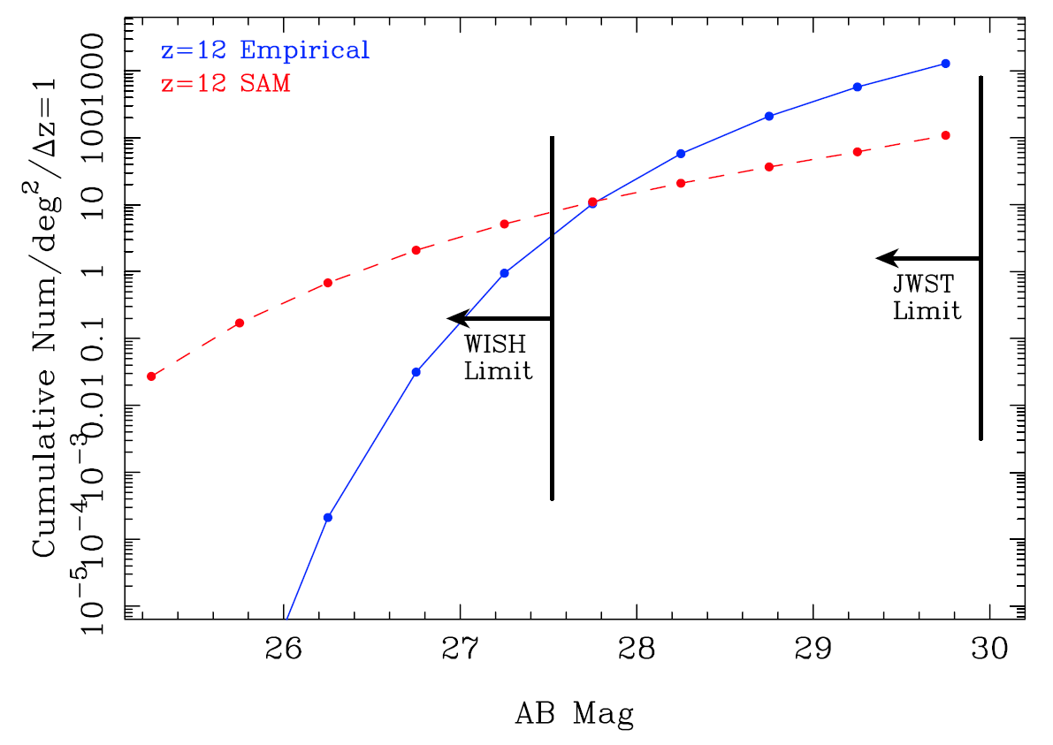
In the observers’ frame…
Limit of
AB>27-28 is
needed
z=12
Empirical
luminosity evolution
Semi-analytic
Model prediction
FoV JWST NIRCam 2.2’x2.2’ x 2ch ~ 2.8x10⁻³ deg²
Only 0.3~3 z=12 galaxies are expected above AB~30 within NIRCam FoV

Slide 12
WISH Science Goals
Expected number of the observed
very high-redshift galaxies
 |  | Number Density [objects per 1 deg²] for AB < 28.0
 | redshift | No Evolution | Empirical | SAM | DMH
1.0μm-drop | 8-9 | 4,000 | 1,700 | 630 | 850
1.4μm-drop | 11-12 | 2,400 | 100 | 50 | 4.1
1.8μm-drop | 14-17 | 1,200 | 0.72 | 1.1 | 0.003
Numbers for 1 deg² , <28AB
Galaxies bright enough for deep spectroscopy
with ELT + AO spectrograph

Slide 13
What is your WISH? Requirements
Limiting magnitude
(at least) AB~28 mag within a reasonable amount of time
- telescope aperture 1.5m
- image size / pixel scale 0.15” / 18μm pix
vs. diff. lim. 0.22” at λ =1.5μm
- telescope temperature ~100K
to achieve ZL-limited observations
Field of View ~1000 arcmin² (0.28 deg²)
survey speed ~2x of JWST NIRCam for extended sources
such as Φ~0.2” (resolved for JWST, not resolved for WISH)

Slide 14
WISH Science Goals
● Exploring the Frontier of Galaxy Creation
Detection of 1st-generation galaxies and
studying cosmic reionization over z=7-15
● NIR search and light curves for type-Ia SNe
History of cosmic expansion and Dark Energy
● Transients: high-z GRB, luminous SNe
● Huge statistics and New discovery

Slide 15
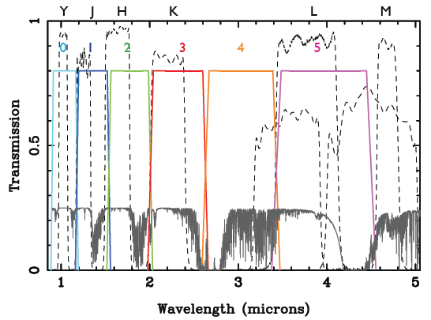
WISH: Survey Strategy
set of broad-band filters to select high-z galaxies

Slide 16
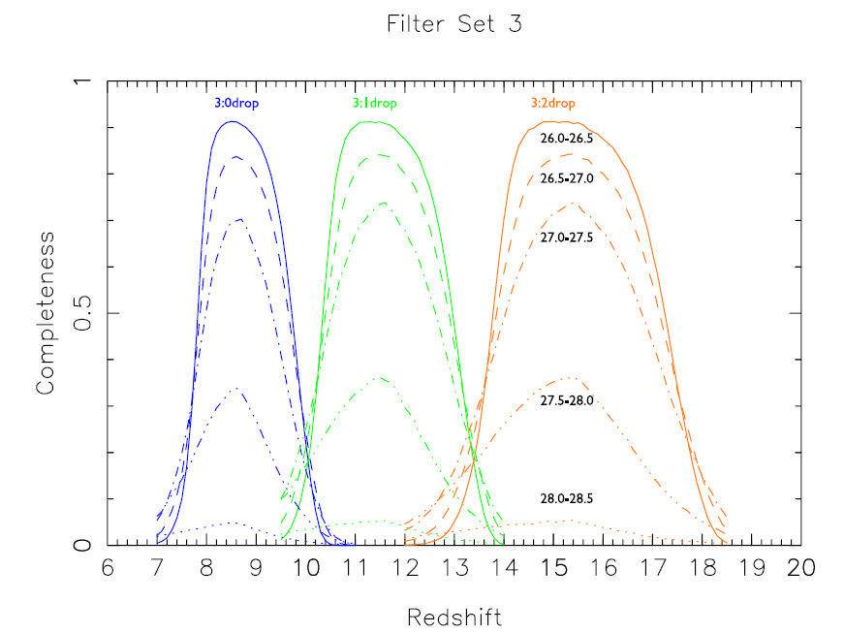
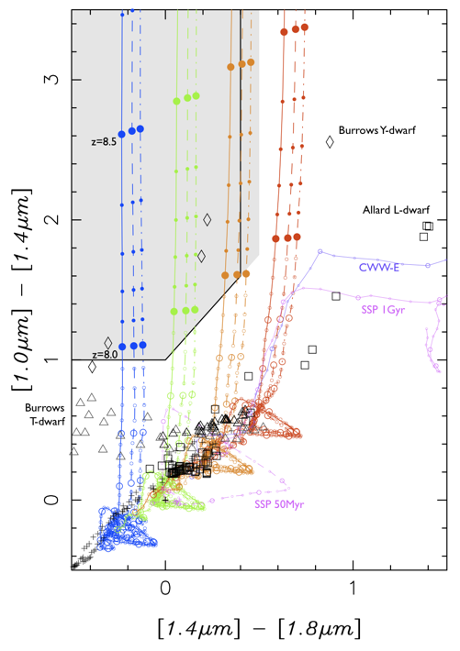
WISH: Survey Strategy
set of broad-band filters to select high-z galaxies

Slide 17
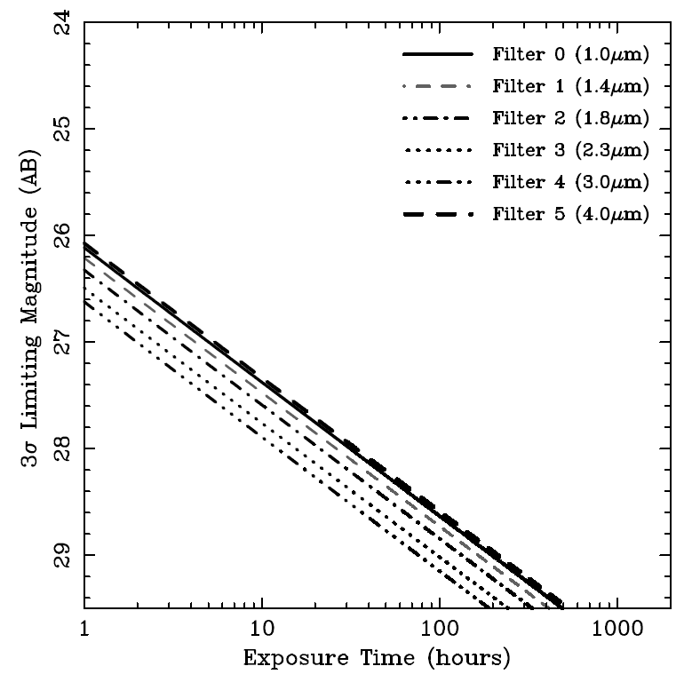
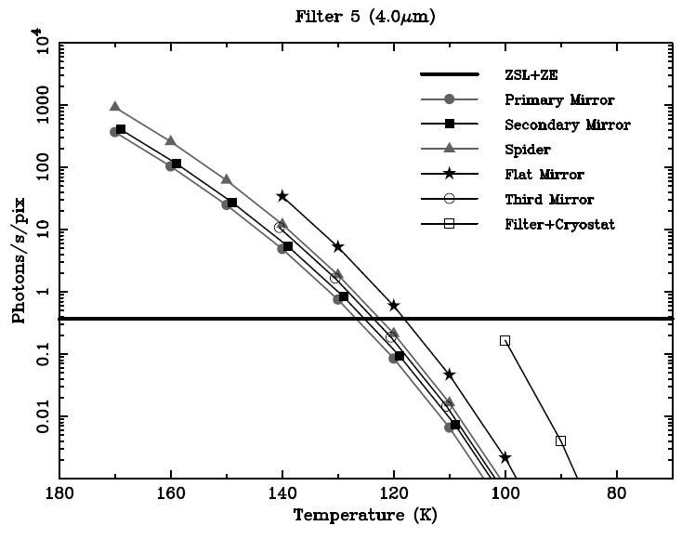
WISH: Survey Strategy
Telescope should be cooled to ~100K
(detector to ~40K for 5 μm)
28mag
10h

Slide 18
WISH: Survey Strategy
Survey categories
 | Depth (3σ) (AB mag) | Area | Example of the Filters (a plan, to be determined)
Ultra Deep Survey (UDS) | 28 | 100 deg² | 1.4,1.8, 2.3, 3.0 μm
Multi-Band Survey (MDS) | 28 | 10 deg² | 1.0,4.0
Ultra Wide Survey (UWS) | 24-25 | 1000 deg² | 1.4, 1.8, 2.3
Extreme Survey | 29-30 | 0.25 deg² | 1.0, 1.4, 1.8

Slide 19
WISH: Survey Strategy
Surveys can be achieved
within ~1000 days (50% overhead)
 | WISH UDS |  | WISH MBS
 | Filter Choice | Area (deg²) | Filter Choice | Area (deg²)
Plan 1 | 1.8, 2.3, 3.0 μm | 64 | 1.0,1.4,4.0 μm | 14
Plan 2 | 1.4, 1.8, 2.3, 3.0 μm | 64 | 1.0,4.0 μm | 9
+ Ultra Wide Survey (~1000 deg2 shallow)
+ Extreme Survey (~29 mag narrow field)

Slide 20
WISH: Survey Strategy
WISH can detect
~10⁴ galaxies at z=8-9,
~10³⁻⁴ galaxies at z=11-12,
and
~50-100 galaxies at z=14-17
Many of them are feasible spectroscopic targets

Slide 21
WISH Development

Slide 22
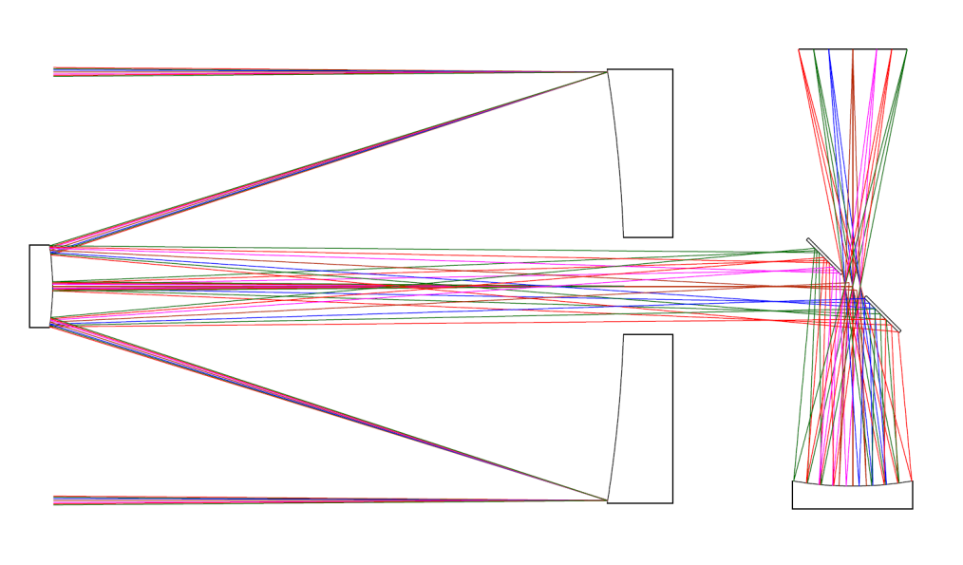
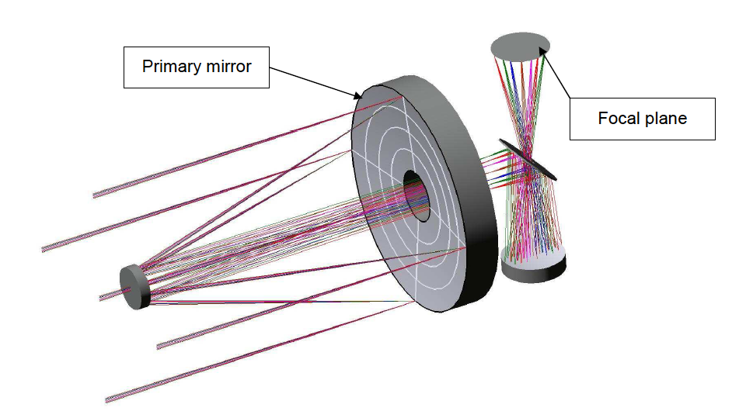
WISH Development: Optical Layout
Focal Plane
M1
M2
M1: Ellipsoidal
M2: Hyperboloid
M3: Ellipsoidal
Cold stop
M3
- Very flat focal plane
Diffraction-limited
images to φ ~50’
at 1-5 μm
Yuji Ikedaet al.
(photocoding)

Slide 23
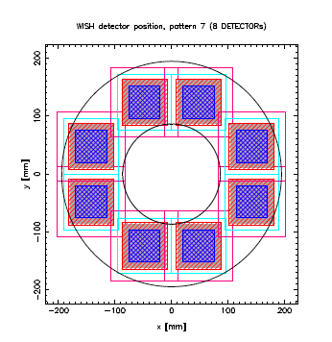
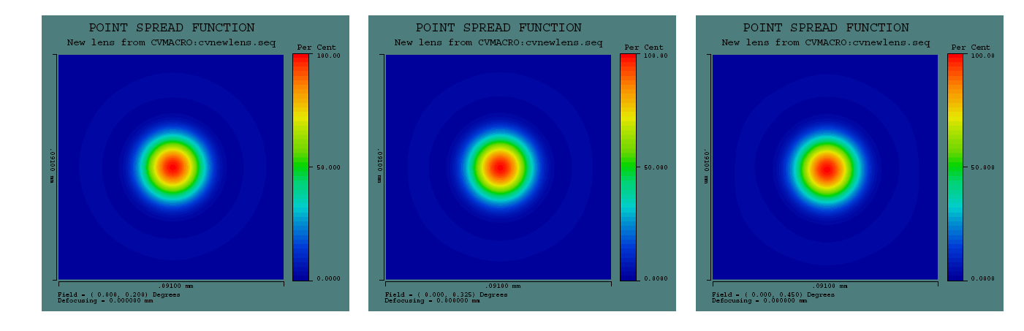
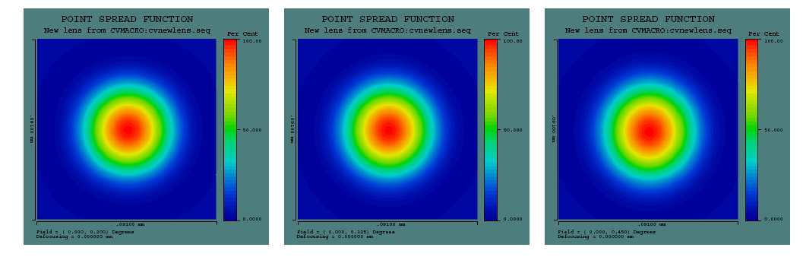
WISH Development: Optical Layout
Simulated Point Spread Function
at radius 0.2, 0.325, and 0.45 deg
at λ ~ 1.3μm SR> 0.99
at λ ~ 1.3μm SR > 0.99
4kx4k (4 x 2k x 2k ) array

Slide 24
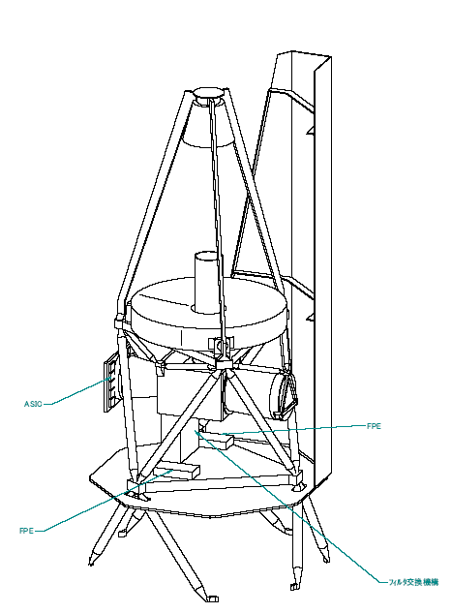
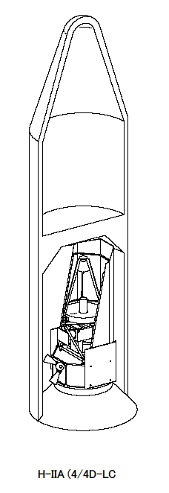
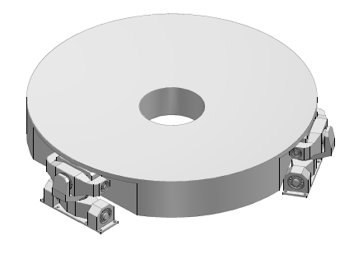
WISH Development: Telescope Structure
1.5m Primary Mirror
- ultra low-expansion
glass material
light weighted
(< 200kg)
Supported by CFRP structure

Slide 25
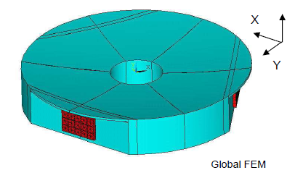
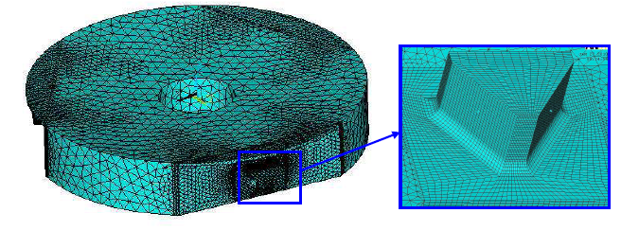
WISH Development: Telescope Structure
Mirror fixation
- launch load
- thermal road (to 100K)
Bonding / clumping
solutions studied
w/ SAGEM

Slide 26
WISH Development: Filter Exchanger
Requirements:
- operate more than 7 filters
(selection of high-z galaxies)
- large-sky survey in a single filter
➔ Needs for the filter exchanger
Type | Merits/advantage | difficulties
Wheel | heritage | Large beam size, weights
Slider | works in room temperature | Lubrication at 100K
Flip | Less difficulty in lubrication | Gaps between detectors

Slide 27
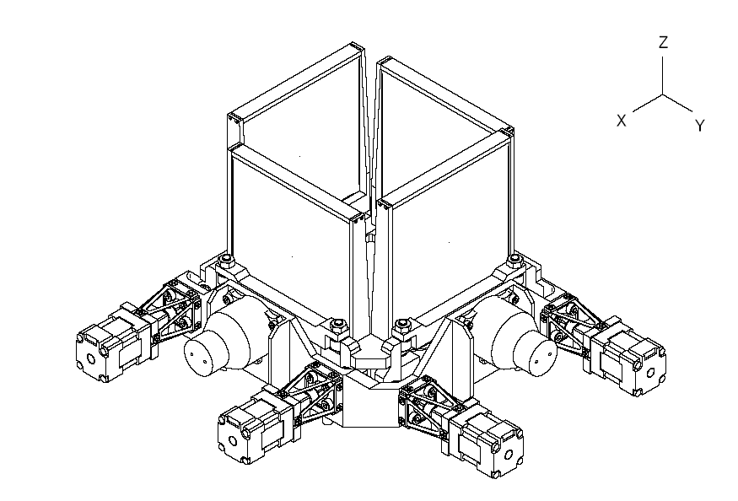
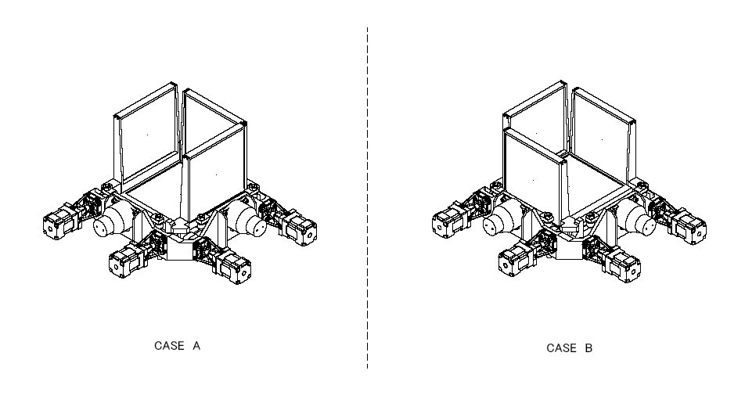
WISH Development: Filter Exchanger
Flip-type filter exchanger
in use
less difficulty of lubrication at low temperature
helps thermal design easier
needs gaps between detectors

Slide 28
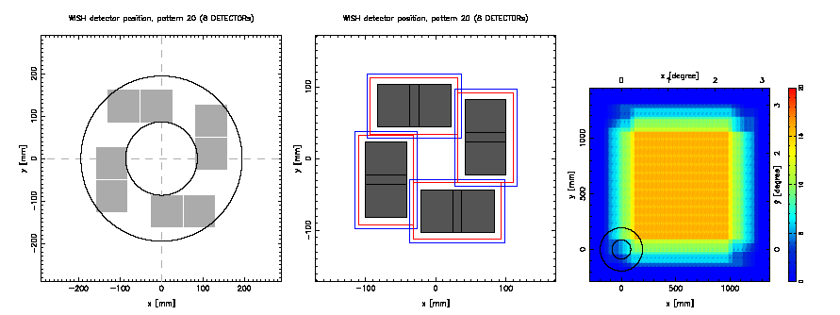
WISH Development: Filter Exchanger
Detector Focal Plane
Filter location
Dithering Pattern
● 1 filter exchanging unit for a two (4k x 4k) arrays
● 8 filters for 1 unit

Slide 29
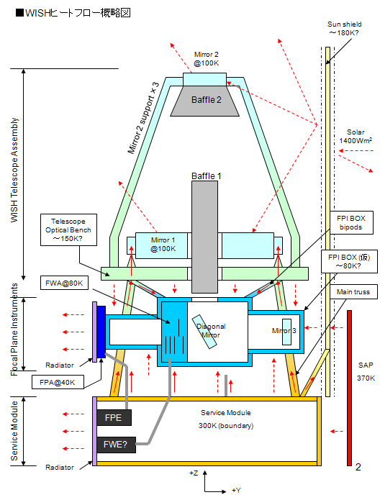
WISH Development: Preliminary Thermal Design
Passive cooling
Telescope 100K
FPI Box 80K
Detector 40K (radiator)
Preliminary Thermal Design
On-going
 | achieved | requirement
M1 | 79K | ~100K
M2 | 132K | ~100K
FPI BOX | 95K | ~80K

Slide 30
Summary
● NIR Deep and Wide-field Imaging Surveyor
● 1.5m aperture, 0.15”/pix
● Exploring the 1st generation galaxies
● Dedicated, ~100 deg², 28AB (~25nJy)
● ~10⁴ galaxies at z=8-9, ~3-6x10³ at z=11-12,
and ~50-100 galaxies at z=14-17
● Concept developed under JAXA/ISAS WG
to be launched in late 2010’s

